Slide 1
Slavery at Loring Greenough House
Hidden Jamaica Plain
***
***

Slide 2
Tonight’s Agenda
Hidden Jamaica Plain research
  Who we are
  What we discovered in JP
Project funded by the Reparations Task Force
Relation to reparations and the legacy of slavery

Slide 3
Hidden Jamaica Plain:
A Truth Telling Public History Project
Members Come From:
  JP Historical Society
  First Church in Jamaica Plain Unitarian Universalist
  The Eliot School
  Loring Greenough House
  First Baptist Church in Jamaica Plain
  Community Activists
  Academic Community
  Advisors: Christle Rawlins-Jackson and Byron Rushing
100% volunteer effort
  Join us: HiddenJamaicaPlain@gmail.com

Slide 4
Hidden Jamaica Plain Goals
Understand the history of the Indigenous people who lived in reciprocity with the land we call Jamaica Plain, and how Europeans claimed that land for private use and extraction
Identify enslaved people and enslavers from the 1600s/1700s in Jamaica Plain and develop a picture of the lives of enslaved people as well as the economic system and societal institutions that supported slavery in
New England
Develop a history of the abolitionism in Jamaica Plain
Research Black, Indigenous, and People of Color movements and activities in the 19th, 20th and 21st centuries that made an impact in our Jamaica Plain community and beyond
Coordinate with neighboring communities to share awareness and knowledge

Slide 5
What Hidden JP Discovered in
Jamaica Plain
We know that at least 27 people were enslaved in our neighborhood in the 1700s
Roxbury 1771 tax records
  Nearly 11% were owners of “servants for life” [enslaved people]
Based on that, we believe much more research is needed

Slide 6
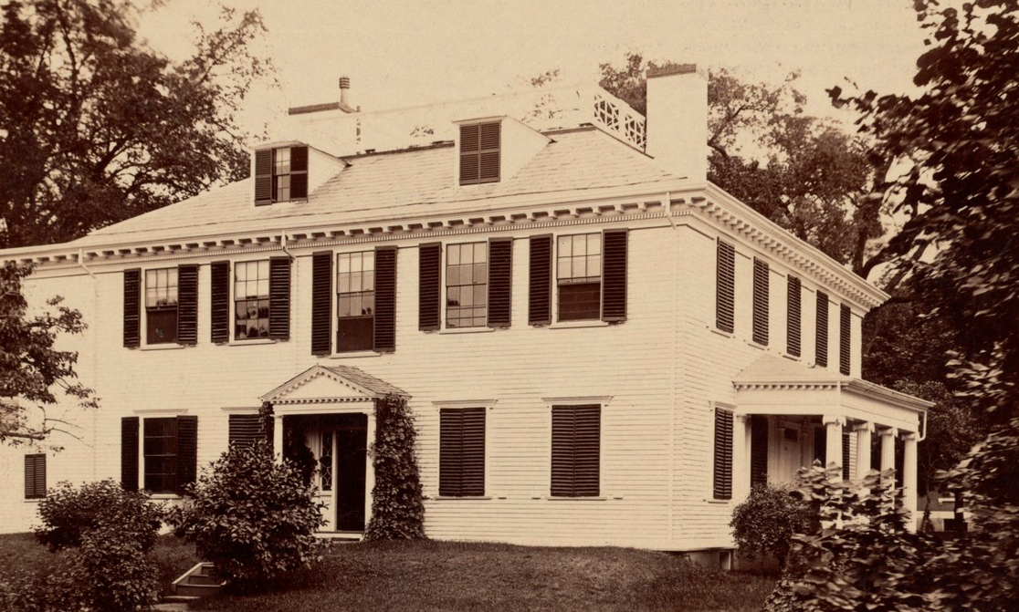
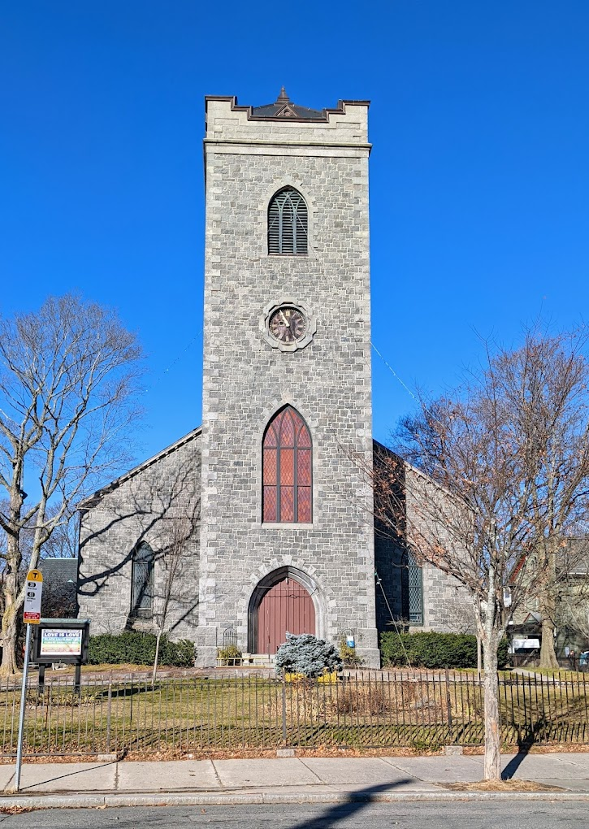
We Also Discovered in Jamaica Plain
At least 7 people were indentured in the 1700s
A slave trader who later turned to opium
smuggling into China lived in JP in the early 1800s
Successive families at Loring Greenough House
enslaved and indentured people
Some of the founders of First Church in Jamaica Plain were enslavers
The First Church JP death records from the early 1800s include free Black Americans

Slide 7
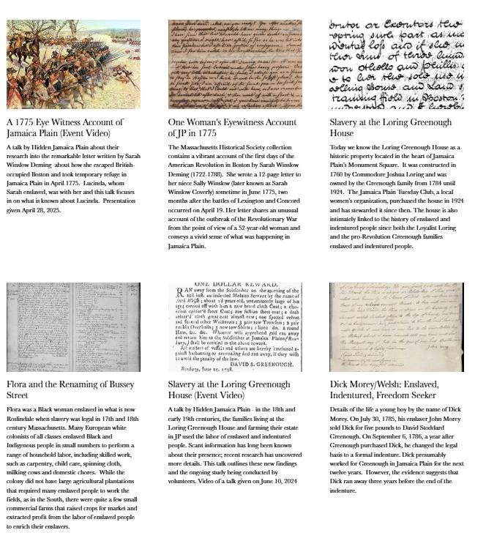
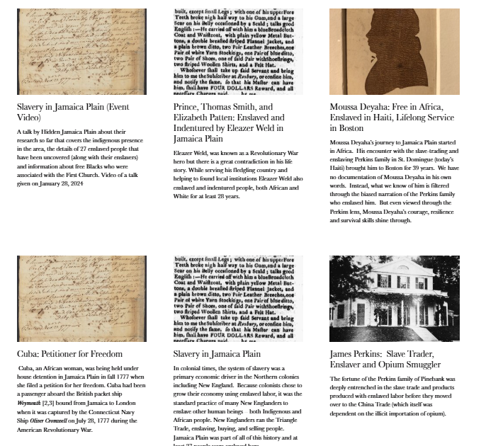
Hidden JP Articles Are on the
JP Historical Society Website: JPHS.org

Slide 8
Reparations Task Force Grant
Goal 1: Enable Hidden JP to research and publish an article on slavery at Loring Greenough House
Goal 2: Create a web page to honor the to honor the enslaved and indentured people of LGH
Goal 3: Research 500+ pages of David Stoddard Greenough’s Antigua plantation ledgers for the more than 100 people enslaved there in the late 1700s/early 1800s

Slide 9
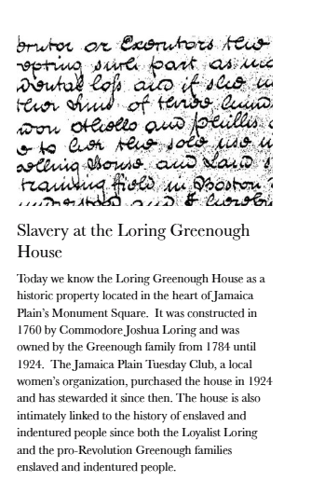
Goal 1: Research and Publish Article on Slavery at Loring Greenough House
JP Historical Society website: JPHS.org/Colonial

Slide 10
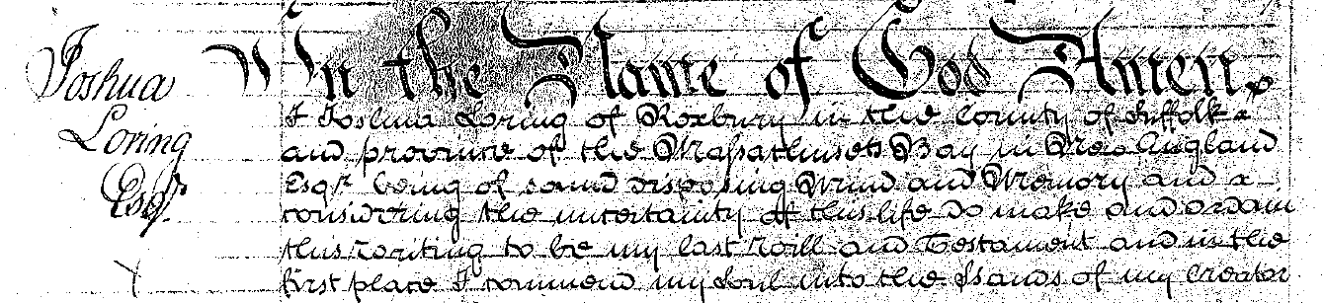
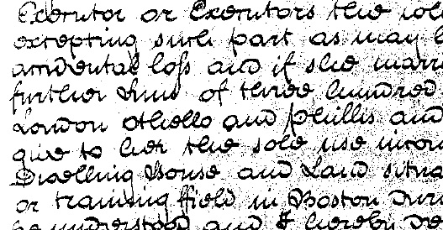
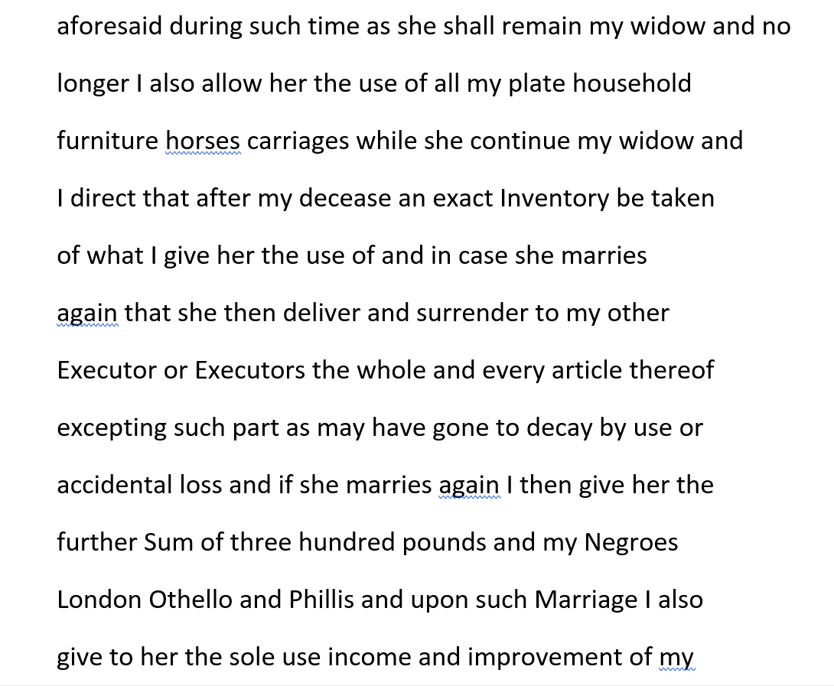
Commodore Joshua Loring’s Will (1774)
Source: British National Archives

Slide 11

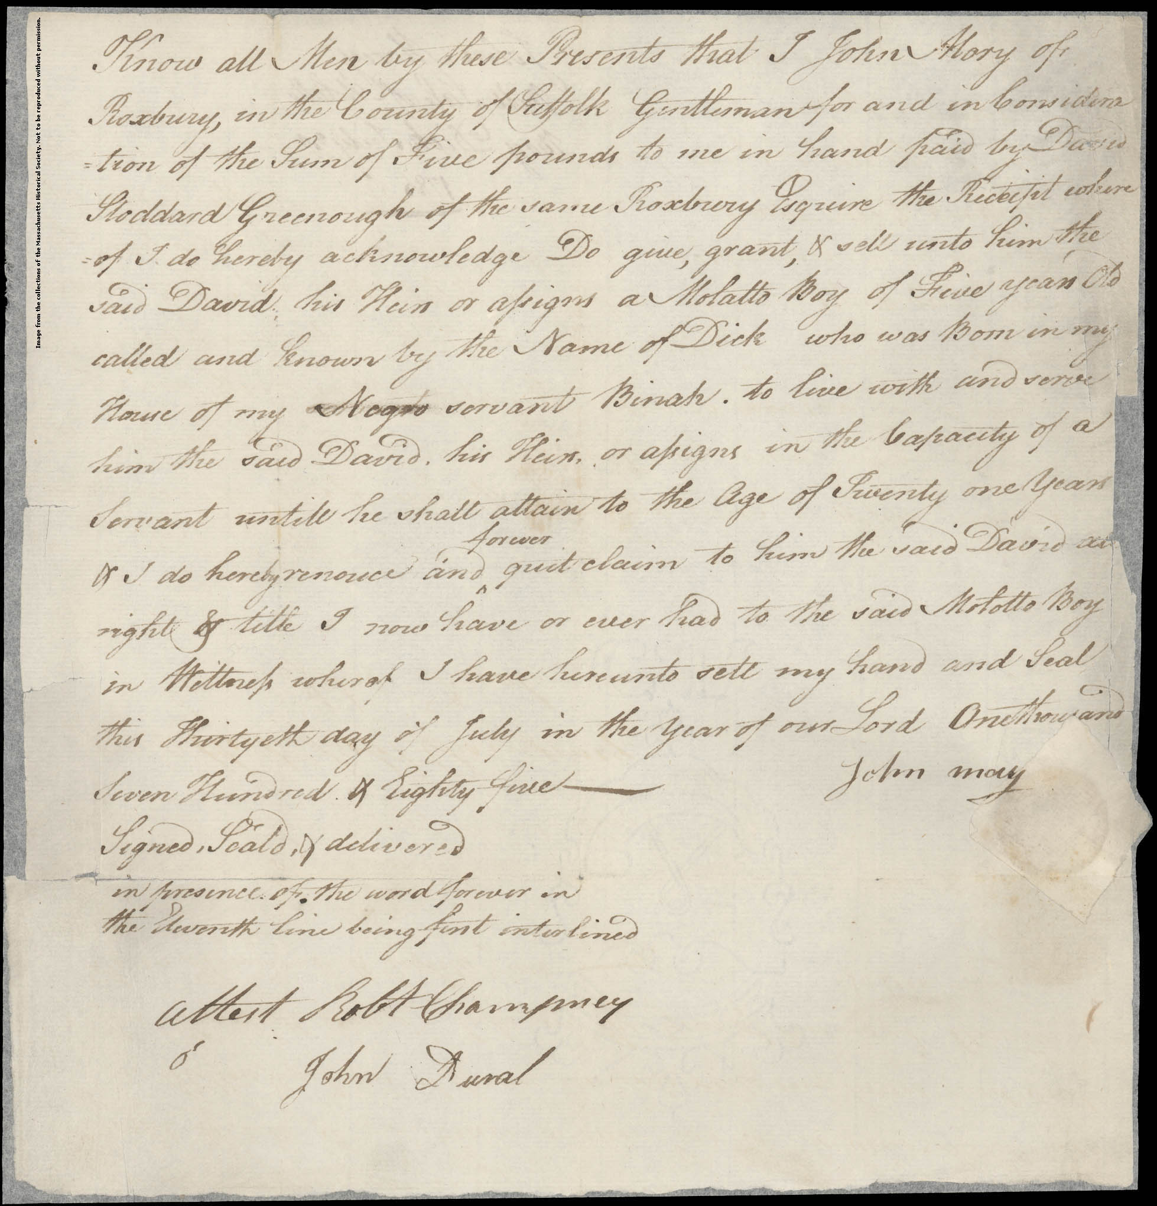
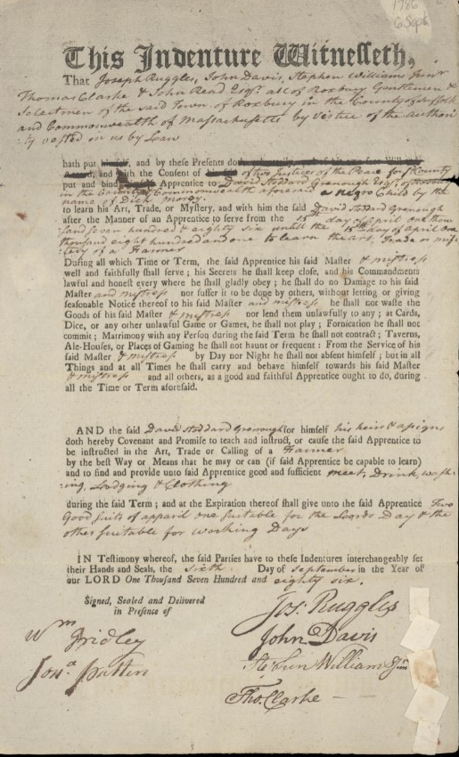
Dick Morey/Welsh
Enslaved at Birth, Sold at age 5 in 1785
Indentured at age 6 in 1786
Credit: Boston Slavery
Exhibit, Faneuil Hall
Sought freedom at age 18 in 1798

Slide 12
David Stoddard Greenough’s
Antigua Plantation
David Stoddard Greenough inherited a sugar plantation in Antigua in 1774
Over 100 people were enslaved there
In 1819, the plantation failed but it supported the Greenoughs in comfort for nearly 50 years

Slide 13
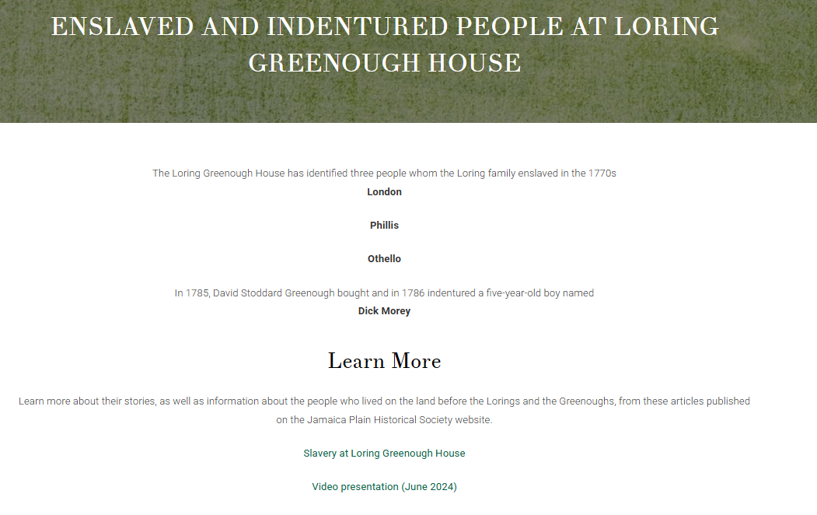
Goal 2: Create a Web Page to Honor the Enslaved and Indentured People of LGH
On the Loring Greenough House website: Loring-Greenough.org

Slide 14
Goal 3: Research Greenough’s Antigua Plantation Ledgers for 100+ Enslaved People
Grant enabled HJP to engage Selvin Backert
  Education Specialist at the Museum of African American History
Selvin reviewed 500+ pages and wrote a research summary
Discovered plantation’s operational expenses revealed information about the lives of enslaved people on the plantation
  1782 purchase of fabric for “45 Negroe clothing (300) Yards.” Also in 1782, the purchase of “180 yards of Negroe clothing”
  Funds for “Negors Xmas Allowance” in 1815
    Christmas was one of the few holidays enslaved people were allowed to celebrate, and possibly rest. This suggests that enslaved people were permitted to celebrate Christmas and that they possibly received some monetary gift for the holiday and/or the possible purchase of extra rations and materials

Slide 15
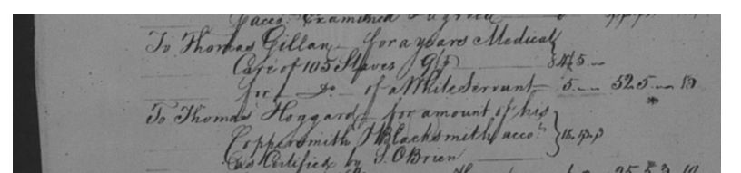
Antigua Plantation Research
Payment for “Sundays of sick negroes”
Payment for medical care for enslaved people
  For “105 Negros” in 1812
  For “102 Negros” in 1815
Excerpt listing medical care for 105 enslaved people

Slide 16
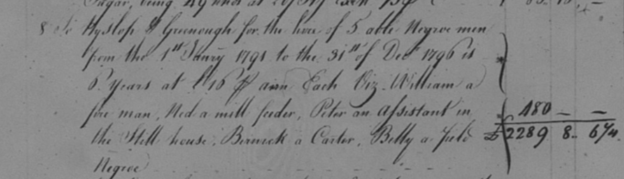
Antigua Plantation Research
Discovered the names and roles of “5 able Negroe Men” rented from Hyslop Greenough in 1796
  “William a fore man”
  “Ned a mill feeder”
  “Peter an Assistant in the Mill house”
  “Beinuck a Carter” [someone who operates a horse-drawn carriage]
  “Billy a field Negro”
The same men may reappear in the 1798 accounts — the payment at 10 pounds each for “5 Negroes from 1 January 1798”

Slide 17
Project Relation to Reparations and the Legacy of Slavery
Truth telling about the past helps to set the stage for reparations
If people today do not understand what happened in the past, how can they:
  Acknowledge how that history has shaped the lives of descendants of
  enslaved people
  Take responsibility for changing the future
Hidden JP is sharing the stories of the 27 people enslaved in Jamaica Plain with our community to assist our neighbors to understand and acknowledge enslavement as part of our collective history
This project was an important building block in moving this process forward
Thank you to the Reparations Task Force for this grant!

