Slide 1
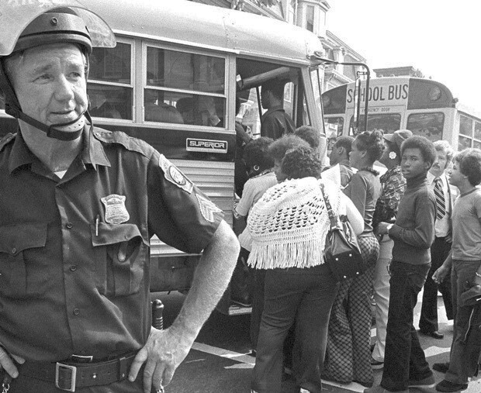
SLAVERY AND ITS LEGACY: BOSTON, 1940-2020
NORTHEASTERN UNIVERSITY
Research Partners: EVOOO13090
March 24, 2025

Slide 2
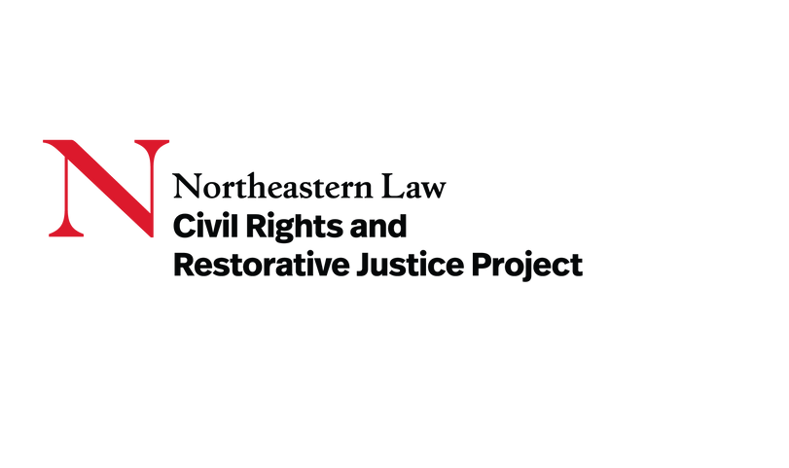






Primary Organizations
SLAVERY AND ITS LEGACY: BOSTON, 1940-2020
NORTHEASTERN UNIVERSITY
CONTACT INFORMATION
Deborah A. Jackson
Managing Director, Center for Law, Equity and Race
360 Huntington Avenue, 140 DK, Boston, MA 02115
de.jackson@northeastern.edu
617-373-4066
Archives and Special Collections
Notes:
Is there a clearer logo for the Reckoning Project?

Slide 3
Team Members
MARGARET BURNHAM PRINCIPAL INVESTIGATOR
KABRIA BAUMGARTEN
LEAD RESEARCHER
DEBORAH A. JACKSON
CO-PRINCIPAL INVESTIGATOR
DONNA BIVENS
RESEARCHER
SLAVERY AND ITS LEGACY: BOSTON, 1940-2020
NORTHEASTERN UNIVERSITY
THEODORE C. LANDSMARK CO-PRINCIPAL INVESTIGATOR
GIORDANA MECAGNI RESEARCHER
RICHARD L. O’BRYANT
LEAD RESEARCHER
TAYLOR MCDOWELL
RESEARCHER
PETER ENRICH
LEAD RESEARCHER
CHRISTOPHER THOMAS
RESEARCHER
ZEBULON MILETSKY
LEAD RESEARCHER

Slide 4
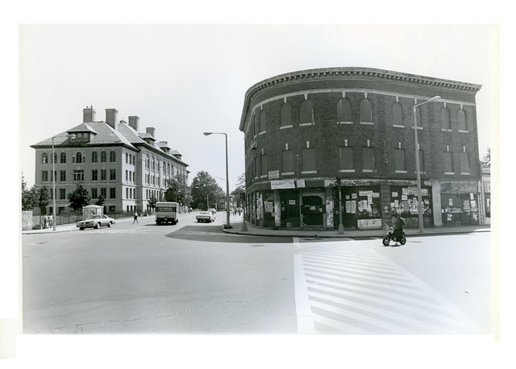
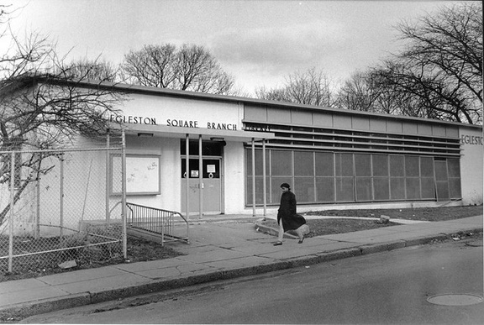
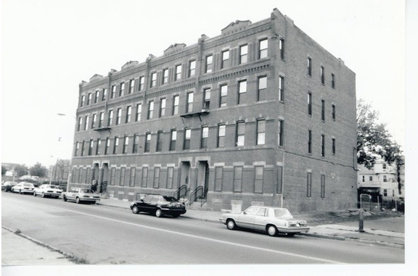
Topics
THREE PRIMARY TOPICS:
EDUCATION
BOSTON POLICE AND FIRE DEPARTMENTS
HOUSING AND URBAN RENEWAL
THREE SUB-AREAS:
SLAVERY AND ITS LEGACY: BOSTON, 1940-2020
NORTHEASTERN UNIVERSITY
DISPARITIES IN TREATMENT IN THE CRIMINAL JUSTICE SYSTEM
HEALTH DISPARITIES
PROCUREMENT POLICIES AND PRACTICES
Notes:
It might be better to list the six topics under the guidance heading and place the three areas of focus in a different box.

Slide 5
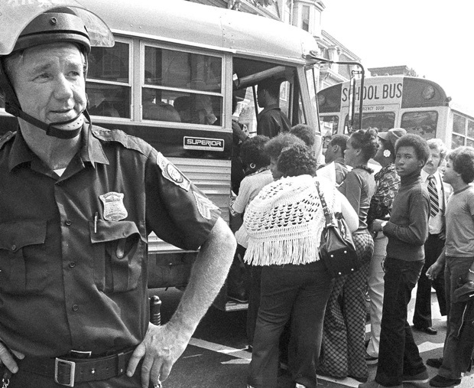
Our Report on The Boston Public Schools will include a comprehensive timeline of desegregation from 1940 to 2020, emphasizing the role of the City of Boston and other government actors; a descriptive analysis of racialized school discipline practices from 1970-2020; and a descriptive analysis of the community-based projects that have or are examining the history of the issues.
“WHEN WE FIGHT ABOUT EDUCATION, WE’RE FIGHTING FOR OUR LIVES. WE’RE FIGHTING FOR WHAT THAT EDUCATION WILL GIVE US, WE’RE FIGHTING FOR A JOB, WE’RE FIGHTING TO EAT, WE’RE FIGHTING TO PAY OUR MEDICAL BILLS. THIS IS A TOTAL FIGHT WITH US.”
SLAVERY AND ITS LEGACY: BOSTON, 1940-2020
NORTHEASTERN UNIVERSITY
Boston Public Schools and Equal Quality Education
Ruth Batson, 1988

Slide 6
Sarah c. Roberts v. The City of Boston, 59 Mass. 198 (1849)
Half a century before Plessy v. Ferguson, Judge Lemuel Shaw ruled that five-year-old Sarah Roberts had not been unlawfully excluded from a Boston primary school for white children. Roberts v. Boston was later cited to support the Supreme Court’s decision in Plessy, although by then Boston schools were legally desegregated, the state legislature having banned racial school assignment in 1855.
The Legal Battle to Desegregate Schools
SLAVERY AND ITS LEGACY: BOSTON, 1940-2020
NORTHEASTERN UNIVERSITY
“IT IS URGED, THAT THIS MAINTENANCE OF SEPARATE SCHOOLS TENDS TO DEEPEN AND PERPETUATE THE ODIOUS DISTINCTION OF CASTE, FOUNDED IN A DEEP-ROOTED PREJUDICE IN PUBLIC OPINION. THIS PREJUDICE, IF IT EXISTS, IS NOT CREATED BY LAW, AND PROBABLY CANNOT BE CHANGED BY LAW.”
Roberts v. Boston, 59 Mass. at 210, (1849).

Slide 7
Morgan v. Hennigan, 379 F. Supp. 410 (1974)
The legacy of Judge Shaw’s Boston was alive and well over a century later. A plaintiff class of local Black school children sued the city. Judge Wendell Arthur Garrity, Jr. found that:
The Legal Battle to Desegregate Schools
SLAVERY AND ITS LEGACY: BOSTON, 1940-2020
NORTHEASTERN UNIVERSITY
“[T]HE DEFENDANTS HAVE KNOWINGLY CARRIED OUT A SYSTEMATIC PROGRAM OF SEGREGATION AFFECTING ALL OF THE CITY'S STUDENTS, TEACHERS AND SCHOOL FACILITIES AND HAVE INTENTIONALLY BROUGHT ABOUT AND MAINTAINED A DUAL SCHOOL SYSTEM. THEREFORE THE ENTIRE SCHOOL SYSTEM OF BOSTON IS UNCONSTITUTIONALLY SEGREGATED.”
MORGAN V. HENNIGAN, 379 F. Supp. at 410 (1974).

Slide 8
The Role of the City in School Desegregation
JOHN J. KERRIGAN, BOSTON SCHOOL COMMITTEE MEMBER
THOMAS MEAGHER, DEPUTY SUPERINTENDENT
LOUISE DAY HICKS, CITY COUNCIL MEMBER AND R.O.A.R. FOUNDER
SLAVERY AND ITS LEGACY: BOSTON, 1940-2020
NORTHEASTERN UNIVERSITY
WILLIAM M. BULGER, SENATOR, BUSING OPPONENT
WILLIAM H. OHRENBERGER, BPS SUPERINTENDENT 1963-1972
CITY LEADERS WHO
FOMENTED RESISTANCE
TO SCHOOL DESEGREGATION
ELVIRA PALLADINO, BOSTON SCHOOL COMMITTEE MEMBER AND R.O.A.R.BOARD MEMBER
JOHN J. MCDONOUGH, BOSTON SCHOOL COMMITTEE CHAIRMAN 1967
PAUL J. ELLISON, BOSTON SCHOOL COMMITTEE MEMBER

Slide 9
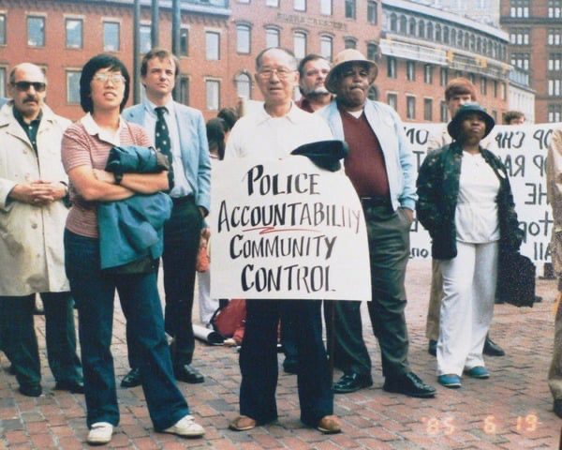
Boston Police and Fire Department
SLAVERY AND ITS LEGACY: BOSTON, 1940-2020
NORTHEASTERN UNIVERSITY
EMPLOYMENT DISCRIMINATION
“THESE YOUNGER OFFICERS THAT ARE COMING UP IN THE RANKS, THEY'RE GOING TO BE THE LEADERS OF THE DEPARTMENT AND IN A FEW YEARS, IF WE DON'T HAVE THE NUMBERS OF MINORITY OFFICERS, THEN WE'RE GOING TO BE LEFT BEHIND. IT'S GOING TO BE THE SAME AS IT HAS BEEN THE WHOLE TIME I'VE BEEN IN THE DEPARTMENT- A WHITE, MALE-DOMINATED DEPARTMENT.”
Our Report on Police and Fire Departments: Employment and Workplace Policies will include a comprehensive timeline of the issue from 1940 to 2020, emphasizing the role of City of Boston and other government actors; a descriptive analysis of discriminatory practices in these important departments from 1970-2020; and a descriptive analysis of the community-based projects that have or are examining the history of the issues.
Larry Brown,
Mass. Assoc. of Minority Law Enforcement Officers

Slide 10
1972: Appellate federal court affirmed a lower court ruling that the Boston Police Department discriminated against Black applicants through the use of entry-level testing that favored whites. The court required the department to attain a percentage of Black and Hispanic officers that would reflect their percentage in the city’s population.
The Legal Battle to Desegregate Police and Fire Departments
1972: A federal appeals court required the virtually all-white Fire Department to hire one African American or Hispanic firefighter for every new white employee.
SLAVERY AND ITS LEGACY: BOSTON, 1940-2020
NORTHEASTERN UNIVERSITY
1983: “Reverse discrimination” claim, which would have resulted in a policy of “last hired, first fired” disproportionately affecting newly hired non-white officers, was rejected by a federal court.
1998: Appellate federal court concluded that racial discrimination at the entry level prevented African Americans from climbing the ranks in the police department.

Slide 11
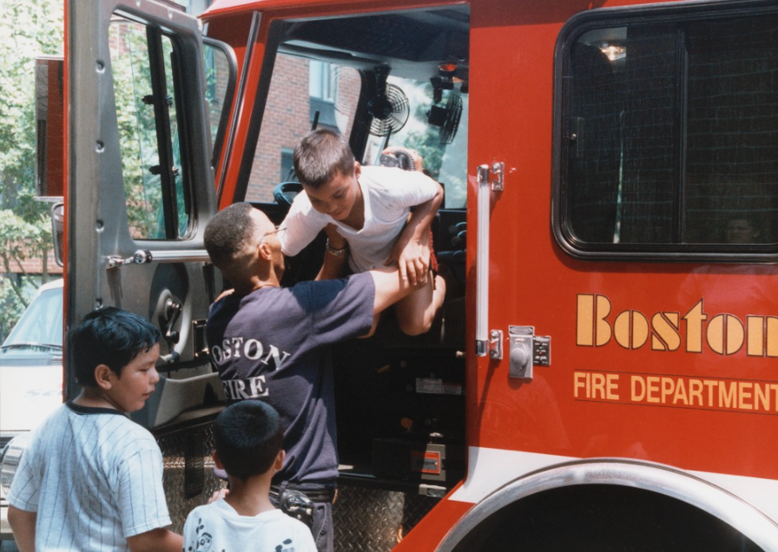
Community Campaigns to Desegregate Police and Fire Departments
SLAVERY AND ITS LEGACY: BOSTON, 1940-2020
NORTHEASTERN UNIVERSITY
The Boston Society of Vulcans was founded in 1969 in response to racial discrimination within the Boston Fire Department. They pushed for more inclusive hiring and promotion practices during the 1990s and 2000s. They still exist today.
The 1970s and 1980s saw coalitions of minority firefighters and police officers in Boston form to protect job security. Heavy backlash by white officers and community members followed.
“THERE WERE ILL FEELINGS, VANDALISM, AND GRAFFITI . . . WHITES AND [B]LACKS DIDN’T EAT TOGETHER ANY LONGER. THERE WAS MORE RACISM.”
“TO MAKE A DIFFERENCE ON THE JOB, YOU HAVE TO UPSET PEOPLE. I DON’T THINK [CHANGE] WILL HAPPEN IN MY LIFETIME. IT’S TOO ENTRENCHED.”
Phillip Wornum,
President of the Boston Society of Vulcans. Interviewed by Maureen Goggin, “A Department Under Fire,” Boston Globe, Feb. 8, 1999
Stanley Moore, Black firefighter, April 17, 1983.

Slide 12
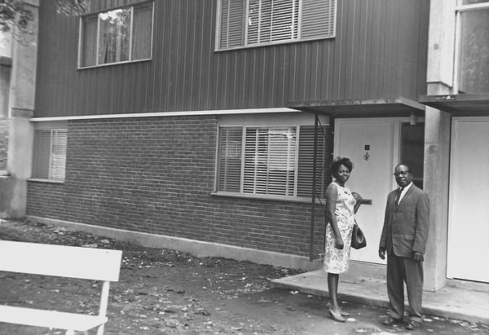
HOUSING DISCRIMINATION
Our Report on The Boston Housing Authority and Equal Access will include a comprehensive timeline of the issue from 1940 to 2020, emphasizing the role of City of Boston and other government actors; a descriptive analysis of discriminatory practices from 1970-2020; and a descriptive analysis of the community-based projects that have or are examining the history of the issues.
Housing and Black Residents of Boston
SLAVERY AND ITS LEGACY: BOSTON, 1940-2020
NORTHEASTERN UNIVERSITY

Slide 13
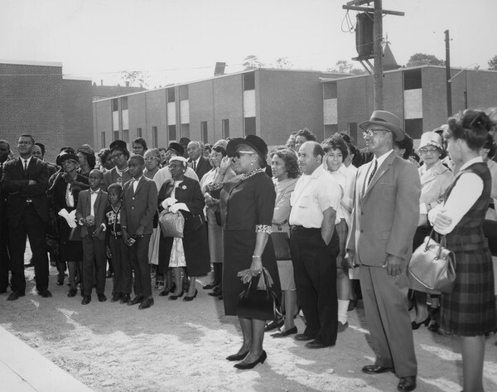
How City Decision Making Contributed to Housing Inequity
The Boston Housing Authority (BHA) was established in 1935 by the Mayor and City Council as a public entity run by an administrator appointed by the Mayor. As a result, the City bears direct responsibility for BHA policies and practices.
In 1978 after a court order, BHA began a slow process to desegregate its housing assignments.
SLAVERY AND ITS LEGACY: BOSTON, 1940-2020
NORTHEASTERN UNIVERSITY
BHA’s failure to implement several court orders to address the deplorable living conditions in its properties led to BHA being placed in receivership in 1979.
In 1988, the BHA was back in court for actively discouraging Black families from applying for available housing units in predominantly white areas.
Guests stand at the dedication of Charlame Park Homes In Roxbury. Photograph by
Del Brook Binns Studio of Photography,
September 27, 1964. Courtesy of Northeastern University Library.

Slide 14
“Nonwhites are likely to experience far more short-term financial disruptions due to their lack of liquid buffer assets. They are also more likely to experience much poorer longer-term housing and retirement outcomes as a consequence of their lack of homeownership, housing equity, and retirement savings. The result is that the net worth of whites as compared with nonwhites is staggeringly divergent.”
Long Term Impact of Housing Discriminationin Boston
SLAVERY AND ITS LEGACY: BOSTON, 1940-2020
NORTHEASTERN UNIVERSITY
While white Boston households have
a median wealth of
$247,500
Black Bostonian households have a median wealth of close to
zero
Federal Reserve Bank of Boston, The Color of Wealth in Boston, 2015

Slide 15
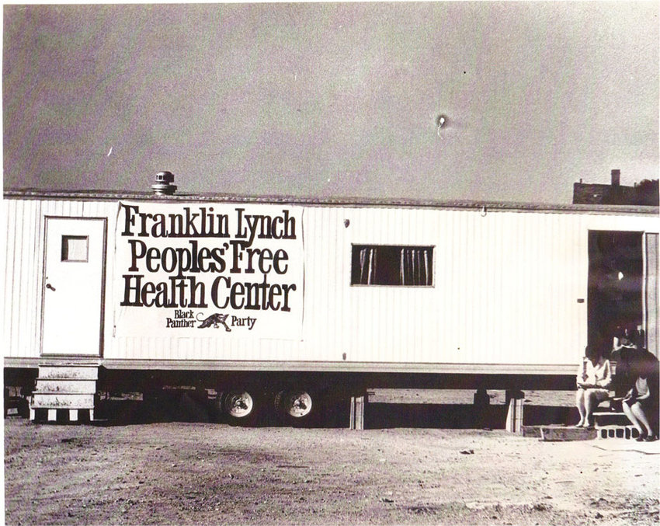
RACE-BASED INEQUALITIES IN HEALTH CARE
Framework: Social Determinants of Health
Discrimination against Black providers by their peers, institutions, and patients
Deleterious Effects on Health of Discriminatory Treatment
  Residential Segregation
  School Segregation, substandard education
  Racialized Policing
  Discriminatory Employment Practices and Poor Working Conditions
  Health effects of exposure to violence, including gun violence
  Exposure to Environmental Hazards
    Inadequate services from Public Works
    Poor air quality
SLAVERY AND ITS LEGACY: BOSTON, 1940-2020
NORTHEASTERN UNIVERSITY
Health Disparities

Slide 16
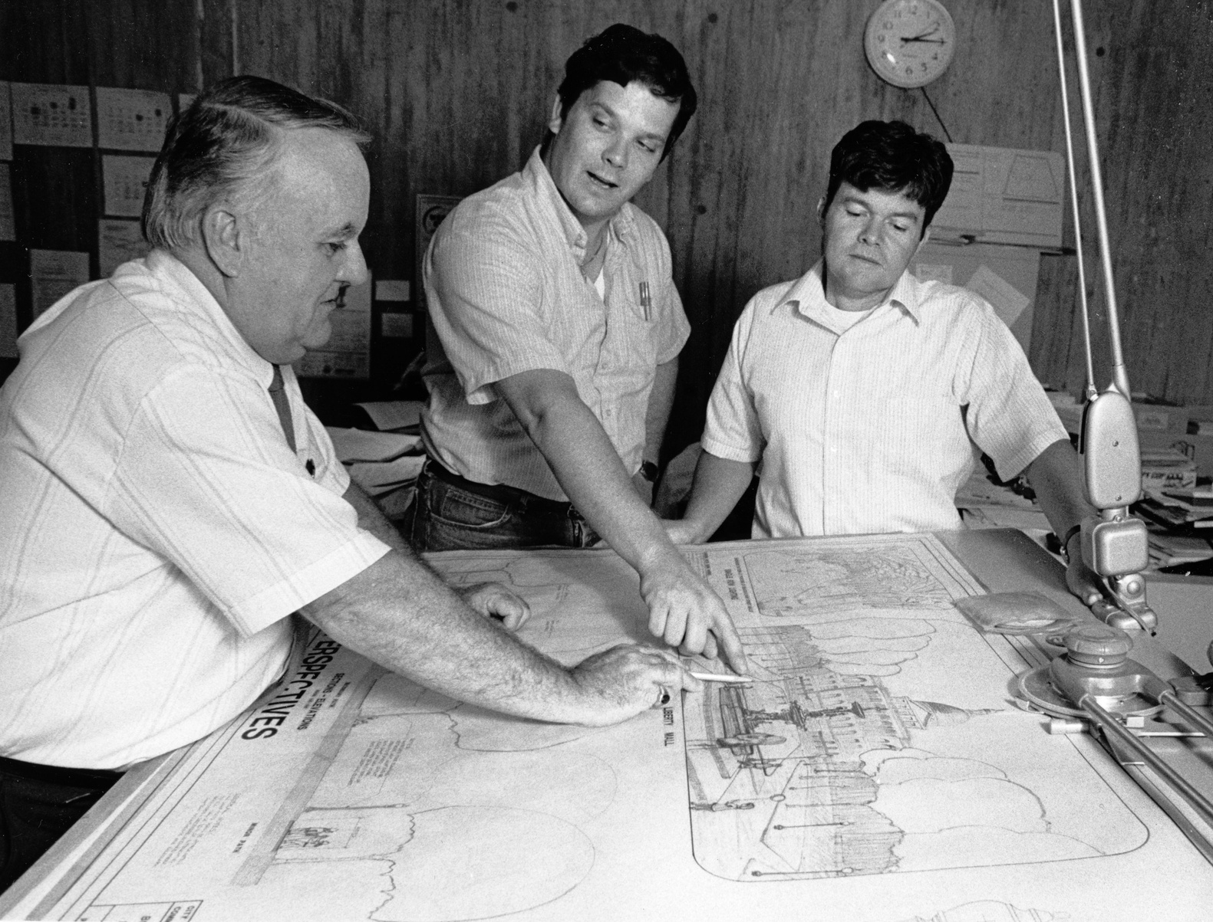
PROCUREMENT
1978: Minority Business Enterprises Program established to address exclusion from contracting opportunities with 10% set-aside requirement
1987: 15% set-aside requirement; Women-owned businesses included with 5% requirement
2003: Targeted program ended in 2003 with shift to race-neutral Small and Local Business Enterprise (SLBE) program
Reduction in percentage of contracts awarded
2017: Ordinance on Equity in City Contracts adopted
2020 study: Continuing underutilization of MBEs
– about 1.2% of $2.1B city contracts benefitted Black and Latinx-owned companies
SLAVERY AND ITS LEGACY: BOSTON, 1940-2020
NORTHEASTERN UNIVERSITY
Procurement Policies and Practices

Slide 17
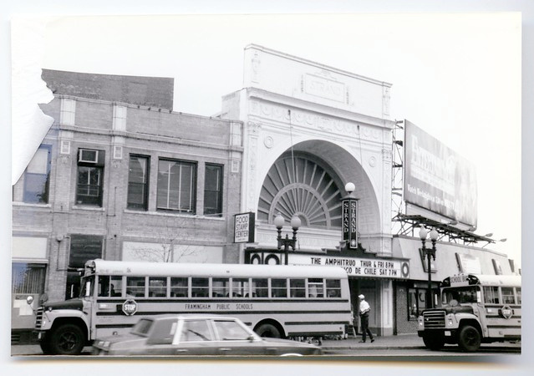
THE HARMS
Housing Disparities and Residential Segregation
Inequities in Educational Opportunities
  Ongoing segregation
  Disparities in School performance and access to higher education
  Exposure to criminal legal system
Criminal Legal System
  Over-criminalization and Over-Policing
  Disproportionate Imprisonment
  Impact on incarcerated persons and families
Economic Impacts
  Wealth Inequality
  Diminished Employment Opportunities
  Long-term income disparities
Health Inequities
  Physical and mental disparities
  Reduced life expectancy
  Inadequate access to healthcare and health insurance
  Traumatic and Stress effects of systemic, repeated exclusion
SLAVERY AND ITS LEGACY: BOSTON, 1940-2020
NORTHEASTERN UNIVERSITY
The Harms

Slide 18
Literature Review and Bibliography
TO BE MADE AVAILABLE TO THE TASK FORCE IN THE COLLECTION
SLAVERY AND ITS LEGACY: BOSTON, 1940-2020
NORTHEASTERN UNIVERSITY
SOURCES
  Databases, including ProQuest and Westlaw
  Primary material, including papers of advocacy organizations, held by the National Archives and Records Administration (NARA) and the Library of Congress (LOC)
  Northeastern University’s collections
  City of Boston Archives
  Newspapers

Slide 19
Our report will focus on three areas: 1) the Boston Public Schools; 2) the Police and Fire departments; and 3) the Boston Housing Authority. We propose to capture the literature on these three sectors to inform the Task Force, and to highlight how power was exercised in the City of Boston to allocate resources, benefiting certain groups and burdening others.
SLAVERY AND ITS LEGACY: BOSTON, 1940-2020
NORTHEASTERN UNIVERSITY
TO THIS AIM, WE WILL PRODUCE...
A NARRATIVE REPORT WITH ACCOMPANYING CHRONOLOGY
A COLLECTION OF RESOURCES

Slide 20
THANK YOU FOR YOUR TIME AND THIS OPPORTUNITY
SLAVERY AND ITS LEGACY: BOSTON, 1940-2020, NORTHEASTERN UNIVERSITY

