Slide 1
Reparations Task Force
April 14, 2025 Public Meeting

Slide 2
Call to Order + Roll Call
Chair Joseph D. Feaster, Jr.

Slide 3
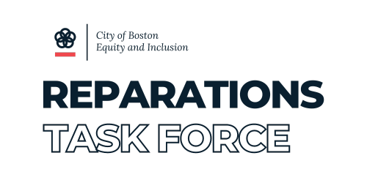

Slide 4
Opening Remarks
Chair Joseph D. Feaster, Jr. / Chief Mariangely Solis Cervera

Slide 5
AGENDA
Chair of Reparations Task Force Opens Meeting and takes roll call of RTF members
Opening remarks
Community Partnership Program
Beacon Hill Scholars
Jibril Haynes
Afrimerican Culture Initiative Inc.
American Descendants Of Slaves
e. Loring Greenough House
Q&A for Community Partners
Update for Next Meeting - May 12, 2025 (second Monday of the month)
Public Comments
Adjournment

Slide 6
Community Partnership Projects
Reparations Task Force Member

Slide 7
Community Partner
Loring Greenough House - Dorothy Clark

Slide 8
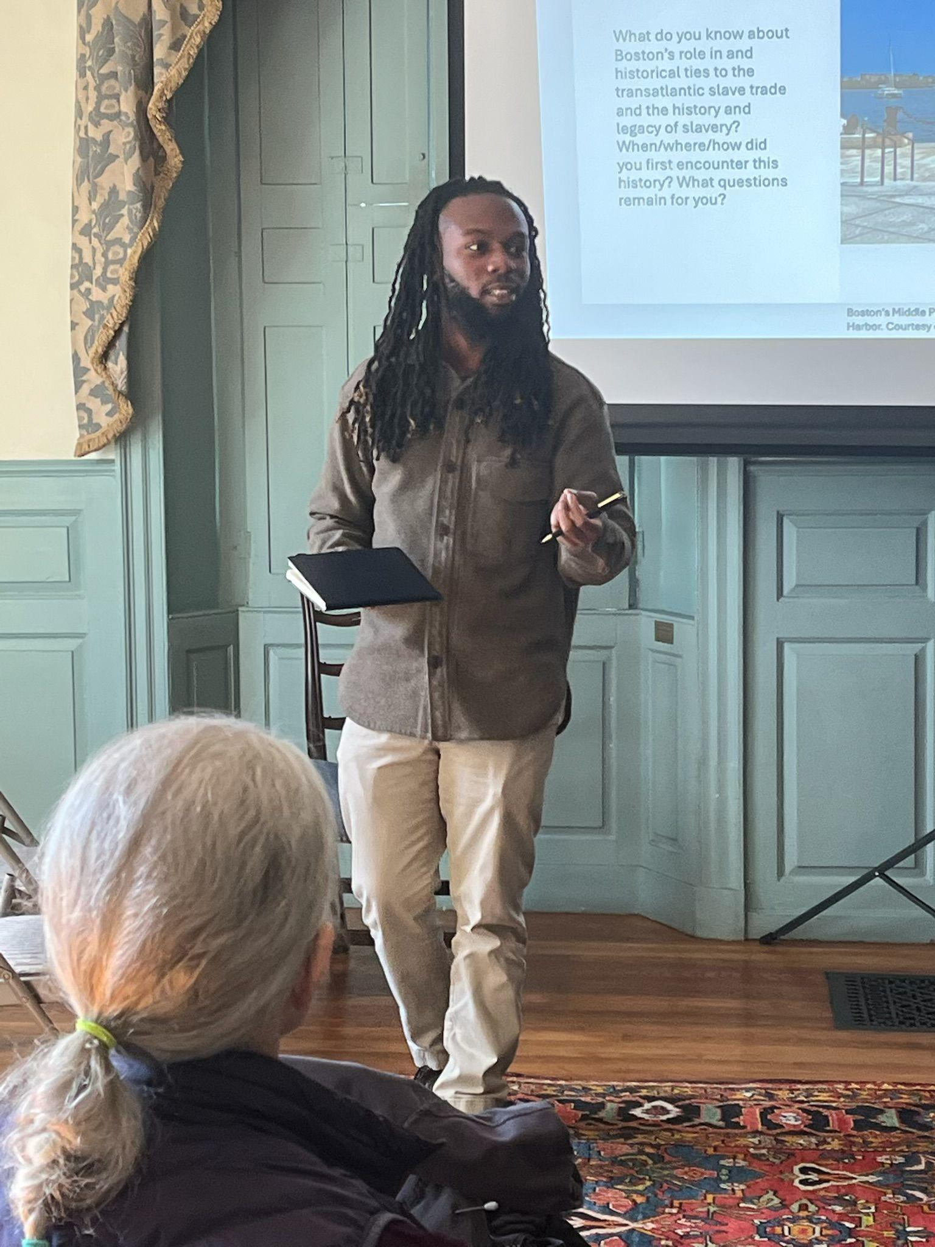
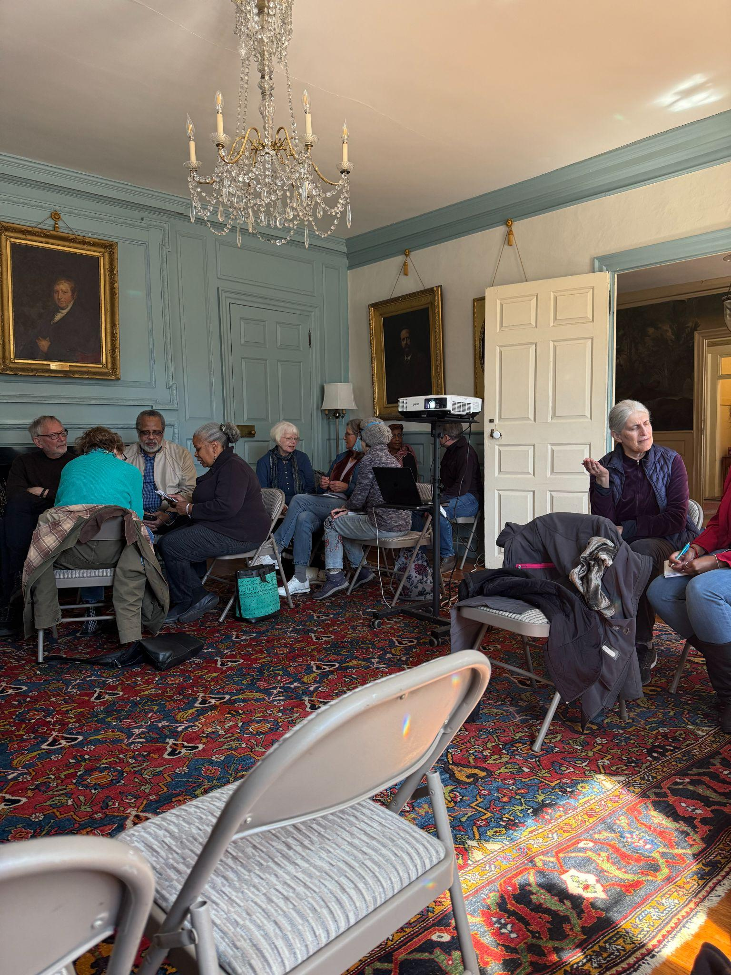
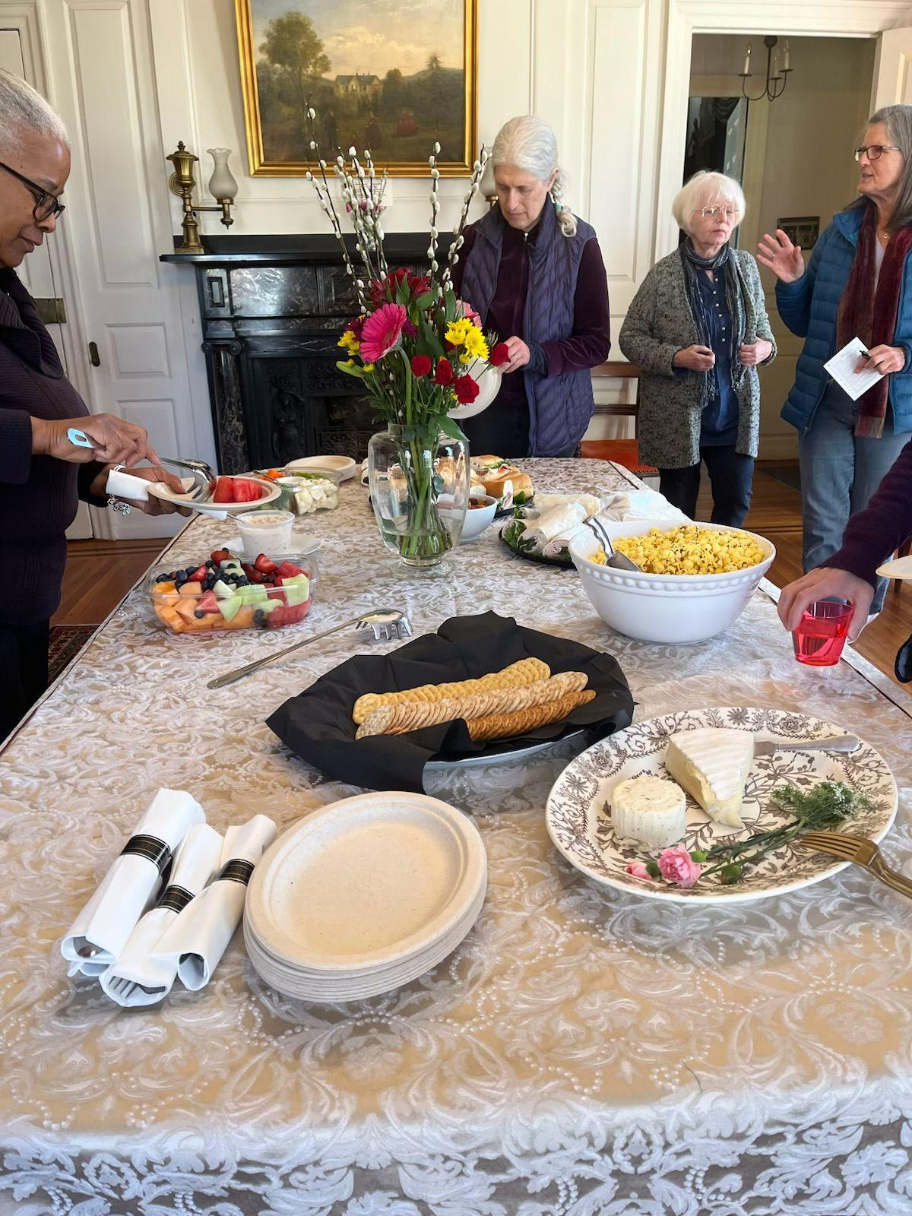
Loring Greenough House - Dorothy Clark

Slide 9
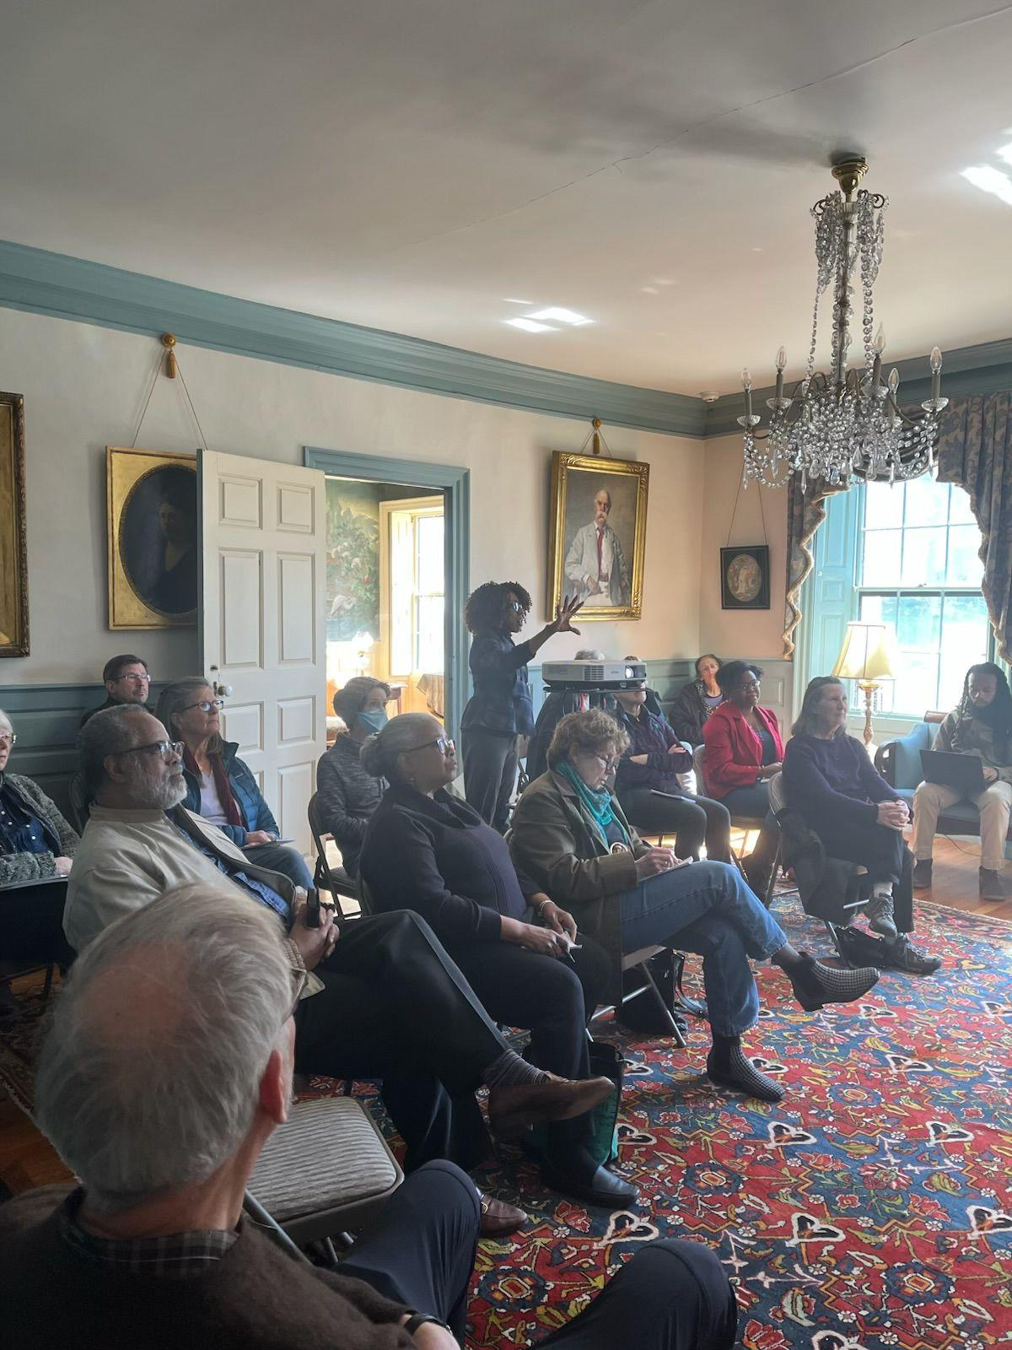
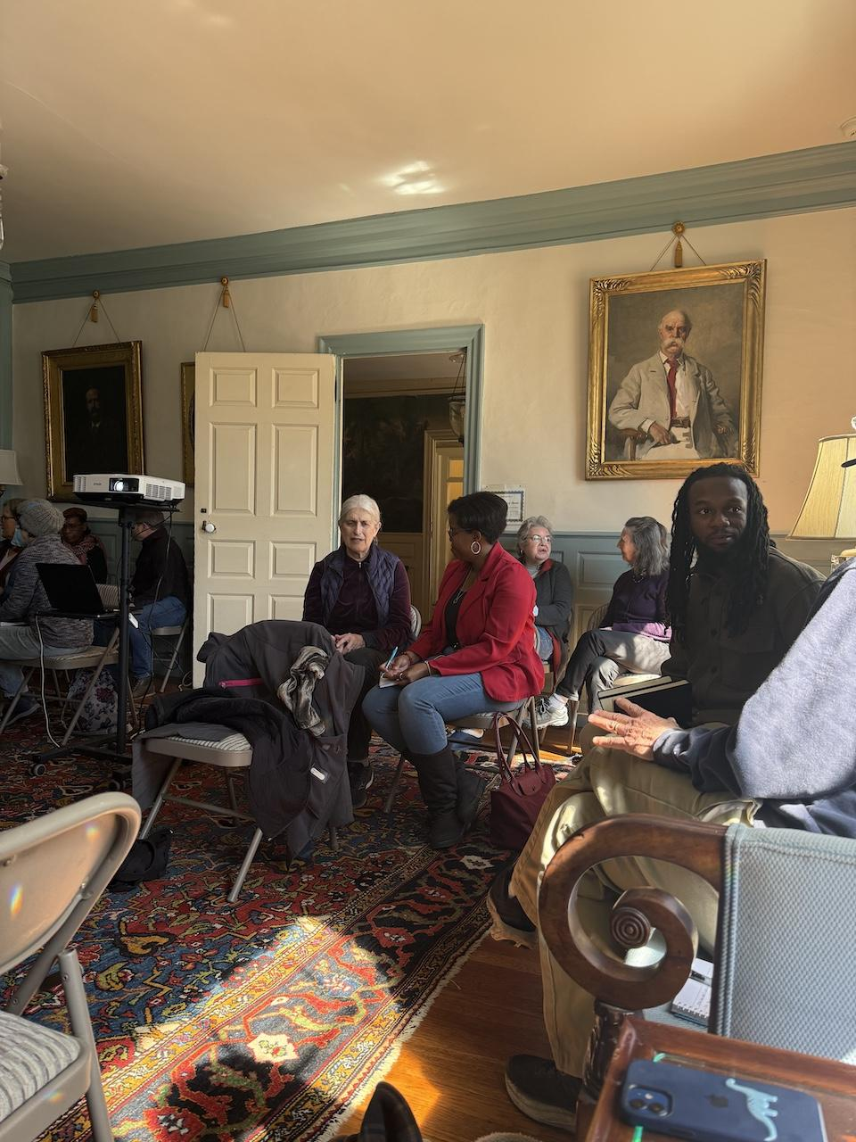
Loring Greenough House - Dorothy Clark

Slide 10
Community Partner
Jibril Haynes

Slide 11
Community Partner
Jibril Haynes

Slide 12
Community Partner
Beacon Hill Scholars - Peter Snoad

Slide 13
Community Partner
American Descendants Of Slaves - Reggie Steward

Slide 14
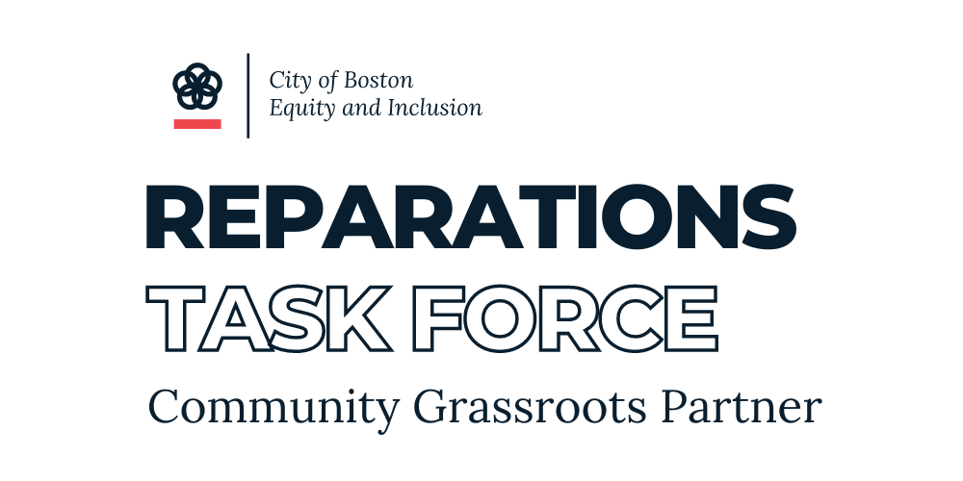
REPARATIONS
Informational and Listening Sessions
OCTOBER 26, 2024

Slide 15
Mission
We foster a culture of proactive volunteerism, civic participation, and social responsibility, believing that these are the foundations of empowerment and self-determination. We are committed to providing resources, support, and opportunities to the ADOS community to collectively enhance their socio-political influence, economic standing, and to cultivate a powerful voice that reflects our diverse and vibrant community.
www.adosempowerment.org

Slide 16
The American Descendants of Slavery (ADOS) Advocacy Foundation is a grassroots organization that arose in response to a national landscape rife with yawning racialized gaps. With an eye toward the origins of these asymmetrical outcomes located in the institution of slavery, our organization prioritizes reparations for descendants of chattel slavery in the United States of America. Ours is an experience defined by the unique, shared cost of multigenerational plunder. And as we stand in the shoes of our ancestors, we insist upon a specific group designation as essential to this undertaking.
During Reconstruction, America reneged on the promise of forty acres and a mule, depriving us of the fruits of citizenship and relegating us to a permanent bottom caste within the country that our ancestors built. Reparations is our birthright, and must come through multigenerational direct payments and a redistribution of land that rights the wrongs of the great land robbery.
A debt must be paid, and our inheritance protected. We insist upon an historic, targeted allotment of policy and protections that fulfills the promise of economic inclusion and integrates the descendants of chattel slavery into the drivers of wealth. This restoration—which brings us into alignment with the full measure of our contribution to the U.S.—requires mechanisms to safeguard against subprime and predatory capital and sweeping anti-discrimination legislation targeted for the protection of, and accelerated wealth creation of, the descendants of chattel slavery in the U.S.
Although our justice claim for reparations is sacred to ADOS, we are fiercely committed to advocating for policies that eliminate the divides faced by Black Americans with immigrant backgrounds. We recognize the lived experience of racism and discrimination among all Black people in America and we invite all people from all backgrounds to join this just cause.
MISSION STATEMENT

Slide 17
THE ADOSAF BLACK AGENDA
AGRICULTURE
BLACK BUSINESS
The American Descendants of Slavery (ADOS) Advocacy Foundation believes in building a fairer and more equitable America. Our efforts reflect a concern for, and a commitment to, advocating for policies that will eliminate the divides faced by all Black Americans. For ADOS, the specific call is for a national program for slavery Reparations. For all Black Americans, one would look to our robust BLACK AGENDA. The agenda is data-driven and reflects opportunities to improve the long-standing, dismal outcomes most notably manifested in the lineage-based, racial wealth gap. We call on the Executive Branch specifically—and all elected officials in general—to review our agenda and work with the ADOS Advocacy Foundation to secure the promise of America for all her citizens.
CANNABIS
CLIMATE CHANGE
CRIMINAL JUSTICE
EDUCATION
ENVIRONMENTAL RACISM
HEALTH & NUTRITION
HOUSING
IMMIGRATION
INFRASTRUCTURE
UNEMPLOYMENT

Slide 18
ADOS AF Massachusetts State Chapter
ADOS Massachusetts is focused on advocating for policies that improve the lives of Black residents in the Massachusetts 7th Congressional District and the Commonwealth of Massachusetts. Our local chapter supports the demand of the ADOS Advocacy Foundation for Reparations for American Descendants of Slavery.
In addition, we support a robust and transformative legislative Black agenda that uplifts ALL Black Massachusetts residents.

Slide 19
ADOS AF Massachusetts State Chapter
BLACK AGENDA
WEALTH
INCOME
HOME OWNERSHIP
LENDING DISCRIMINATION
RENTING DISCRIMINATION
HOUSING INSECURITY
BLACK ENTREPRENEURSHIP
BLACK EMPLOYMENT

Slide 20
www.adosfoundation.org
www.adosfoundation.org/MA
@ADOSORG
@ADOSBOSTON

Slide 21
REPARATIONS
Definitions and Timelines

Slide 22
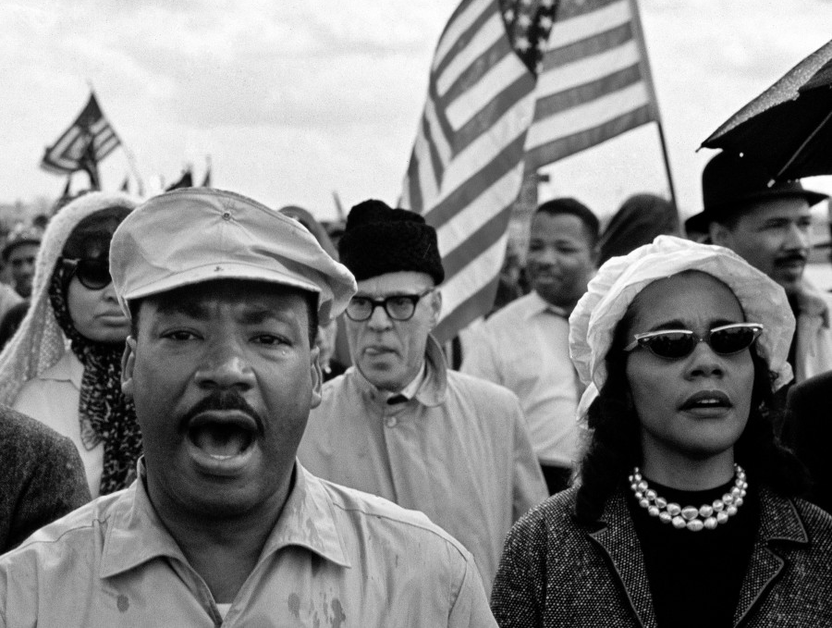
What is REPARATIONS within the context of the
United States of America?

Slide 23
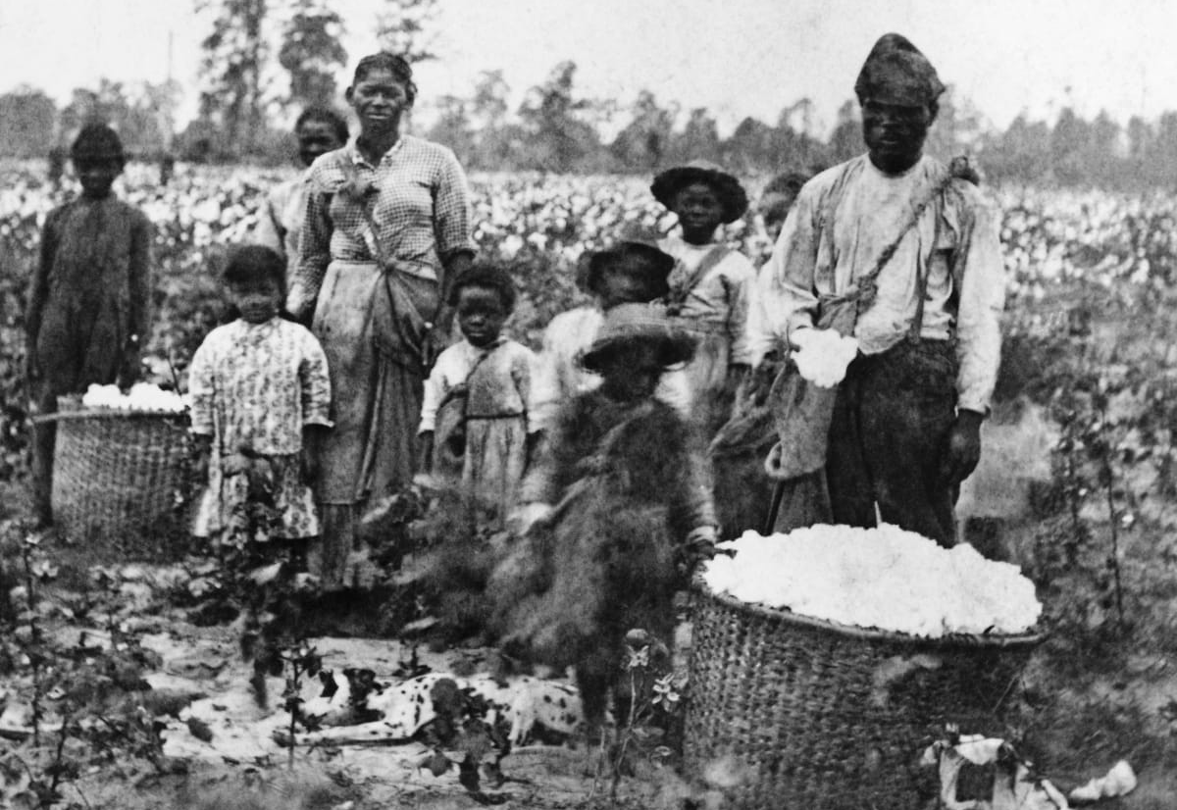
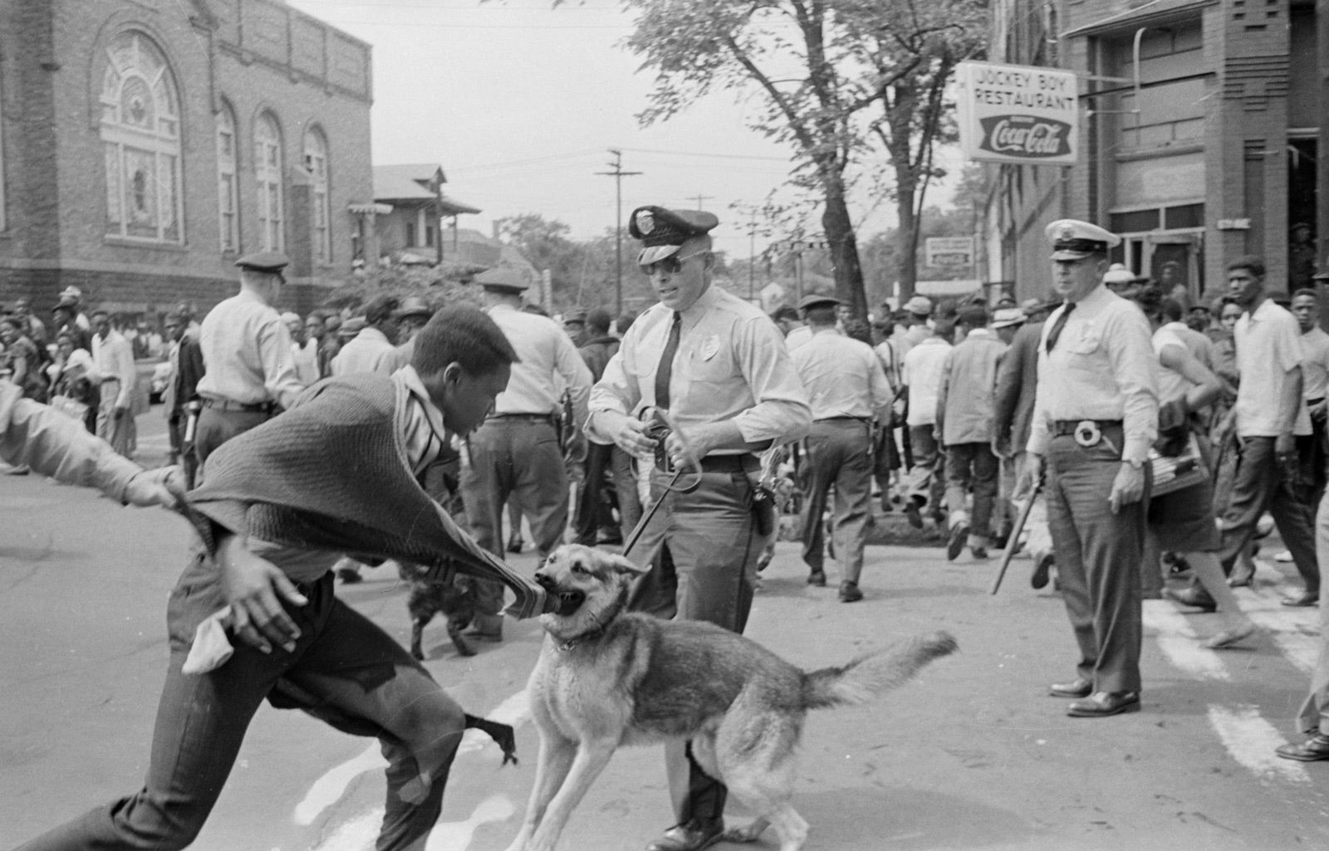
Slavery Reparations:
Timeline of Policy, Litigation, and Advocacy
(Slavery – Jim Crow)

Slide 24
Slavery Reparations:
Timeline of Policy, Litigation, and Advocacy
(Slavery – Jim Crow)
Brom & Bett v. Ashley | Belinda Sutton | Special Field Order 15 | Freedmen’s Bureau Acts | Thaddeus Stevens | Wood v. Ward | H.R. 11119
1781 | 1783 | 1865 | 1865 &1866 | 1866 | 1878 | 1890

Slide 25
Slavery Reparations:
Timeline of Policy, Litigation, and Advocacy
(Slavery – Jim Crow)
Callie House | Rep. Jeremiah Botkin | Johnson v. McAdoo | Queen Mother Moore | Malcolm X | Black Panther Party | Martin Luther King, Jr.
1897 | 1898 | 1917 | 1957 & 1959 | 1963 | 1966 | 1968

Slide 26
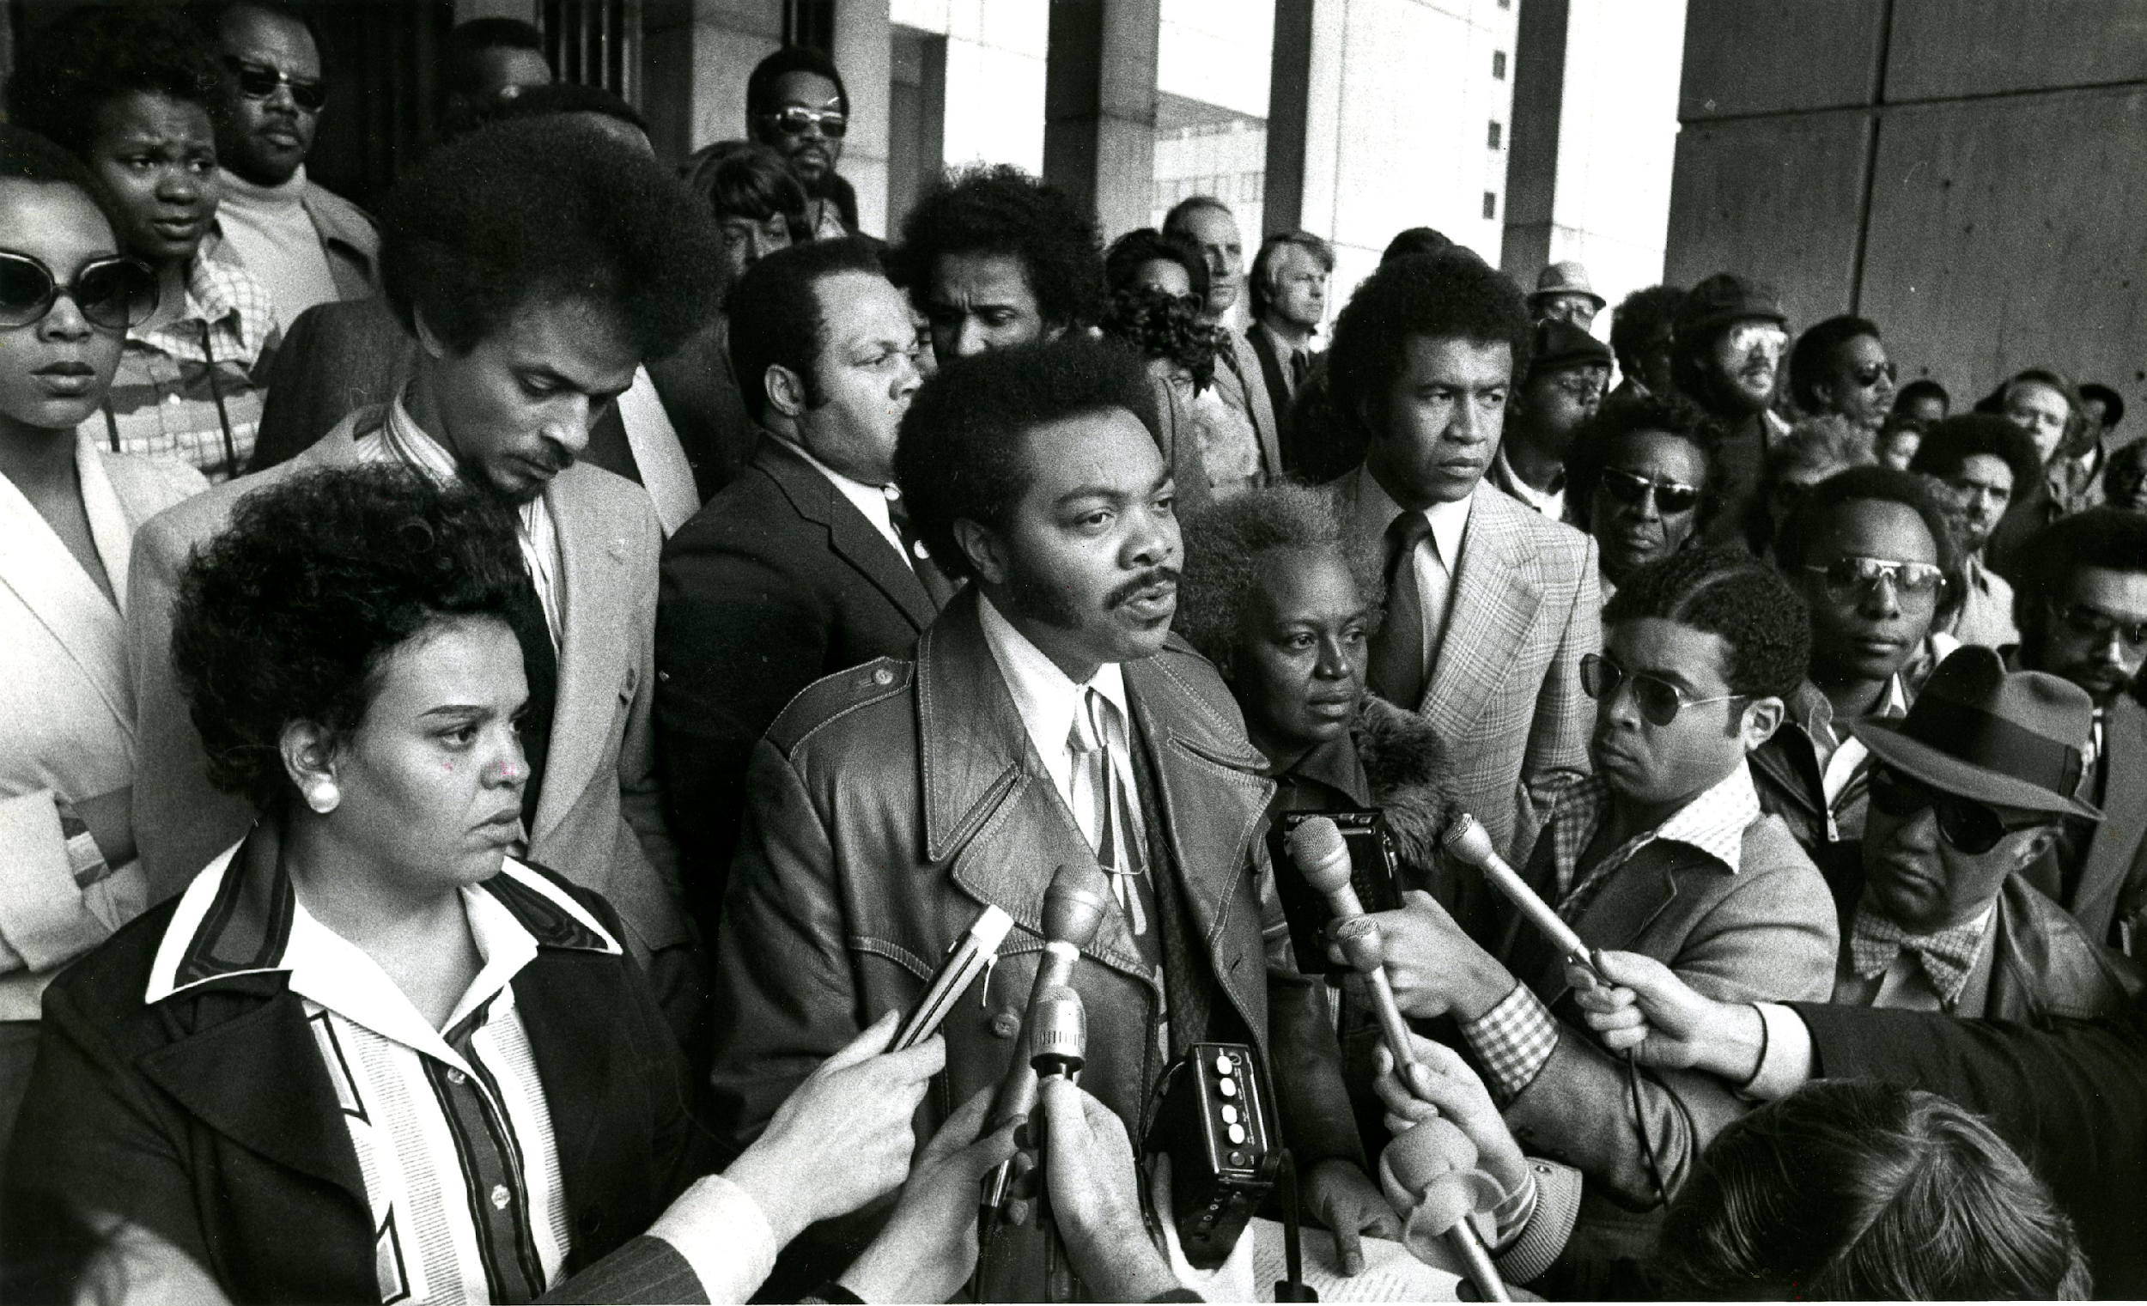
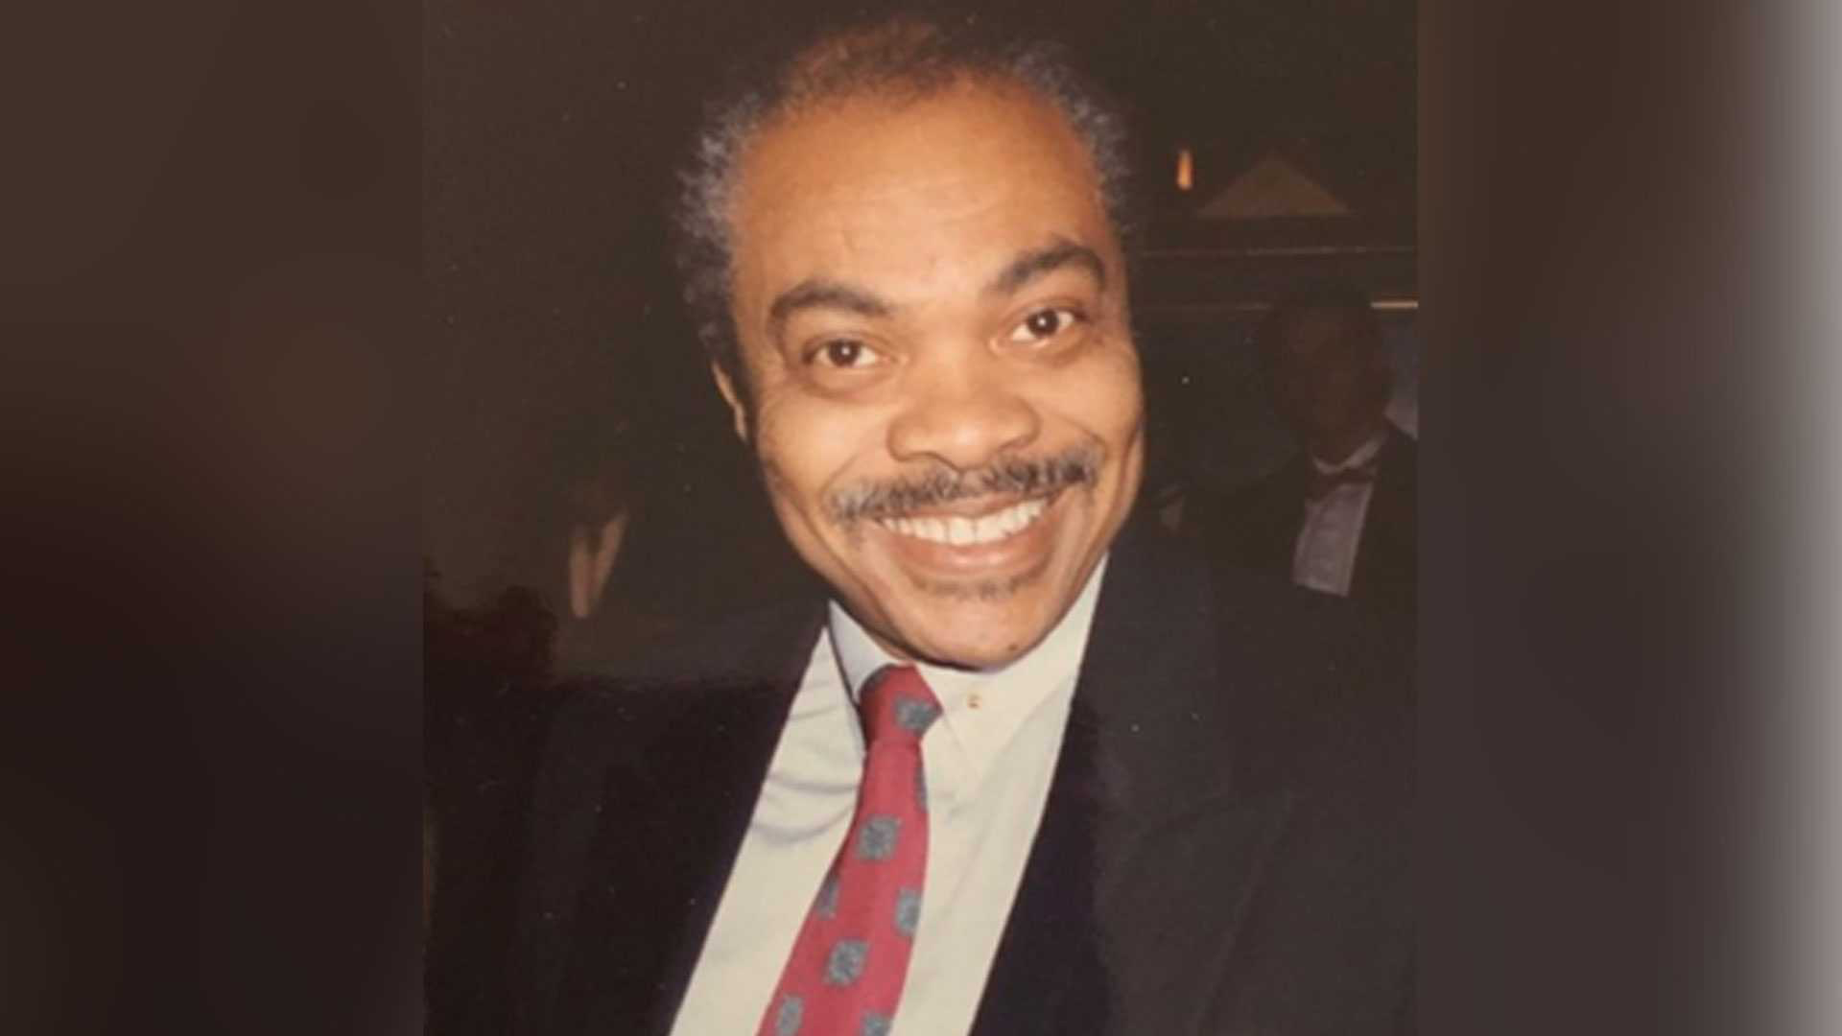
Senator William “Bill” Owens
1988
First Black state senator elected to the Massachusetts Legislature
Filed reparations legislation in 1988
Served as a model for H.R. 40 and Boston City Council ordinance.

Slide 27
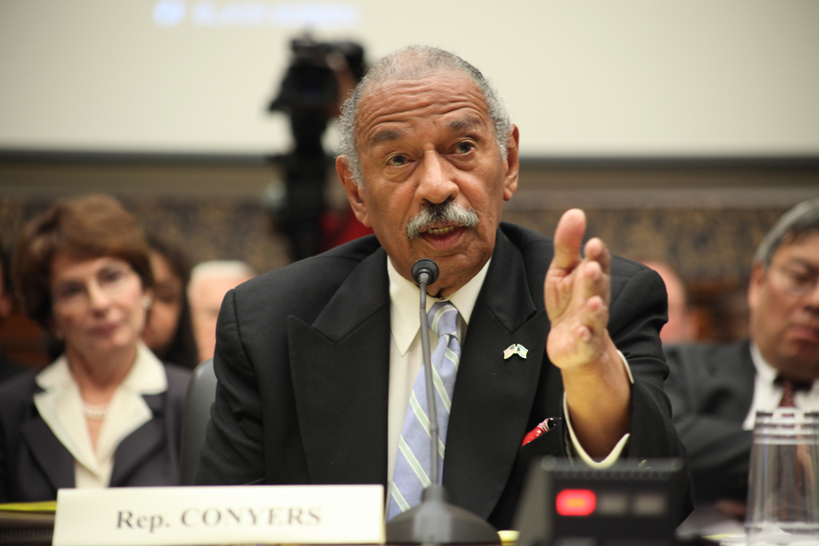
Congressman John Conyers introduced H.R. 40, the Commission to Study Reparation Proposals for African Americans Act. The bill aims to establish a commission to study and develop reparations proposals for African Americans. He reintroduced the bill in every Congress until his retirement in 2017.
H.R. 40
1989

Slide 28
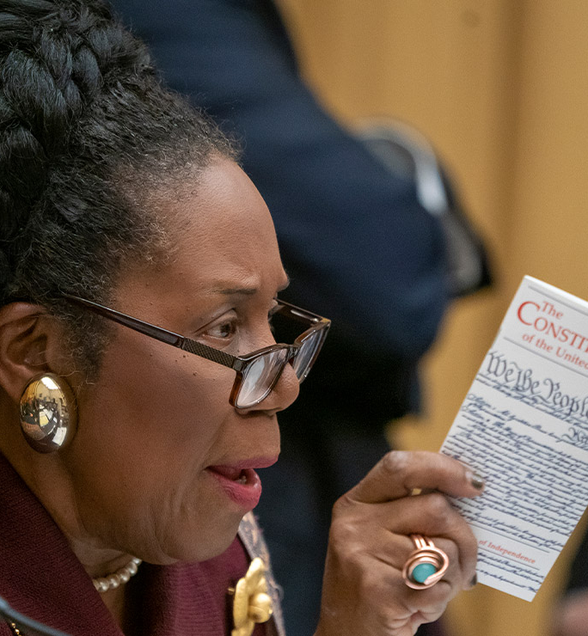
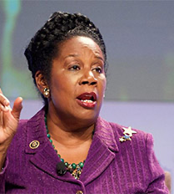
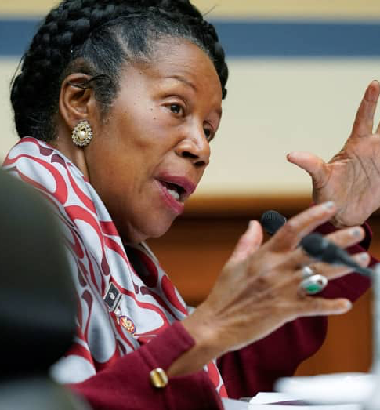
H.R. 40
2019
2019: H.R. 40 is reintroduced by Congresswoman Sheila Jackson Lee, gaining significant attention and support. *

Slide 29
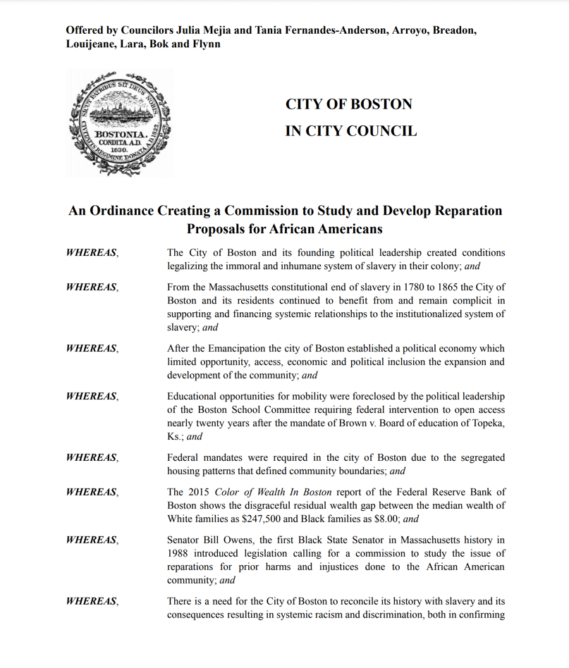
Boston City Council - 2022
An Ordinance Creating a Commission to Study and Develop Reparation Proposals for African Americans
Authored by Yvette Modestin (Encuentro Diaspora Afro) & Professor Jemadari Kamara (Umass Boston Africana Studies Department)
Sponsored by At-Large City Councilor Julia Mejia
Passed unanimously by the Boston City Council in 2022

Slide 30
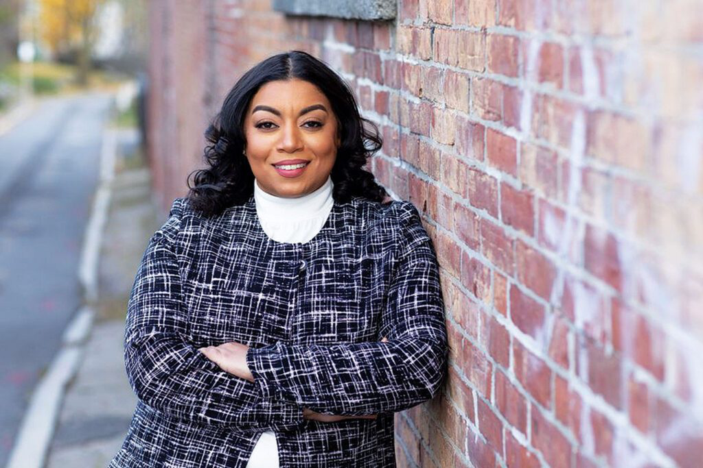
S. 1053 (2023)
By Ms. Miranda, a petition (accompanied by bill, Senate, No. 1053) of Liz Miranda, Lydia Edwards, Jason M. Lewis, Mindy Domb and others for legislation to establish a commission to study reparations in Massachusetts.
Massachusetts State Senator Liz Miranda

Slide 31
H. 3921 (2023)
By Representative Fluker Oakley of Boston, a petition (accompanied by bill, House, No. 3921) of Brandy Fluker Oakley relative to establishing a commission to study and develop proposals for lineage-based reparations programs in the Commonwealth.
Massachusetts State Representative Brandy Fluker Oakley

Slide 32
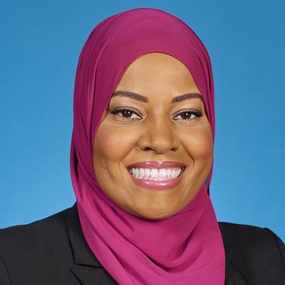
DISTRICT 7 COUNCILOR
Tania Fernandes Anderson
BOSTONDISTRICT7.COM

Slide 33
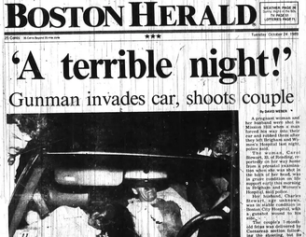
Boston Herald
October 1989

Slide 34
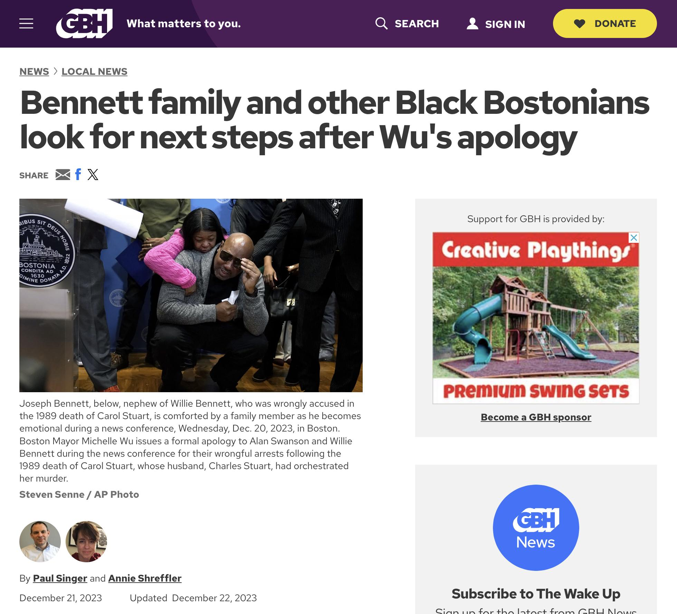

Slide 35
The Mission:
Our mission is to empower returning citizens by addressing their mental health needs, facilitating their successful reentry into society, and strengthening family bonds. We envision a future where every returning citizen in Boston has the opportunity for a fresh start, leading to a safer, more inclusive community.
The Vision:
We envision creating communities with active and engaged fathers in their families and neighborhoods

Slide 36
THE REPARATIONS DEBATE
The Elephants in the Room: Common Knowledge, Uncommon Confrontation

Slide 37
What in the hell is #ADOS
How did we get here?

Slide 38
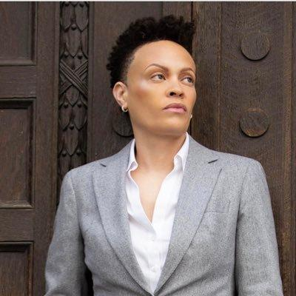
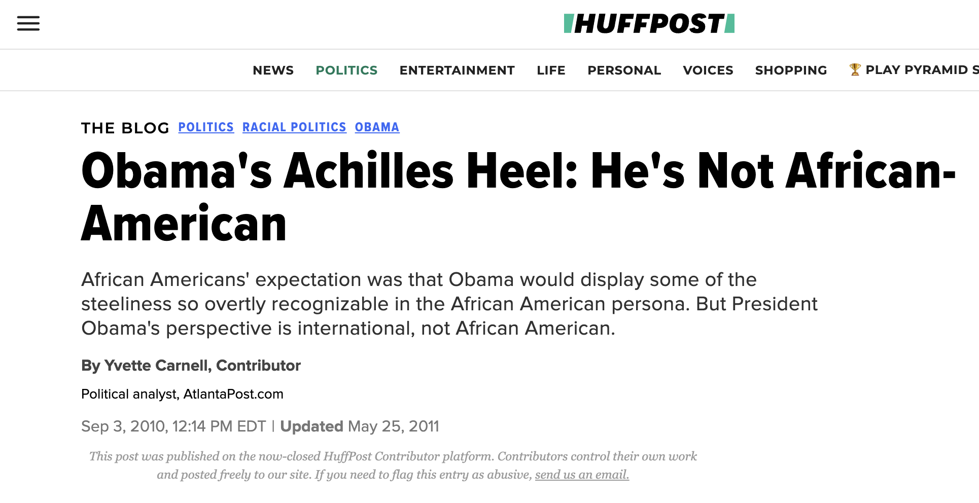
Obama's Achilles Heel: He's Not African-American
September 3, 2010
“Born to a white mother and a Kenyan father, young Obama's world view was fashioned in Indonesia and Hawaii through the prism of his mother. There is nothing unseemly about Obama's upbringing, but it does belie the difficulty inherent in labeling President Obama as African-American.
Even if President Obama's Kenyan father had been in his life, that wouldn't have been enough to link Obama to an African-American experience which is uniquely different from that of Africans in the great vastness of the Diaspora. And to say that Obama is connected to the African-American experience by virtue of his Kenyan father is alarmingly simplistic.
The African-American experience is unique in the level of insight which it imprinted upon its members as well as the relative level of equality bestowed upon a previously enslaved minority group. We view life through a dual lens whereas for Obama, the lens is singular.”
Yvette Carnell
LINEAGE AND IDENTITY

Slide 39
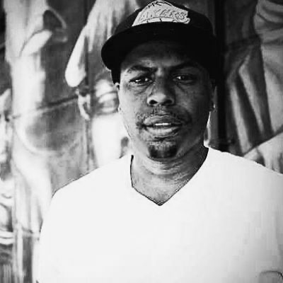
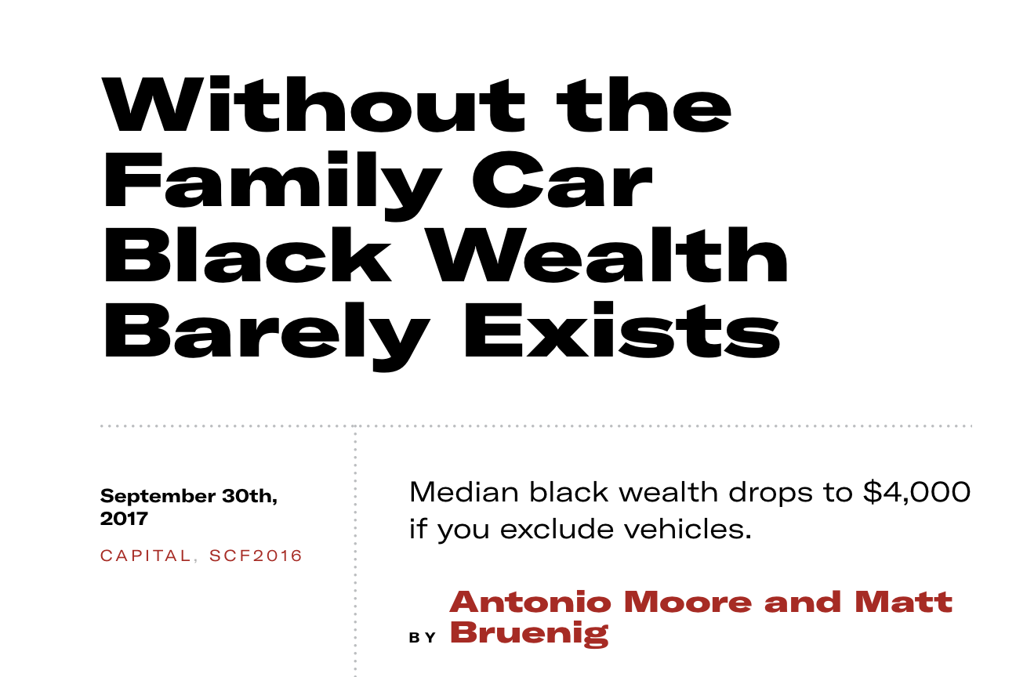
Attorney Antonio Moore
“As noted by Professor Edward Wolff, it would be better to use a wealth concept that excludes these kinds of consumer durables, as they are not readily convertible to cash, their consumption value typically far outweighs their resale value, and they are not generally regarded as wealth…
When we exclude the family car, we get a somewhat different wealth narrative than the one being told across media platforms nationally. Without the family car, the middle black family has a net worth of $4,160. The middle white American family in contrast is still worth $140,600. This means, using an accounting model that more accurately excludes the family car, the median white family is worth over 33 times that of the median black family.”
WEALTH INEQUALITY

Slide 40
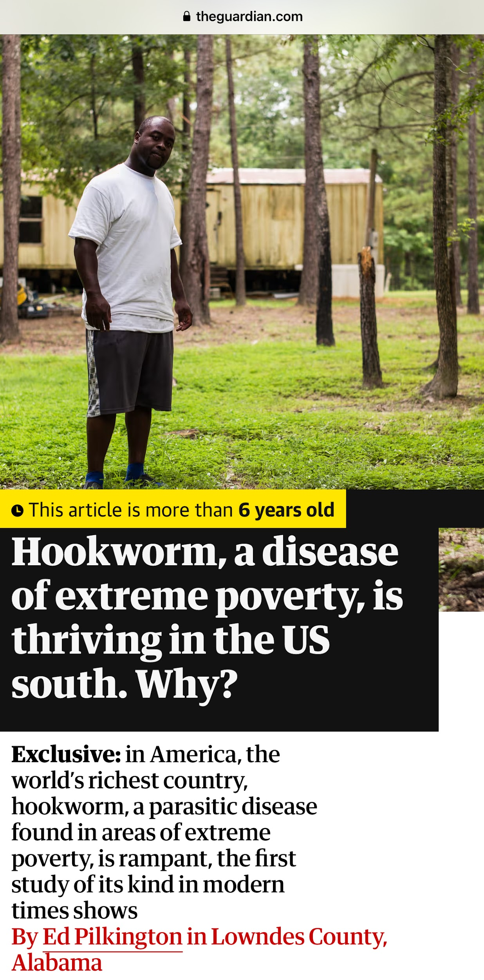
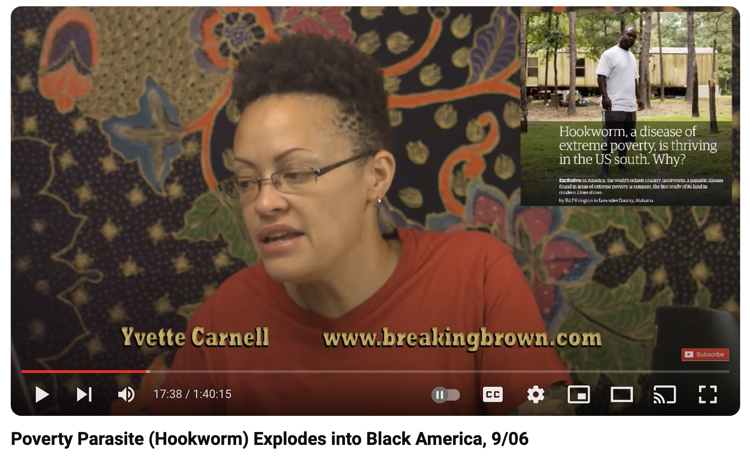
September 6, 2017
September 5, 2017

Slide 41
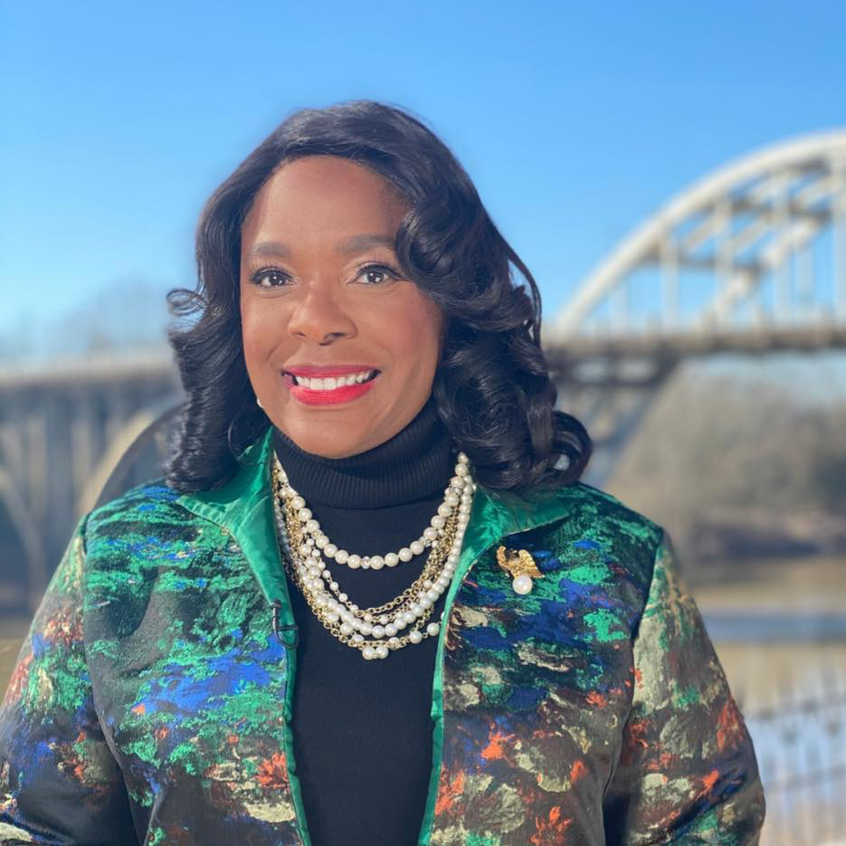
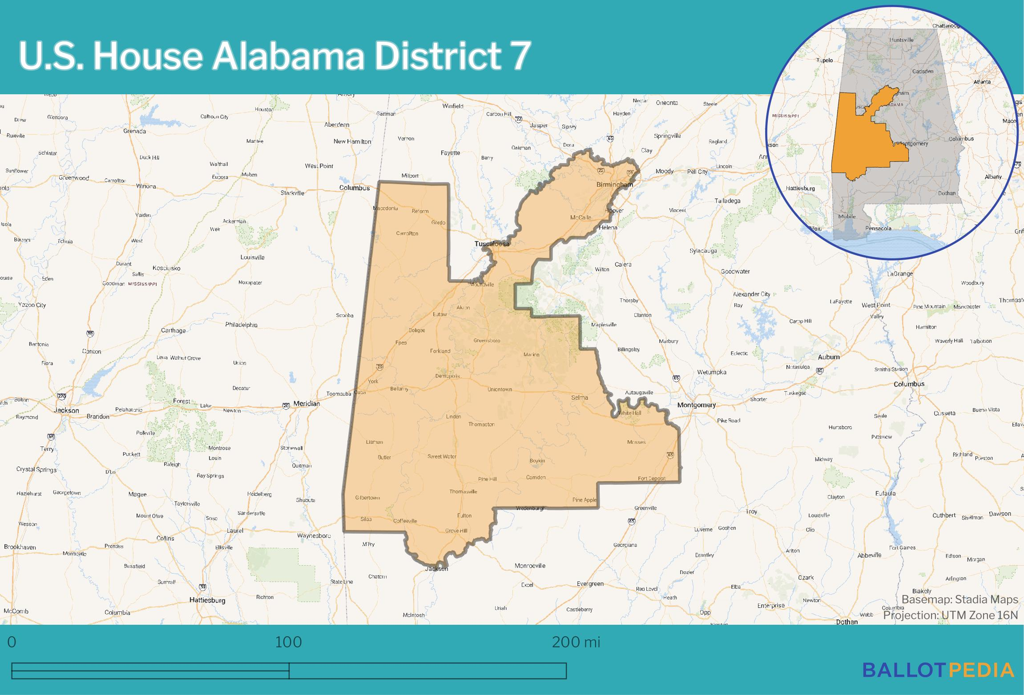
Representative Terri Sewell (D)
Alabama’s 7th Congressional District

Slide 43
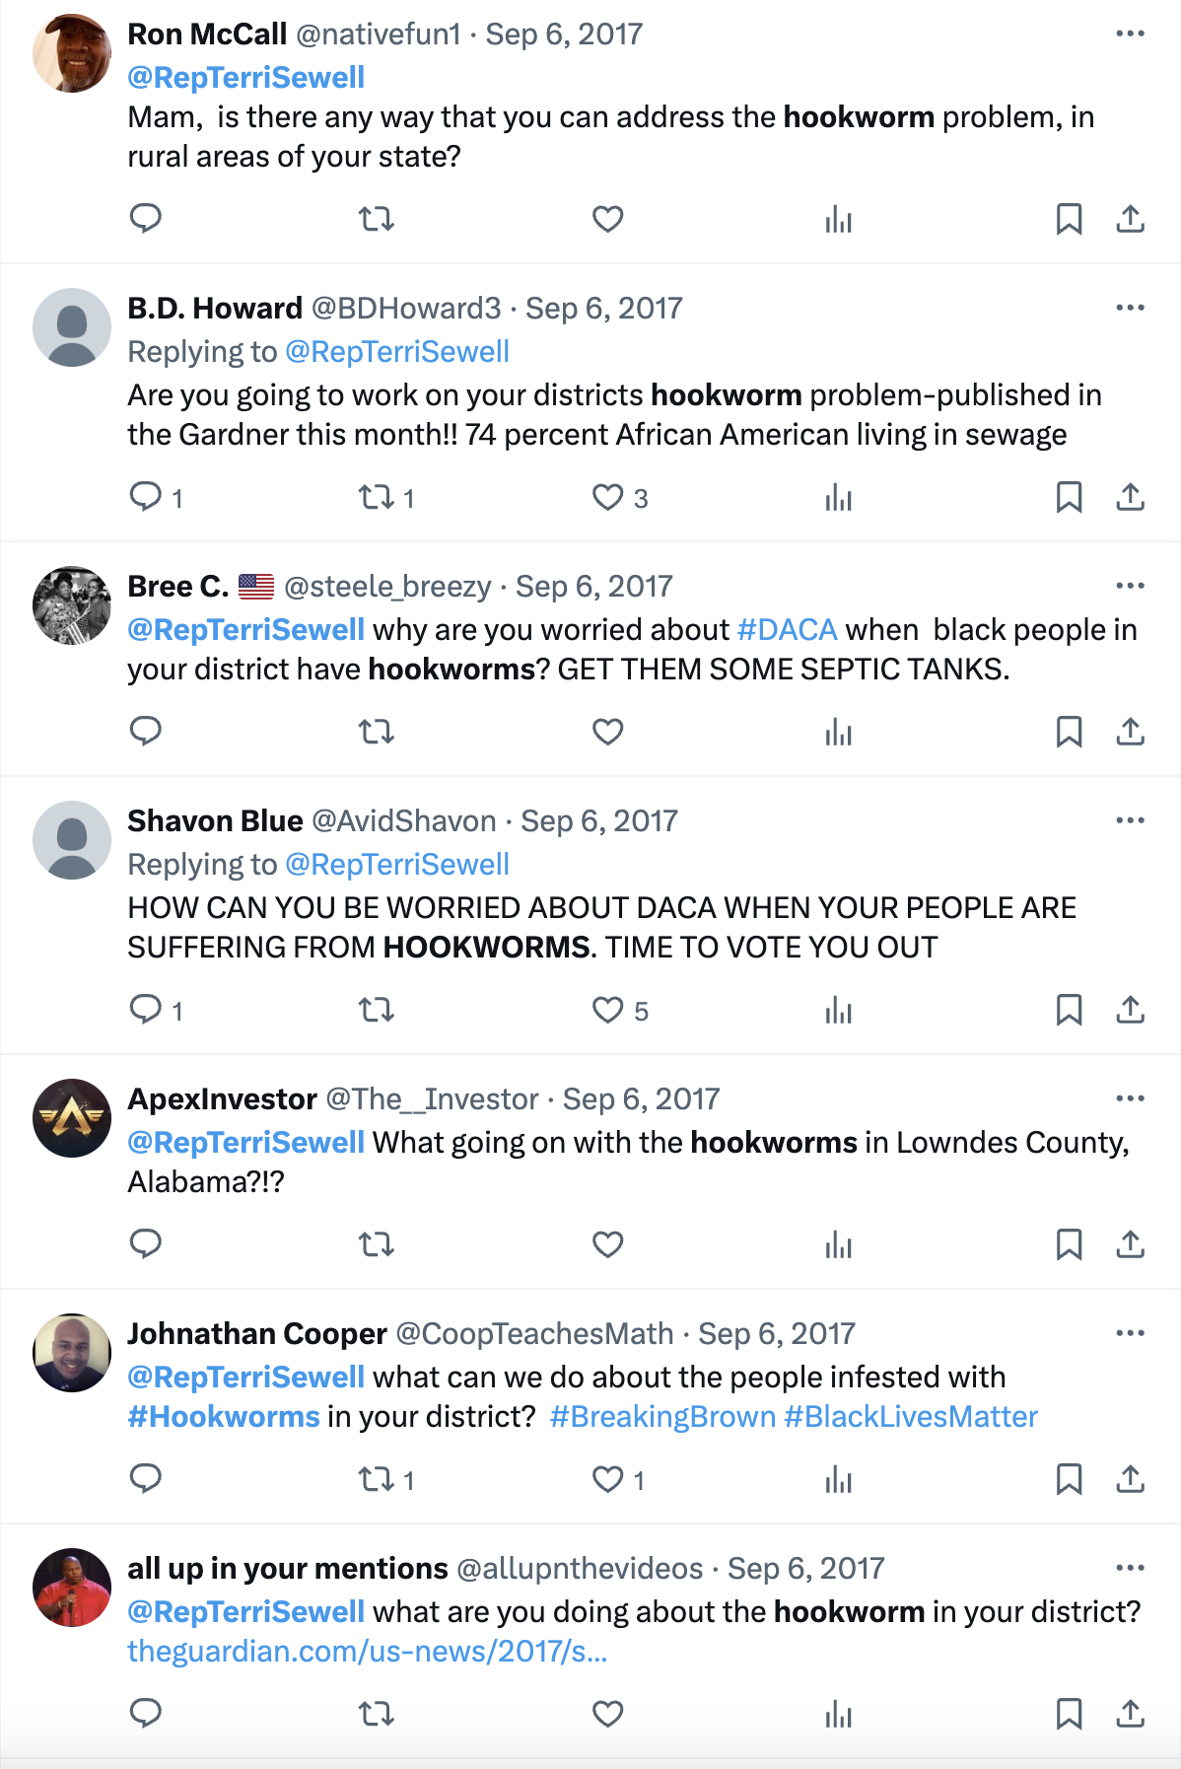

Slide 44
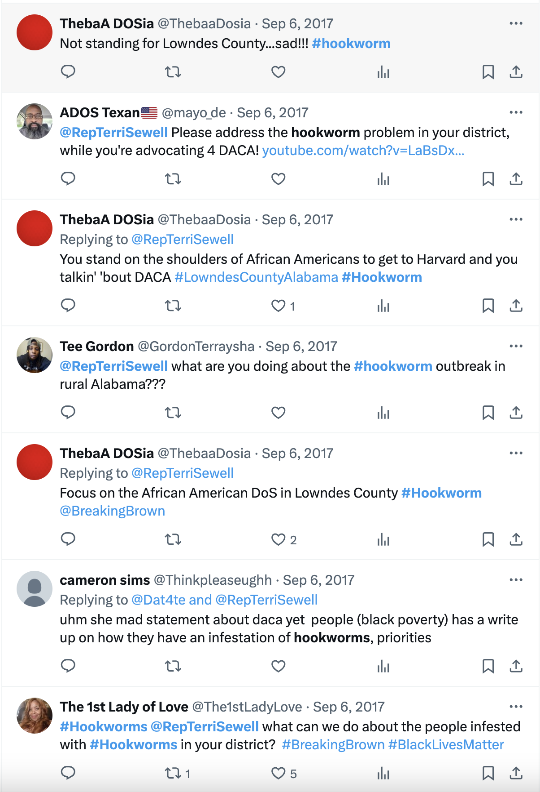

Slide 45
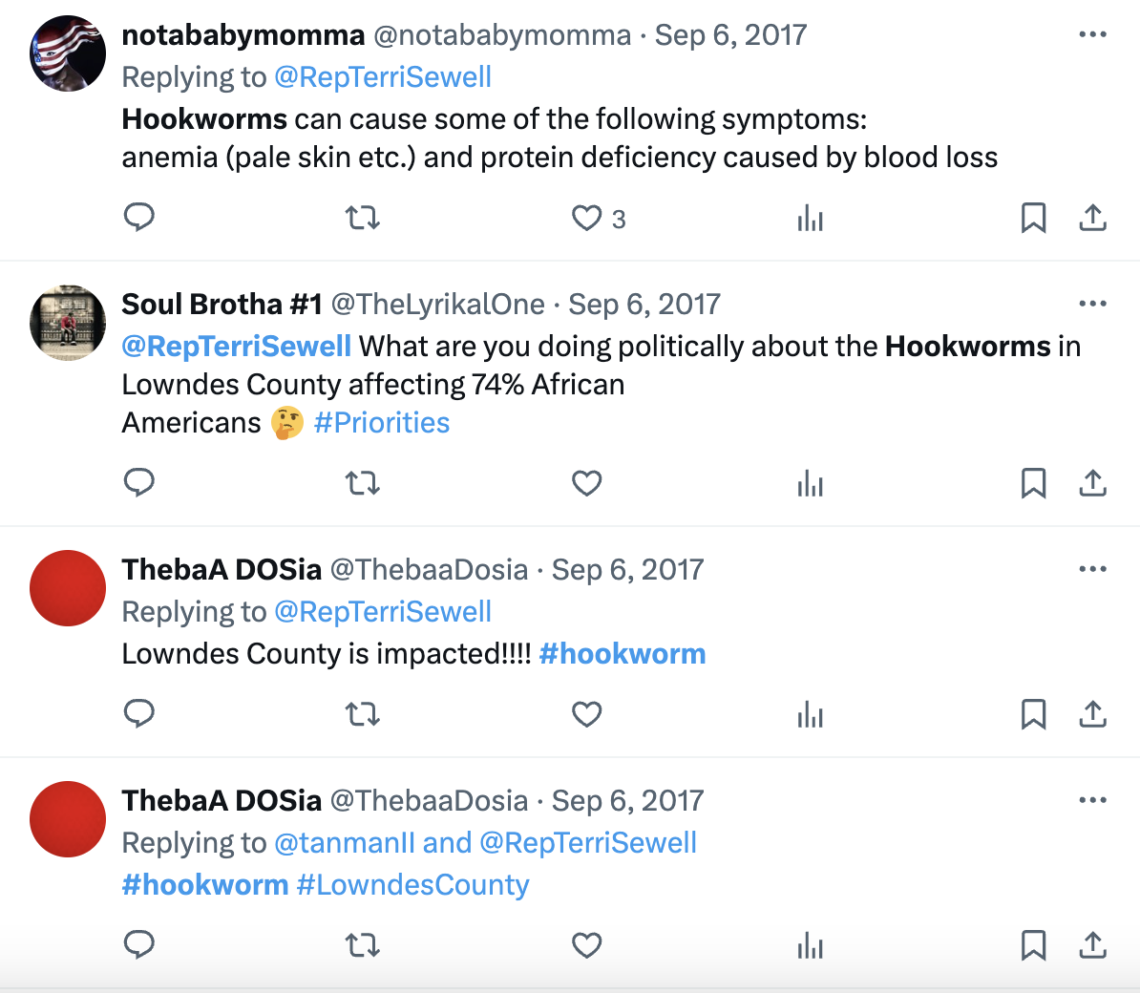

Slide 46
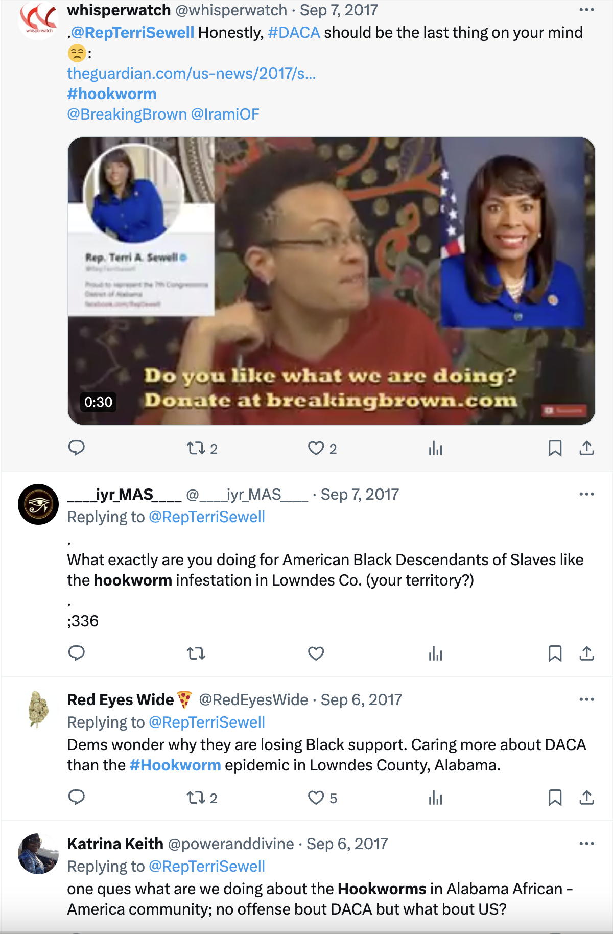

Slide 47
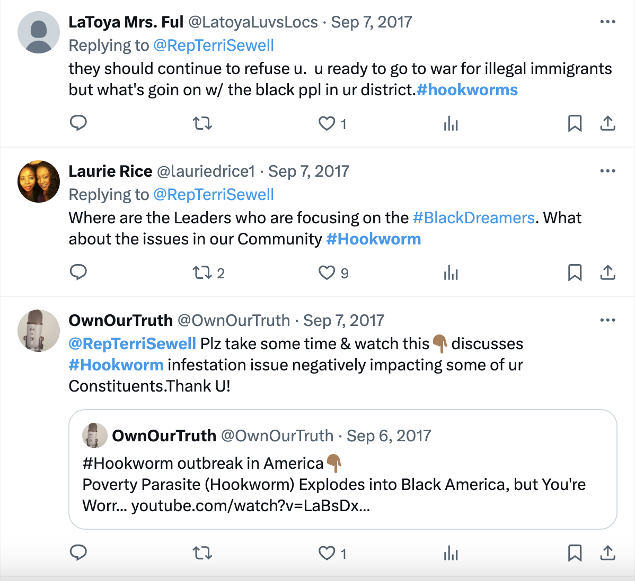

Slide 48
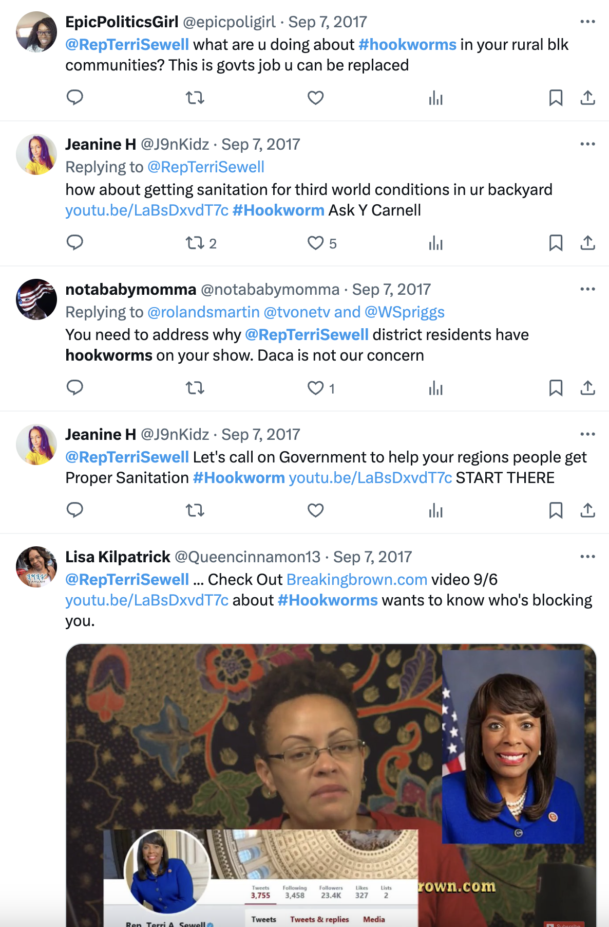

Slide 49
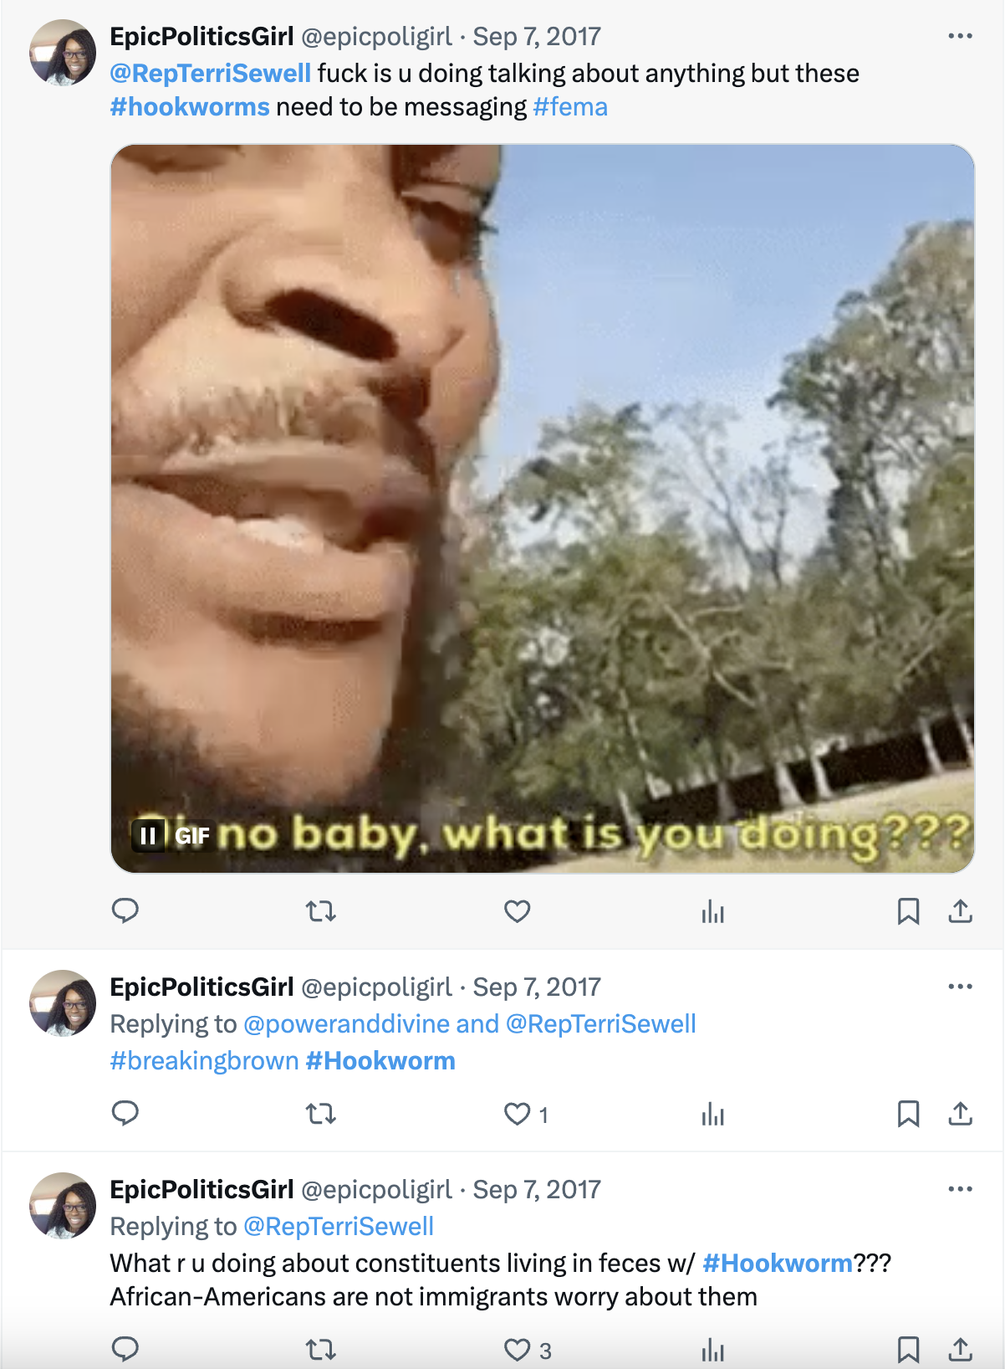

Slide 50
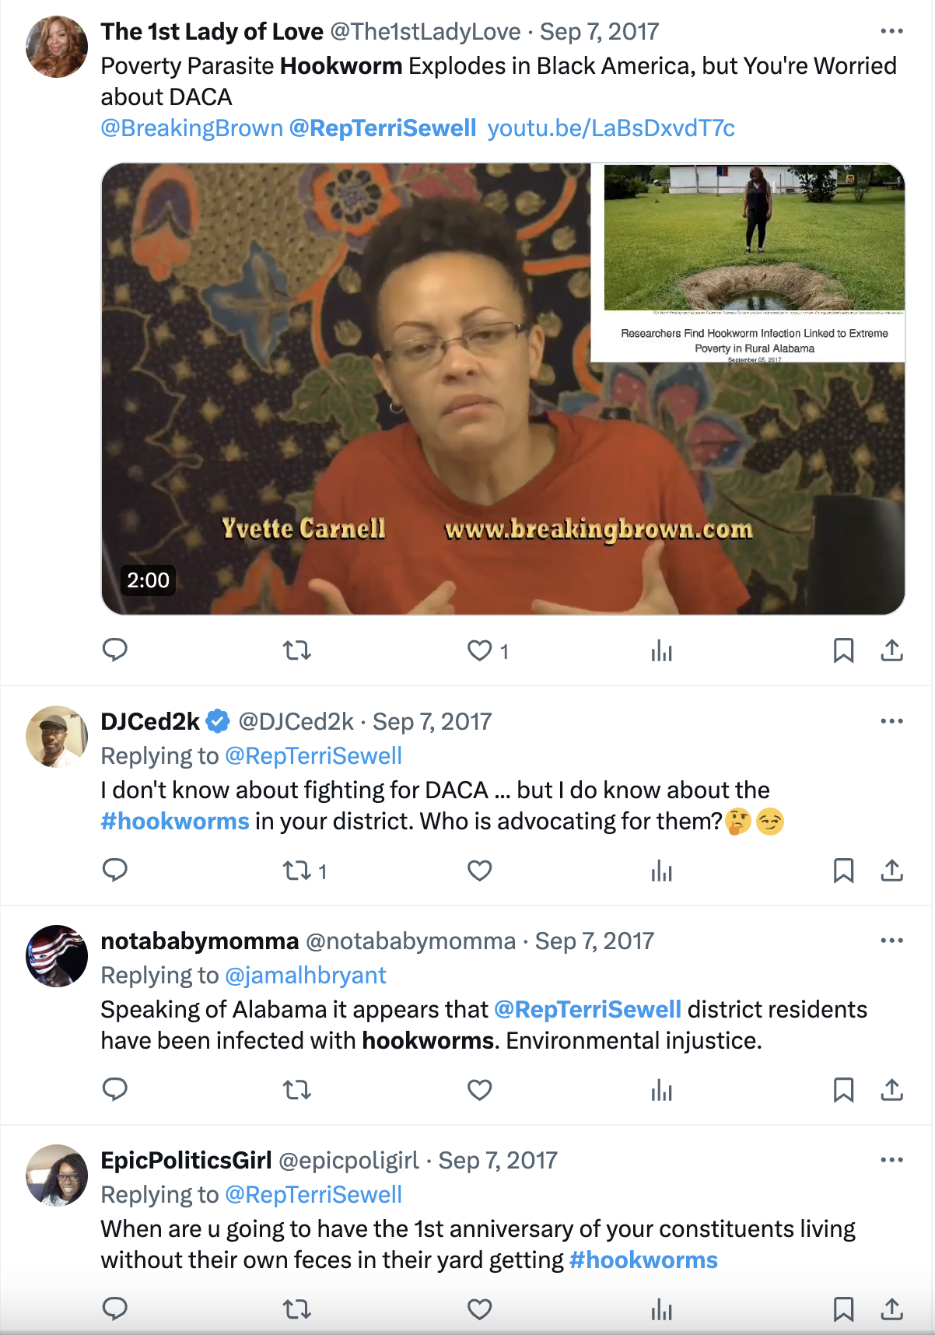

Slide 51
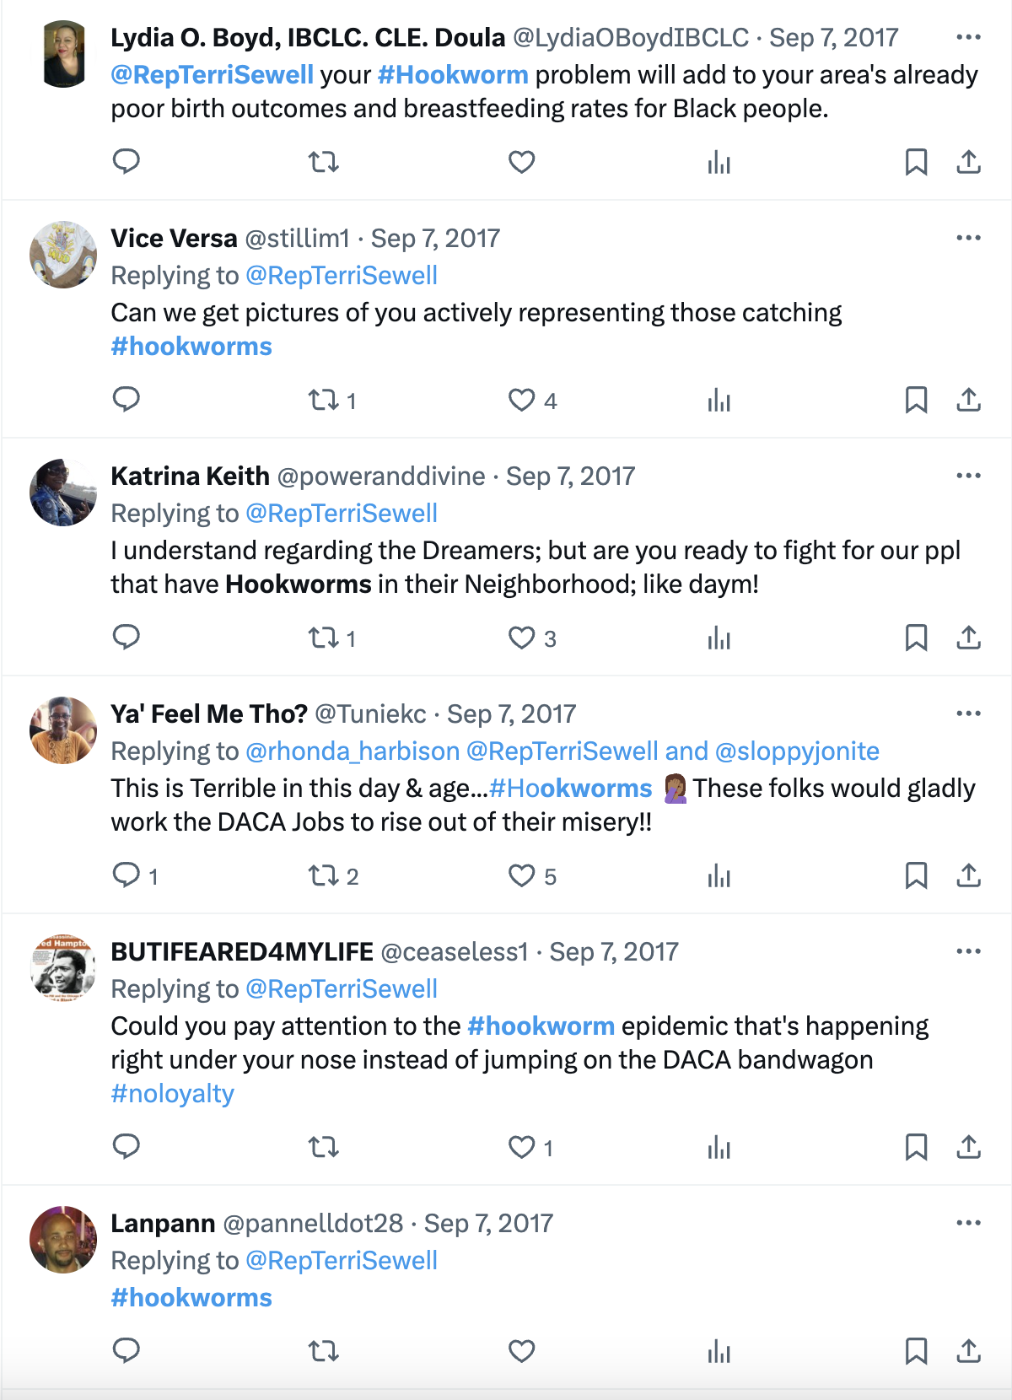

Slide 52
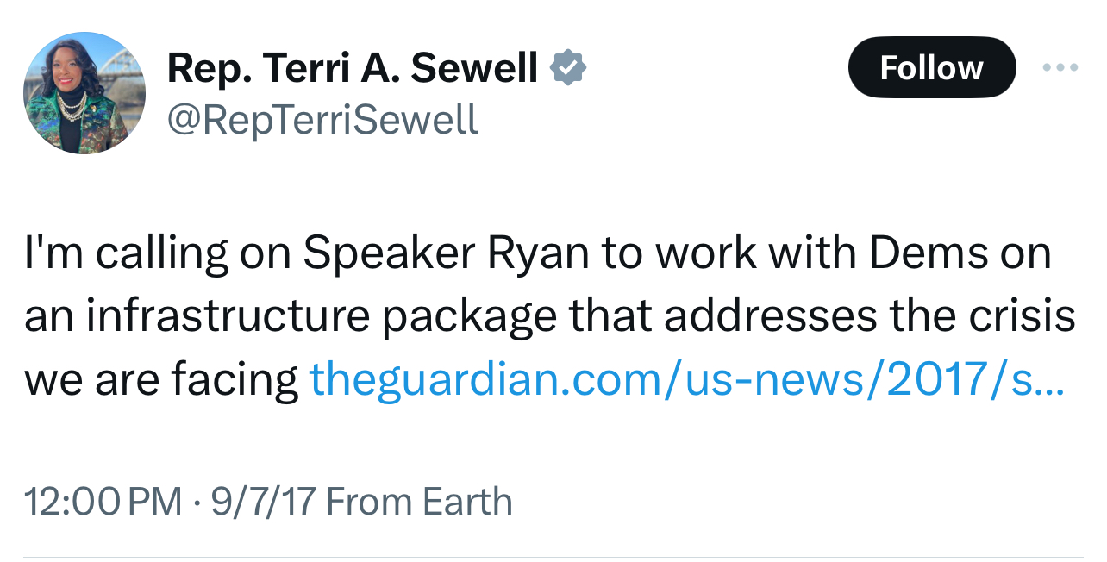

Slide 53
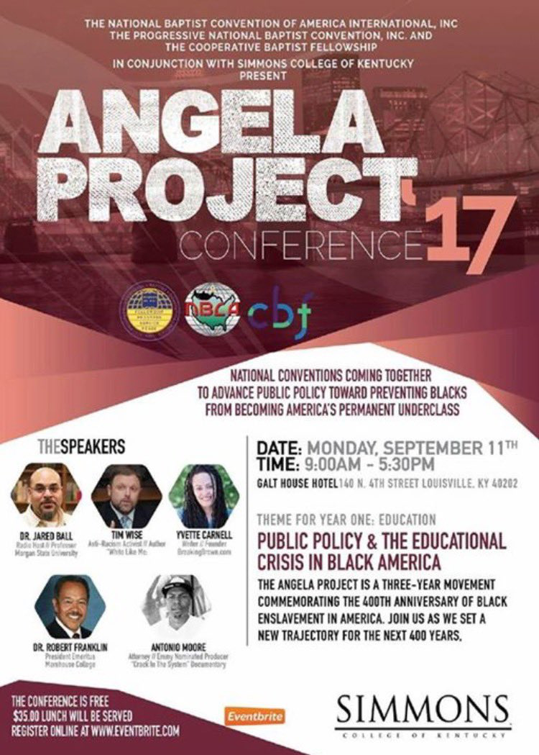
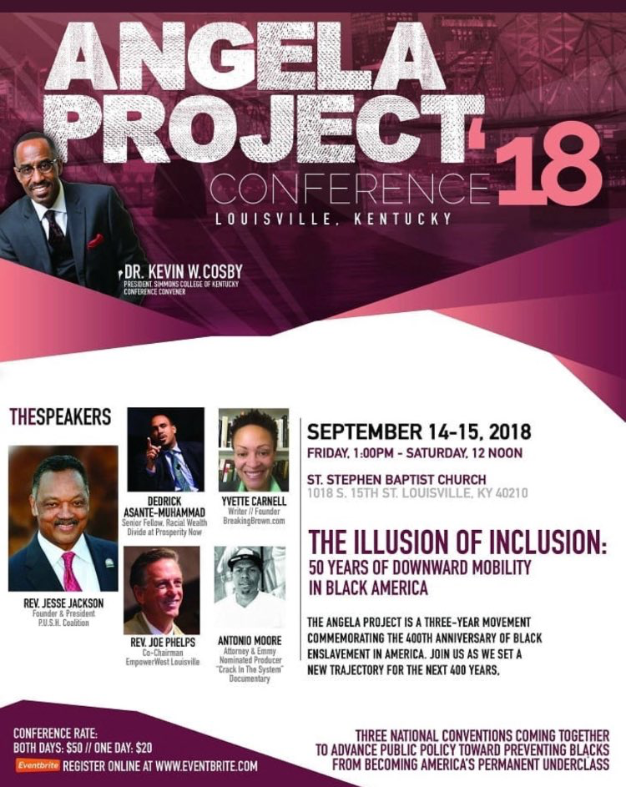
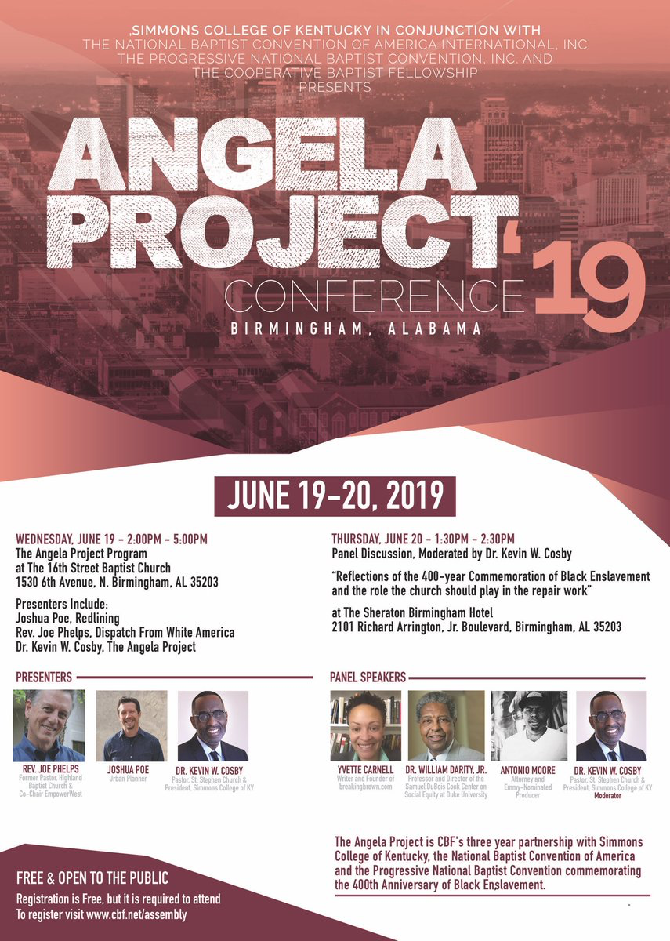
THE ANGELA PROJECT
Do you see a pattern?

Slide 54
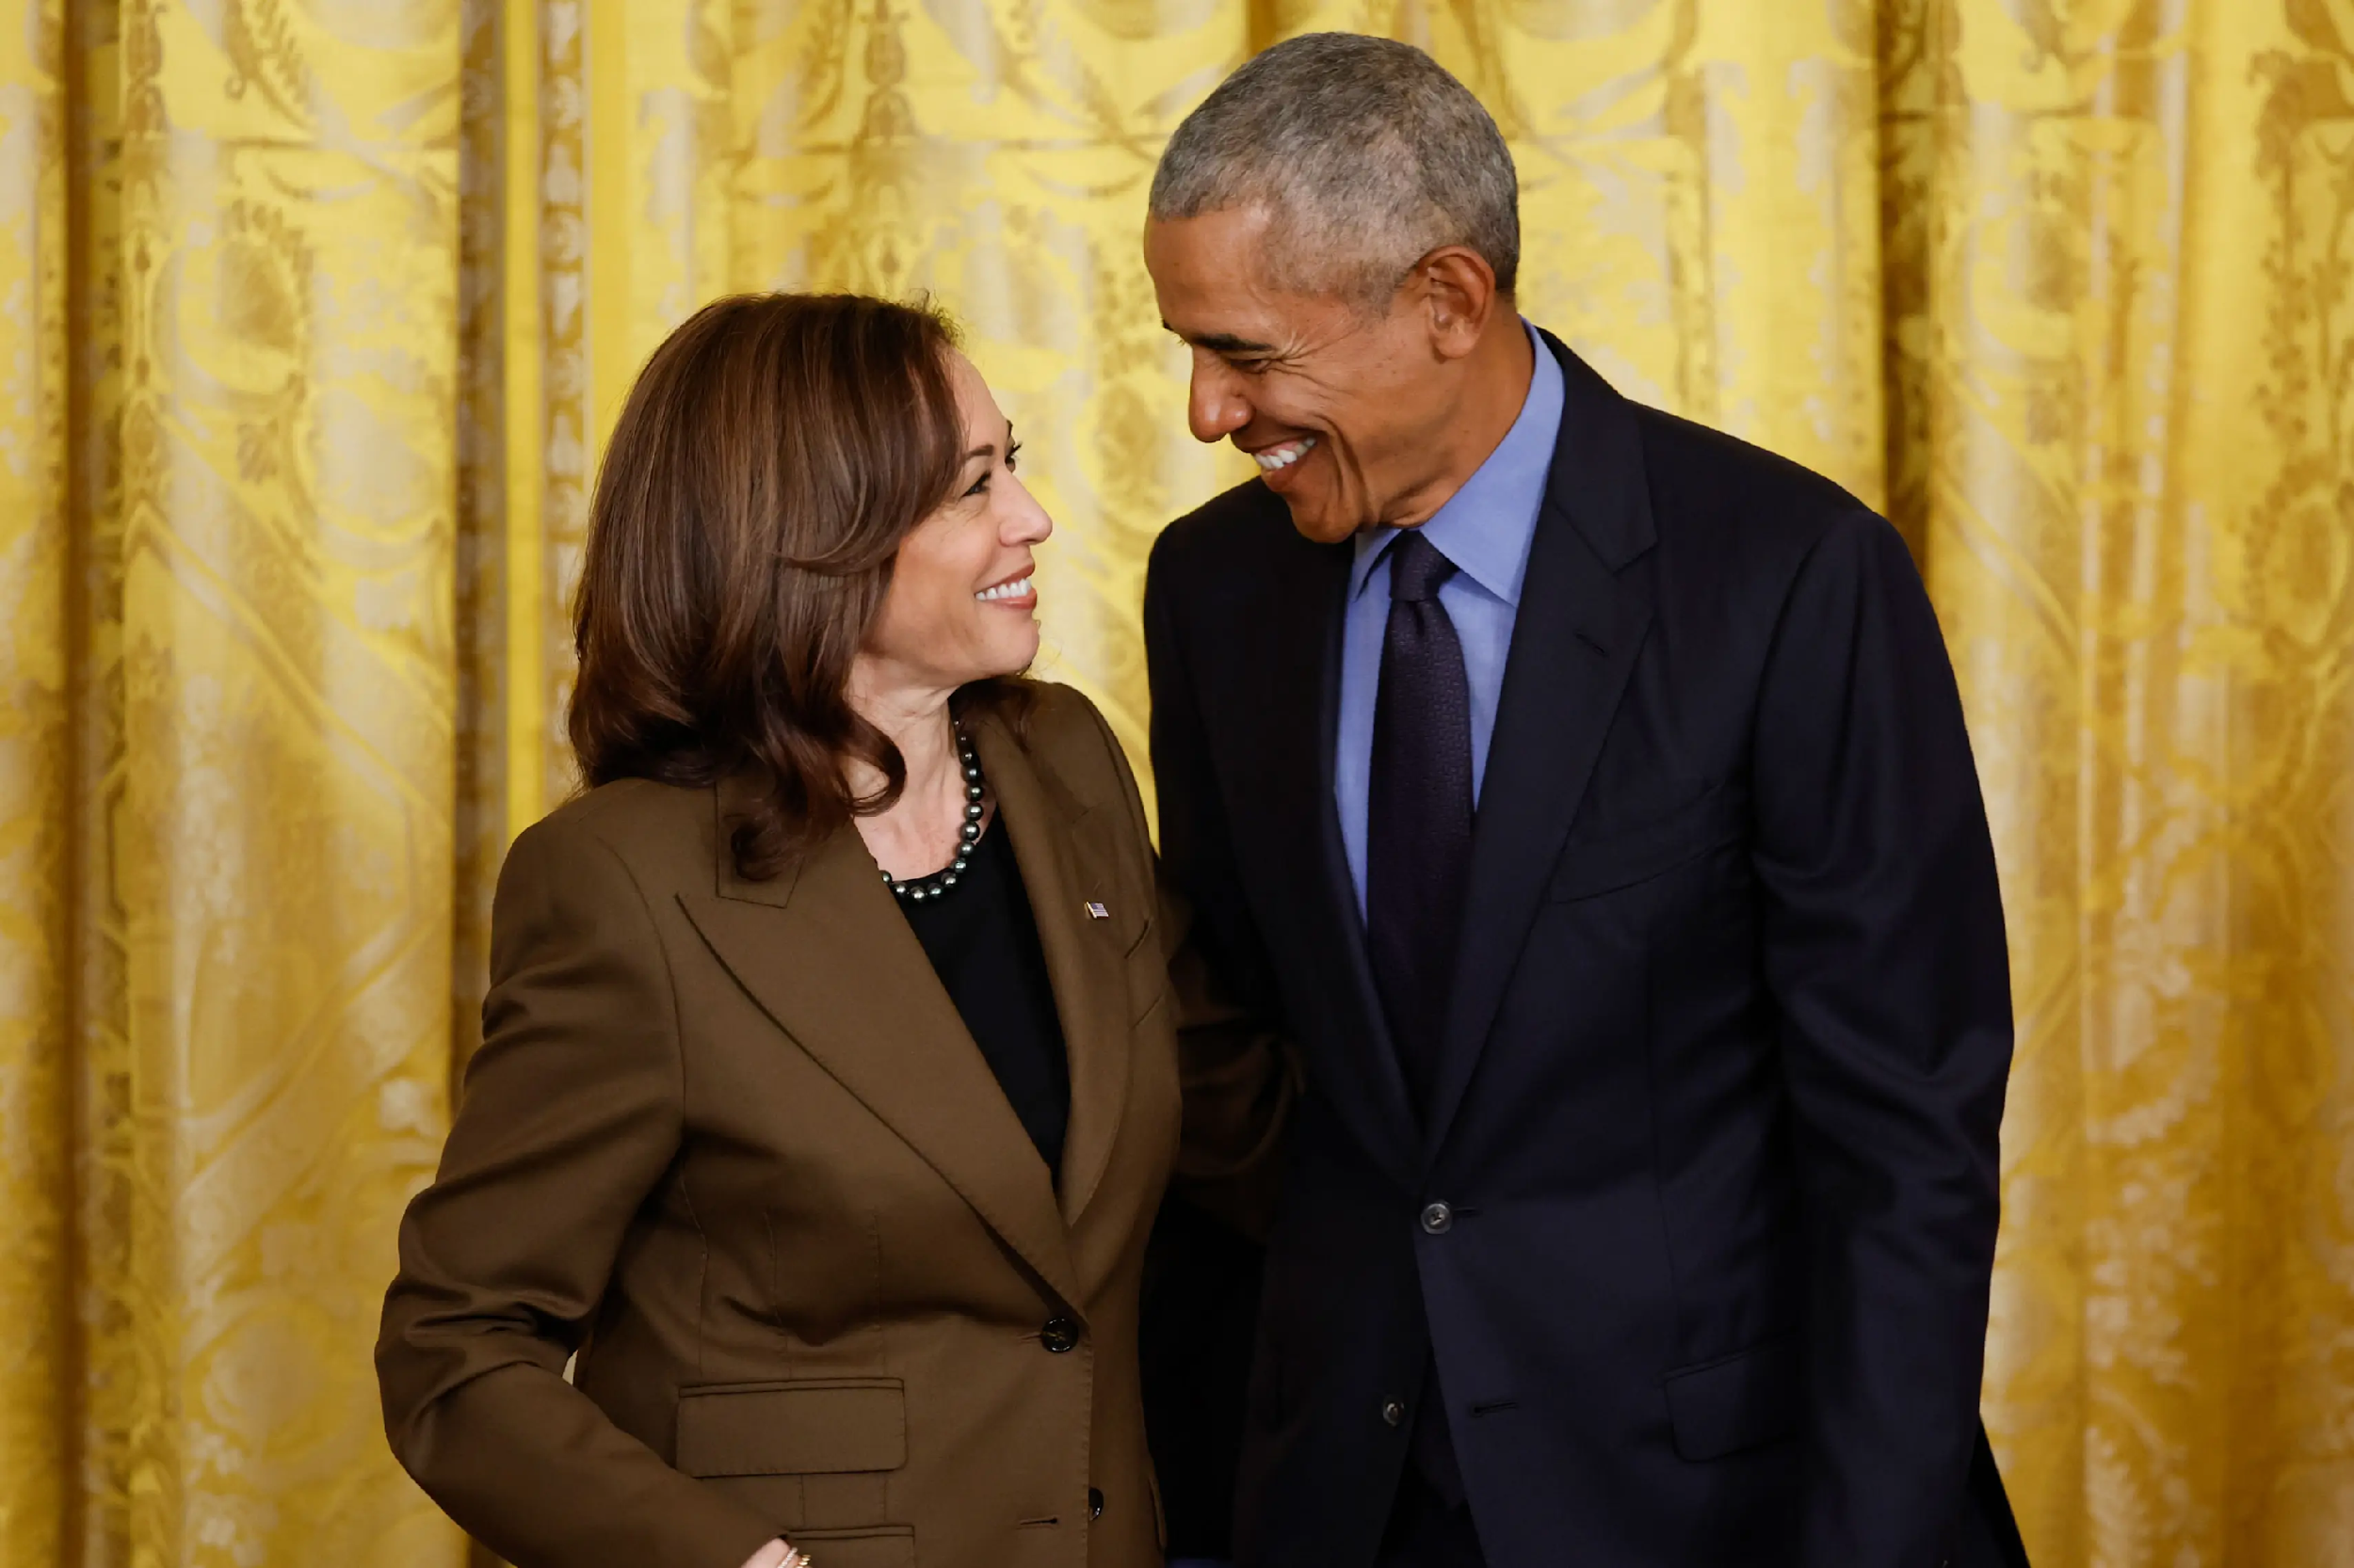

Slide 55
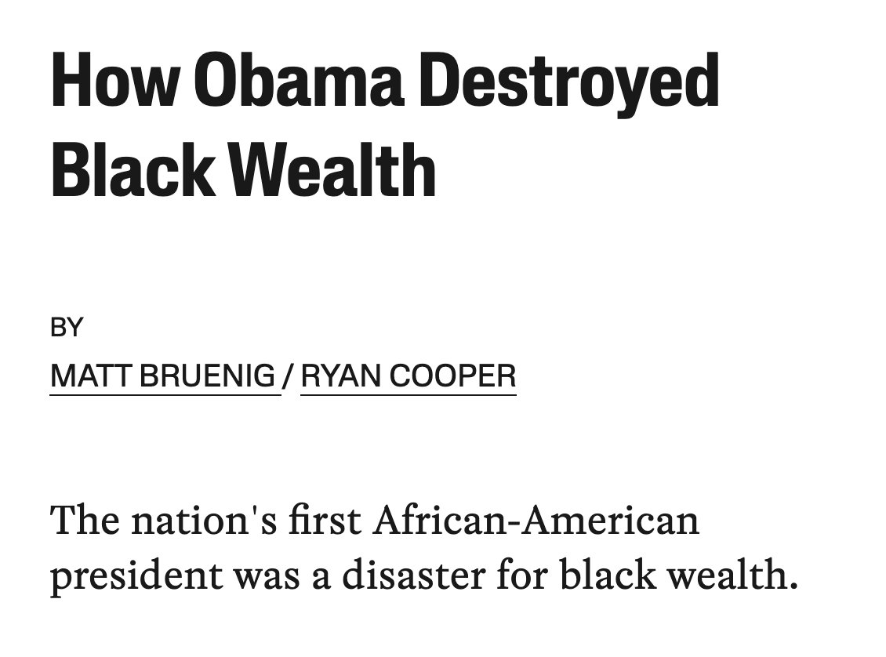
The Obama presidency was a disaster for middle-class wealth in the United States. Between 2007 and 2016, the average wealth of the bottom 99 percent dropped by $4,500. Over the same period, the average wealth of the top 1 percent rose by $4.9 million.
This drop hit the housing wealth of African Americans particularly hard. Outside of home equity, black wealth recovered its 2007 level by 2016. But average black home equity was still $16,700 lower.
Much of this decline, we will argue, can be laid at the feet of President Obama. His housing policies led directly to millions of families losing their homes. What’s more, Obama had the power — money, legislative tools, and legal leverage — to sharply ameliorate the foreclosure crisis.
He chose not to use it. - Jacobin
WEALTH INEQUALITY &POLICY

Slide 56
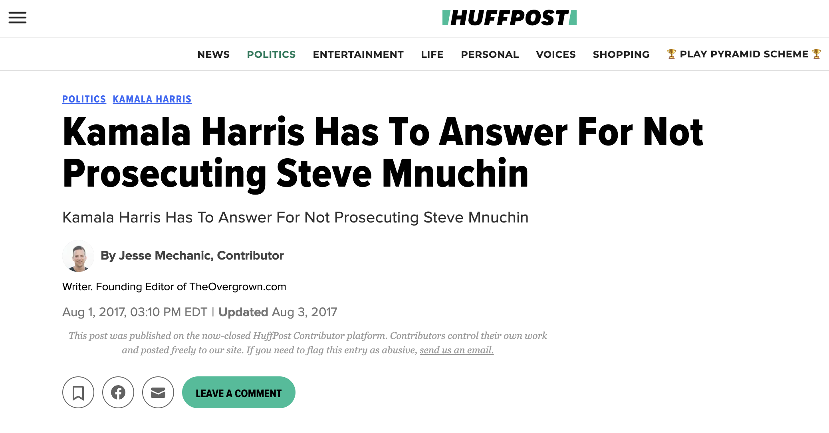
Steve Mnuchin and OneWest Bank were, according to a memo obtained and reported on by The Intercept, guilty of “widespread misconduct” in the form of over 1,000 legal violations. The memo was the result of a year-long investigation and it asserts that OneWest Bank operated to intentionally boost foreclosures. The Campaign for Accountability called for a federal investigation of Mnuchin and OneWest Bank claiming they used “potentially illegal tactics to foreclose on as many as 80,000 California homes.”
Yet despite internal memos explicitly mentioning numerous prosecutable offenses by Mnuchin and co., then California Attorney General Kamala Harris refused to prosecute.
She's never given an explanation for her decision and Mnuchin later donated $2,000.00 to Harris' campaign. It was his only donation to a Democratic candidate.
WEALTH INEQUALITY &POLICY

Slide 57
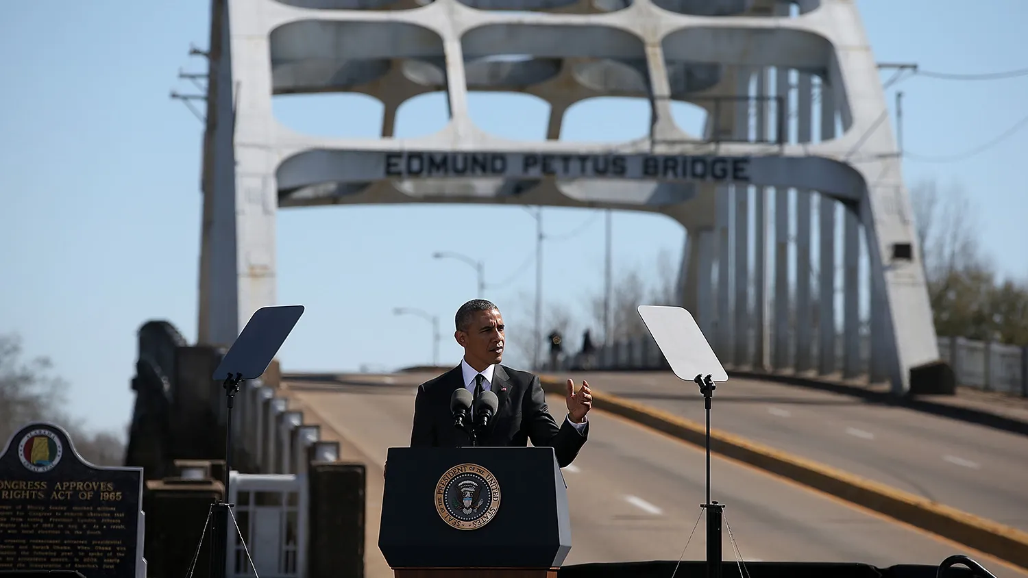
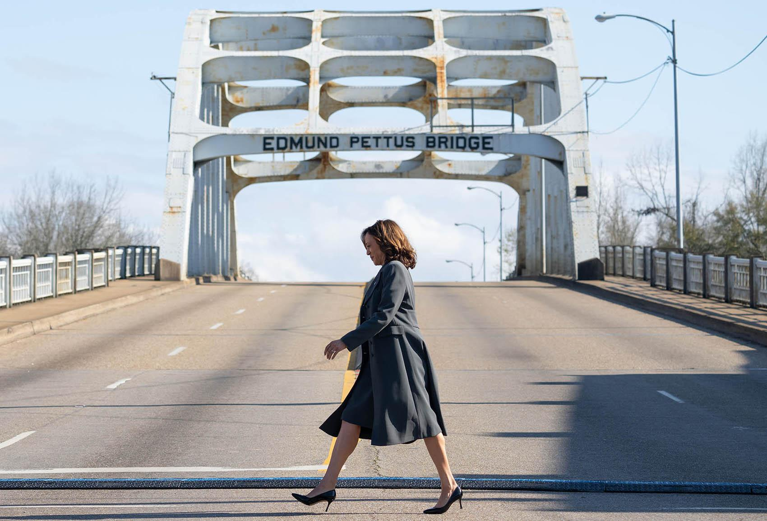
LINEAGE AND IDENTITY

Slide 58
WEALTH INEQUALITY &POLICY

Slide 59
WEALTH INEQUALITY &POLICY

Slide 60
#ADOS
Lineage and Identity in the United States
A political movement for reparations birthed out of and anchored in a unique and specific understanding of:
Wealth inequality
Urgent Need for Targeted Policy

Slide 61
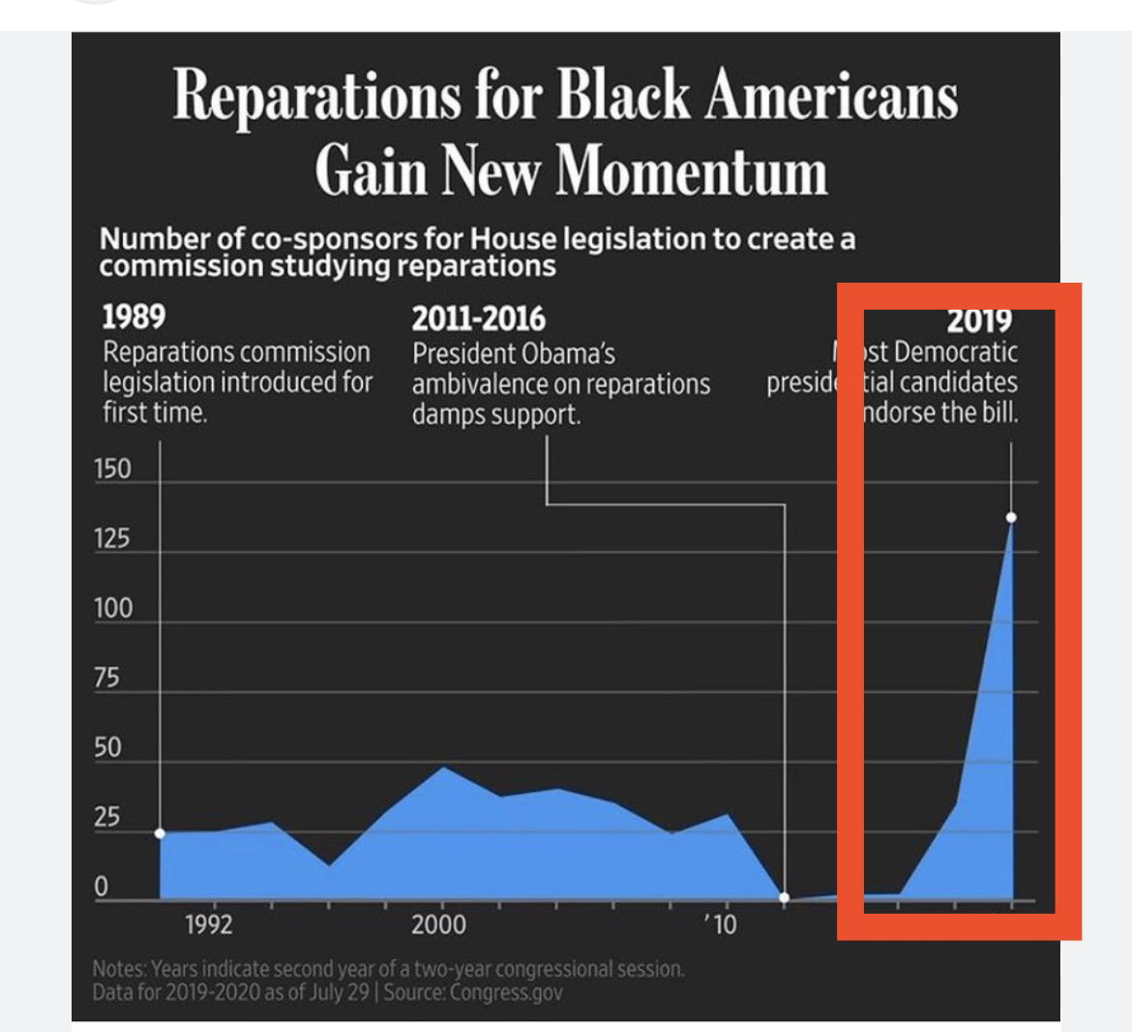
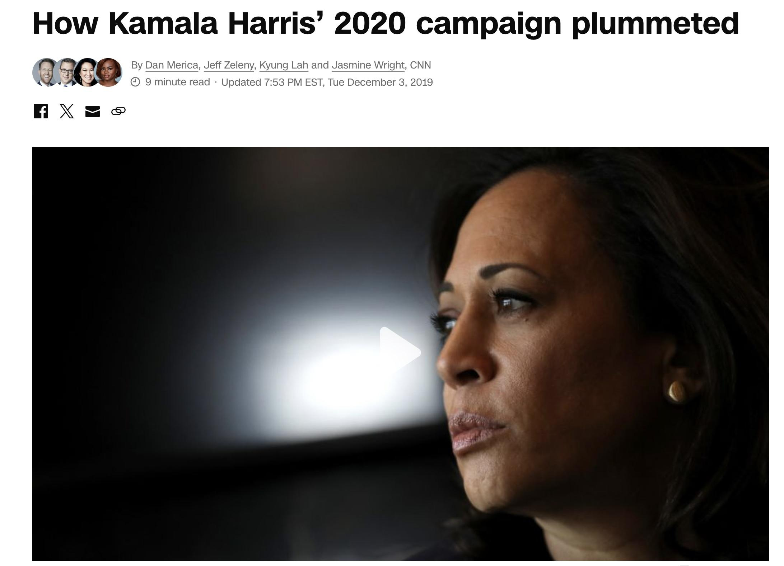

Slide 62
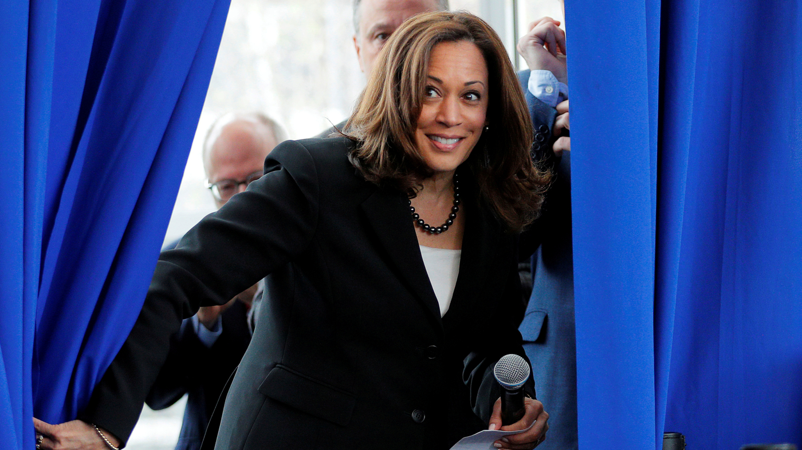

Slide 68
#ADOS

Slide 72
I DON’T WORK FOR YOU

Slide 73
WHAT FORM(S) SHOULD REPARATIONS TAKE?

Slide 74
Slavery Reparations:
Timeline of Policy, Litigation, and Advocacy
(Slavery – Jim Crow)
Brom & Bett v. Ashley | Belinda Sutton | Special Field Order 15 | Freedmen’s Bureau Acts | Thaddeus Stevens | Wood v. Ward | H.R. 1119
1781 | 1783 | 1865 | 1865 &1866 | 1866 | 1878 | 1897

Slide 75
Slavery Reparations:
Timeline of Policy, Litigation, and Advocacy
(Slavery – Jim Crow)
Callie House | Rep. Jeremiah Botkin | Johnson v. McAdoo | Queen Mother Moore | Malcolm X | Black Panther Party | Martin Luther King, Jr.
1897 | 1898 | 1917 | 1957 & 1959 | 1963 | 1966 | 1968

Slide 76
Monetary compensation - referenced 10 times
Land - referenced 5 times
Other - reference 3 times

Slide 77
The ADOS Reparations claim refers to redress for the U.S. government-sanctioned institution of chattel slavery and the failure of the federal government to adequately protect formerly enslaved persons and their descendants. Though many stakeholders such as the Commonwealth of Massachusetts existed in the Trans-Atlantic and domestic slave trades, the federal government was ultimately culpable for allowing the inhumane institution to persist in what is now the United States. As such, the ADOSAF advocates for reparations for the descendants of U.S. chattel slavery to be PAID by the federal government.
While reparations can and does manifest in various forms, for the American Descendants of Slavery, COMPENSTATION is the most symbolically and materially significant aspect of any reparations program. Yes, reparations go beyond a check, but without providing financial compensation to close the racial wealth gap between ADOS families and White families it cannot truly be considered reparations.
In addressing the issue of reparations on the state and local levels, commissions or task forces should have the freedom to illustrate the structure of a comprehensive reparations proposal that could potentially serve as a national model. This remains relevant even in cases where these proposals will likely exceed the current budgetary and legislative capacities of municipal and state governments.

Slide 78
American Descendants of Slavery Advocacy Foundation
Reparations Framework – Phase 1
U.S. Chattel Slavery – the enslavement of persons of African descent and their progeny in the United States of America from 1776 – 1865
The forced labor of the enslaved population for 89 years in the newly formed country
The inability of the enslaved to choose their vocation or prosper from their labor
The inability of the enslaved to patent or prosper from their inventions
Mental, physical, economic, and spiritual abuse
Lack of bodily autonomy: the rampant rape of enslaved women and men; enslaved women forced to nurse their enslavers’ babies
Slave women forced to birth to children conceived without consent – often for the sole purpose of increasing the slave population.
The sale and separation of enslaved families for business purposes

Slide 79
American Descendants of Slavery Advocacy Foundation
Reparations Framework – Phase 1
Forced medical experimentation on enslaved people and their cadavers
As a result of being enslaved, our ancestors were unable to take advantage of the 1862 Homestead Act and subsequent land grant initiatives post-slavery due to discrimination
The failure of the federal government to protect and provide for the freedmen after the Civil War in 1865
The failure of the federal government to keep its promise of 40 acres to ex-slaves
The failure to maintain and sustain the Reconstruction project
Black Codes
Land Theft
Widespread and unchecked lynchings and other violence by white mobs and white supremacist groups (e.g., KKK)
White mobs massacred Negro communities (e.g., Colfax, Wilmington, Leflore, etc.)
Wages, sharecropping, and convict leasing

Slide 80
American Descendants of Slavery Advocacy Foundation
5 Essentials of Repair
Administrative
Financial
Land
Education
Mental Health

Slide 81
Who would be eligible for REPARATIONS?

Slide 82
American Descendants of Slavery Advocacy Foundation

Slide 83
Immigration and Nationality Act of 1965
Refugee Act of 1980
Immigration Act of 1990
70% 1990 or later

Slide 84
Basic Principles and Guidelines on the Right to a Remedy and Reparation for Victims of Gross Violations of International Human Rights Law and Serious Violations of International Humanitarian Law – Section IX. Reparation for harm suffered
Resolution adopted by the General Assembly on December 16, 2005
1. Restitution
2. Compensation
3. Rehabilitation
4. Satisfaction
5. Guarantees of non-repetition

Slide 85
Guarantees of non-repetition

Slide 86
Even though Black immigrants and their progeny who largely arrived in the United States after 1965 would not be the direct beneficiary of reparations in the United States, they would still experience significant ancillary benefits from reparative policies aimed at addressing the legacy of U.S. chattel slavery.
Reparations are designed not only to compensate the American Descendants of Slavery (ADOS) for historical injustices but also to dismantle systemic structures that perpetuate racial inequality. These structures, including discriminatory practices in areas like criminal justice and policing, continue to affect all people of African descent who call the United States home, regardless of their lineage or year of arrival. Therefore, while reparations should aimed at descendants of those directly affected by chattel slavery in America, the resulting systemic changes and reforms will create a more just and equitable society that benefits all Black individuals, including Black immigrants. These ancillary benefits reinforce the broader impact of reparations policies on achieving racial equity and justice.

Slide 87
James Saucer, Jr
December 18, 1937 - February 18, 2018

Slide 88
INSTRUMENT OF TAKING
1996
STATEMENT OF CLAIM
1996
FEBRUARY 2023
140-144 ERIE STREET

Slide 91
Boston Mayor Michelle Wu
Boston Mayor John Bigelow

Slide 92
SPECIAL PANEL
Oral Histories of Urban Renewal

Slide 93
JULY
2023

Slide 94
OCTOBER
2024

Slide 95
$14.01 BILLION DOLLARS

Slide 96
$14.01 BILLION DOLLARS
(over 3X Boston’s Operating Budget)

Slide 97
U.S. CONGRESS

Slide 98
What should our response be?

Slide 100
WWW.JOINADOS.COM

Slide 101
Community Partner
Afrimerican Culture Initiative Inc.

Slide 102
Afrimerican Culture Initiative Inc.
Marlon Solomon

Slide 103
Afrimerican Culture Initiative Inc.
Marlon Solomon

Slide 104
General Public Comments
We will now open the floor and the Zoom chat for questions and comments.
Please keep your comment limited to 2 minutes or less. We will time comments.

Slide 105
Meeting
Update
Second Monday of Month Public Meeting Dates:
May 12th
June 9th
September 8th
October 14th (Second Tuesday)
November 10th
December 8th
Joseph D. Feaster Jr.

Slide 106
Adjournment
Joseph D. Feaster Jr.

