Slide 1
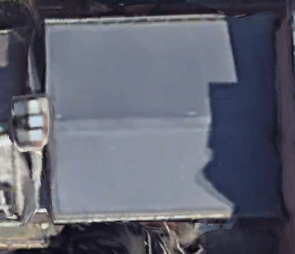
EXISTING CONDITIONS

Slide 2
