Slide 1
Request to Change Paint Color for Front Door from Glossy Red to Matte Black
(Benjamin Moore HC190) to match the newly painted shutters (if approved)
59 River Street, Boston
Townhouse

Slide 2
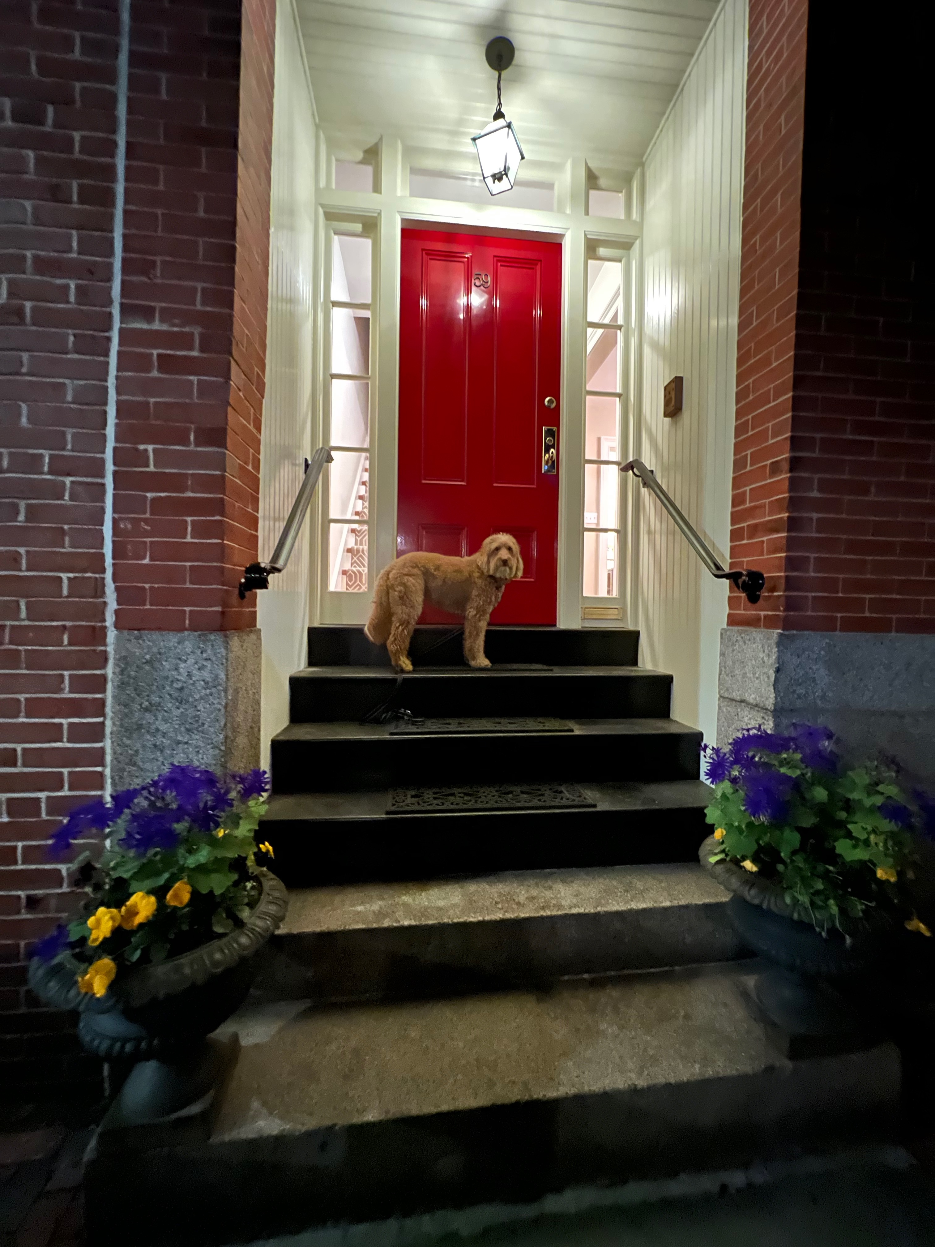
Existing Front of Townhouse
Showing Front Door

