Slide 1

Charting a Strategic Direction for the Future
Board of Health Meeting
July 2018

Slide 2
Alignment across plans
Notes:
Alignment across our major plans at Commission
Community Health Assessment
CHIP
Strategic Plan
Strategic Priorities
Central to each plan and priorities’ work:
Workforce
Commitment to Health Equity
Data informed practices
Culture of Learning & QI
Strategic Leadership

Slide 3
Strategic Plan 2015–2018
Strategic Leadership
Health Equity
Informatics and Surveillance
High Performing Programs
Workforce Development
Strategic Priorities 2016-2018
Treat and prevent substance use disorders
Strengthen Public Health and Healthcare Partnerships
Advance Health Equity

Slide 4
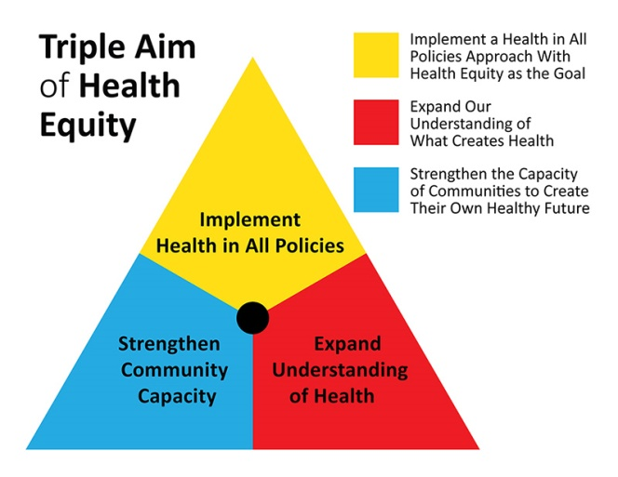
Strategic Priority 1: Advancing Health Equity
Goal 1: Expand understanding and dialogue of what creates health and what creates inequities.
Goal 2: Support comprehensive place-based strategies to improve health.
Goal 3: Strengthen workforce development opportunities for all staff to integrate equity into practice.

Slide 5


STRATEGIC PRIORITY #1:
Advance Health Equity
GOAL | OBJECTIVE | STATUS
1: Expand the understanding and dialogue of what creates health and what creates inequities. | A. Provide a comprehensive approach to knowledge and practice addressing social determinants. | Ongoing
2: Support comprehensive place-based strategies to improve health. | A. Collect quantitative and qualitative information to drive place-based strategies and investments. | Completed
 | B. Expand cross-sectoral partnerships to build and strengthen opportunities | Ongoing
3: Strengthen workforce development opportunities for all staff to integrate equity into practices. | A. Build internal capacity and competency around health equity practices. | Ongoing
Implementation Highlights
Site visits to Rhode Island Department of Health to learn about Health Equity Zones
Active Health Equity Advisory groups
Exploring potential health equity investments from DoN Funds, PILOT
Launched Health Equity in All Policies Task Force with HHS Chief and Chief Resilience Officer

Slide 6

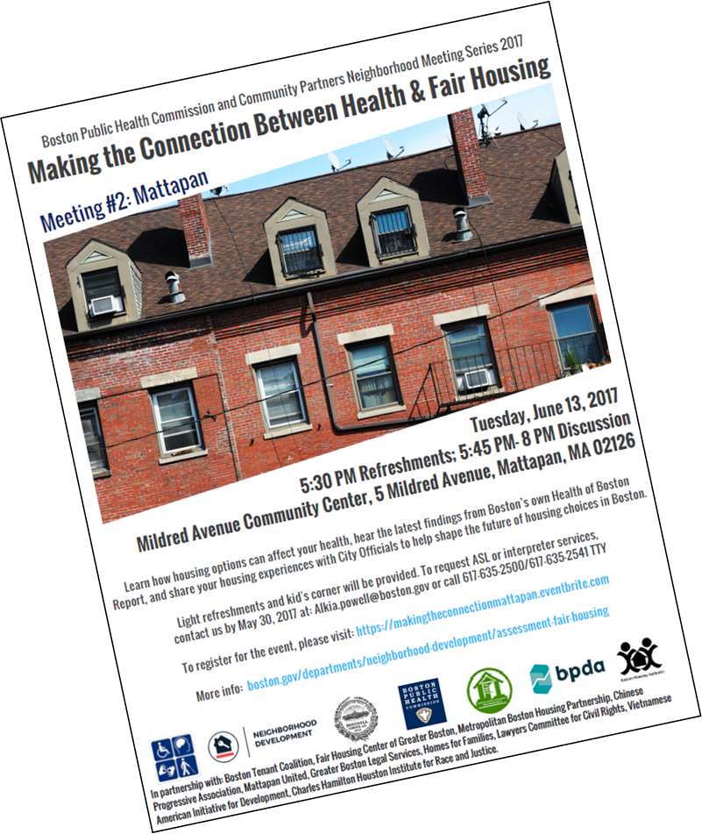

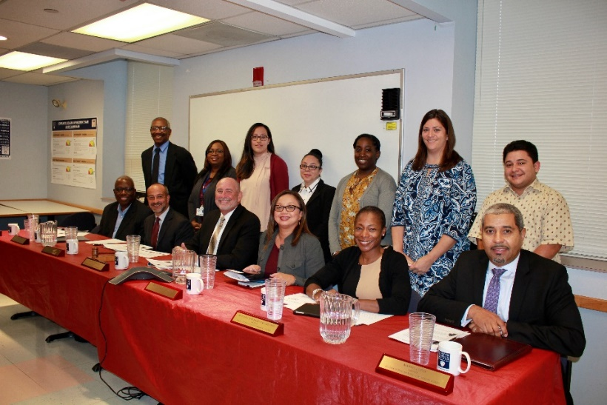
Strategic Priority 1: How are we doing?
Examples:
Community dialogues on impact of housing on health
Health Equity Advisory Committee to inform BPHC initiatives
Kresge Emerging Leaders in Public Health

Slide 7
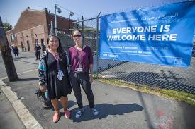
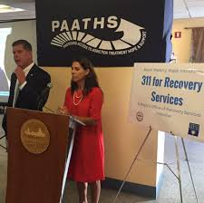
Strategic Priority 1: Advancing Health Equity
Goal 1: Increase awareness about substance use disorders among Boston residents.
Goal 2: Expand BPHC capacity to provide harm reduction services.
Goal 3: Expand BPHC’s role to address disparities in access to the continuum of recovery services.
Goal 4: Expand BPHC’s capacity to engage in substance use prevention.
Goal 5: Improve surveillance efforts to better understand community need and effectively measure impact of programs.
Goal 1: Expand understanding and dialogue of what creates health and what creates inequities.
Goal 2: Support comprehensive place-based strategies to improve health.
Goal 3: Strengthen workforce development opportunities for all staff to integrate equity into practice.
Strategic Priority 2: Treating & Preventing Substance Use Disorders
7

Slide 8
STRATEGIC PRIORITY #2:
Treat and Prevent Substance Use Disorders
GOAL | OBJECTIVE | STATUS
1: Increase awareness about substance use disorders among Boston residents. | A. Identify substance use disorder training opportunities for BPHC employees. | Ongoing
 | B. Build internal capacity to deliver substance use information through program encounters. | Ongoing
 | C. Enhance ability for dialogue with neighborhood groups and residents with questions and concerns about SUD and homelessness issues in their neighborhood. | Ongoing
2: Expand capacity to provide harm reduction services. | A. Deliver overdose prevention trainings across BPHC staff. | Ongoing
 | B. Market overdose prevention training materials. | Completed
 | C. Advocate for pharmacies and health centers to institute syringe take-back policies. | Ongoing
 | D. Develop an engagement center to increase service access for individuals with SUD. | Completed
3: Expand role to address disparities in access to the continuum of recovery services. | A. Create a Boston provider consortium to address disparities in access to the continuum of recovery services. | Ongoing
 | B. Engage BPHC staff working with clients identified as experiencing disparities to provide information on SUD and recovery services. | Ongoing
4: Expand capacity to engage in substance use prevention. | A. Lead the city-wide prevention assessment and planning process. | Completed
 | B. Collaborate internally to increase capacity to provide prevention messaging. | Ongoing
 | C. Collaborate with BCYF centers to increase capacity to provide prevention messaging. | Not Started
5: Improve surveillance | A: Expand and strengthen surveillance related to opioid use and treatment. | Ongoing
Implementation Highlights
Opened Engagement Center and secured $500K in state resources and $1.8M in FY19 City Budget
Co-convened cross sectoral meeting re: opioid overdoses
Convened Data Action Team to improve surveillance
Implemented overdose prevention trainings at new employee orientation and with other departments

Slide 9
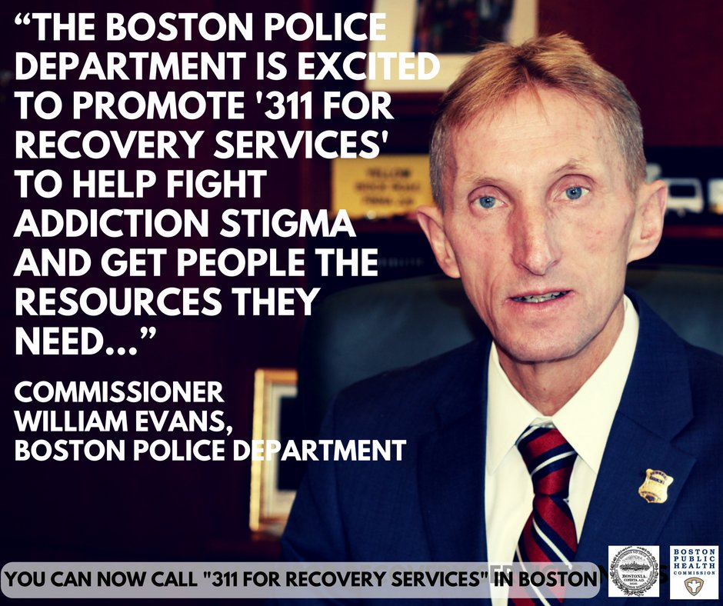
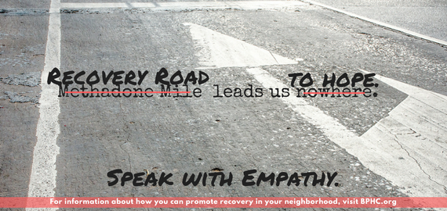
Strategic Priority 2: How are we doing?
Examples:
CareZone Collaborative
311 Paths
Stigma (BPHC/GE Foundation)

Slide 10


Goal 1: Enhance surveillance and data analytics capacity to inform both BPHC and healthcare health improvement goals.
Goal 2: Optimize functioning of Boston’s public health system by providing strategic leadership around citywide policy, planning and communication strategies.
Goal 3: Align BPHC strengths and roles with those of the healthcare sector to address population health needs.
Goal 1: Expand understanding and dialogue of what creates health and what creates inequities.
Goal 2: Support comprehensive place-based strategies to improve health.
Goal 3: Strengthen workforce development opportunities for all staff to integrate equity into practice.
Strategic Priority 1: Advancing Health Equity
Strategic Priority 3: Strengthening Public Health and Health Care Partnerships
10
10

Slide 11
STRATEGIC PRIORITY #3:
Strengthen Public Health and Health Care Partnerships
GOAL | OBJECTIVE | STATUS
1: Enhance surveillance and data analytics capacity to inform both BPHC and healthcare health improvement goals. | A. Collaborate with primary care and hospital sectors on the strategic use and expansion of electronic health surveillance. | Ongoing
 | B. Identify current practices in the collection of SDOH data in public health and healthcare settings. | Ongoing
2: Optimize functioning of Boston’s public health system by providing strategic leadership around citywide policy, planning and communications strategies. | A. Engage in joint PH-HC planning and program development to address population health. | Ongoing
 | B. Engage in joint PH-HC communication activities. | Not Started
3: Align BPHC strengths and roles with those of the healthcare sector to address population health needs. | A. Understand BPHC’s role as a provider of direct care services and the per unit value of BPHC services. | Ongoing
 | B. Increase BPHC’s staff awareness and understanding of new payment models under MassHealth and the ACA. | Ongoing
 | C. Advocate for payment models that reimburse for case management services. | Ongoing
Implementation Highlights
Completed informatics assessment and received CSTE grant; recruiting for 1st Informatics Director
Partnering with COBTH on community health needs assessment and SDoH data
Community Dialogues: 2017 – Impact of Housing on Health; 2018 planned – Youth Engagement
Partnered with Mass211 to roll out HelpSteps statewide
Hosted staff trainings on MassHealth and new payment reform changes

Slide 12


Strategic Priority 3: How are we doing?
Examples:
Re-designed Health of Boston
Integrated Benefits Collaborative
FY19 Investment for $284K

Slide 13
BPHC services/activities and support to ACOs
Core Functions
Community Care Coordination
Care Coordination & Home Visiting e.g. Healthy Baby/Healthy Child, Asthma, TB
Community-Clinical Linkage
Help Steps community resource database
Mayor’s Health Line
PWTF
Expertise in developing and sustaining with CWW’s, cbo’s
Direct Services
Navigation
EMS
Recovery Services
TB Clinic
PAATHS
Education &training of youth workers Youth Development
Community Action Network
CHW training & certification Community Health Education Center(CHEC)
Training and Capacity Building
Community Supported Housing “diversionary services” -HSB
EMS
Coordination of CHAs
Strategic Partnerships
Convener of partnerships
Addressing and measuring SDoH Community Benefits and DoN
Early childhood mental health My Child/Project Launch, Defending Childhood –
Violence Prevention Trauma response Neighborhood Trauma Teams (NTT)
School-Based Health Centers
Population Health Data: Surveillance and data analysis (identify unmet need, disease burden, racial and ethnic inequities
Syndromic Surveillance
Regulatory and policy development
Addressing Health Equity, SDoH, and PSE change

Slide 14
Where do we go from here?
Develop a new strategic plan that reflects Mayor’s vision.
Align with process for updating CHIP and HOB.
Create stream-lined process that engages: staff, Board, Mayor’s Office, HHS, and community partners.
Develop clear strategies, goals, and objectives.
Develop implementation plan that clearly identifies owners for executing activities.

Slide 15
Discussion questions
How can we position BPHC to continue to be a leading health department?
Are there emerging public health trends that we should address?
Diseases of despair: suicide, chronic substance use, and overdoses.
Opioids: stigma and syndromic surveillance
Disease elimination: AIDS, HCV, and HPV
Global health security: pandemic flu, AMR, outbreaks
How does the Board want to be engaged?

Slide 16
Appendix

Slide 17
PRIORITY FOCUS AREA #1:
Q2
2018
STRATEGIC PLAN 2015 – 2018 DASHBOARD
Strategic Leadership
PRIORITY FOCUS AREA #2:
Health Equity
AIM:
Develop and promote strategic leadership at all levels of the organization to advance public health.
AIM:
Build citywide capacity to effectively address racial and ethnic
health inequities.
GOAL 1:
Public health leadership results in improved health of City of Boston residents through equity-based policies and interventions.
GOAL 1:
Strong community and government partnerships support city-wide health equity efforts.
Boston’s leaders and residents value and understand core public health functions and the city’s role in ensuring and providing the ten essential public health services.
Examples:
Completed revisions to communications plan
GOAL 2:
BPHC’s programs, practices, and organizational policies are aligned with racial justice and health equity principles.
Examples:
Established Community Engagement partner database
GOAL 2:
PRIORITY FOCUS AREA #5:
Workforce Development
AIM:
Assure a diverse, qualified and prepared workforce that can monitor and respond to the current and
future public health needs of Boston’s residents.
GOAL 1:
BPHC’s workforce is trained to effectively monitor and respond to the
current and future public health needs of Boston’s residents.
BPHC’s procedures support recruitment, retention and advancement of a qualified and prepared workforce that is reflective of the community we serve.
Examples:
Developed New Hire promotion and retention proposals
GOAL 2:
PRIORITY FOCUS AREA #3:
Informatics & Surveillance
PRIORITY FOCUS AREA #4:
High-Performing Public Health Programs
AIM:
Support the use of data in priority setting and decision making at every level of the public health
system in Boston by assuring that policy makers, health leaders and the general public have access
to information on issues that affect population health.
AIM:
Ensure effective programs that make measurable progress towards the vision of a thriving Boston where all
residents have equitable access to resources and opportunities to achieve optimal health and well-being.
GOAL 1:
Boston residents and policy makers can access information they need to support programs and policies affecting the health of Boston residents.
GOAL 1:
Increase BPHC capacity to achieve health and health equity performance stan­dards:
Develop and implement BPHC Performance Management System
Receive PHAB accreditation to promote a culture of organizational learning and continuous improvement.
GOAL 2:
BPHC programs and policies are shaped by data reflecting needs of residents and are rigorously evaluated to assure quality and efficacy.
Examples:
Ongoing CTSE training
Updated data collection and management protocols
Examples:
Received accreditation November 2017
Demonstrated improvement in culture of quality
GOAL 3:
BPHC optimally uses technology to report on health status, risks and resources, informing residents and policy makers on health concerns.
For more information, please visit AQI’s Intranet page
Notes:
Dashboard Legend
Green – Completed/On Schedule
Yellow – In Progress/Slightly behind schedule
Red – Not Started/Significantly behind schedule

Slide 18
Strategic Plan #1: Strategic Leadership
GOAL | OBJECTIVE | STATUS
1: Public Health Leadership through equity-based policies and interventions | A. Implement at least two city-wide initiatives that increase capacity and knowledge of public health functions and programs among policymakers and stake-holders. | Completed
2: Boston leaders and residents value and understand core public health functions and the city’s role in ensuring and providing the ten essential public health services | A. Develop a plan to engage the community in decision making about BPHC services, aligned with racial justice and health equity principles. | Completed
 | B. Develop and implement a Commission-wide communication plan (inclusive of a risk communication plan) for BPHC’s key audiences; staff, stakeholders and the general public. | Completed
Implementation Highlights
The Community Engagement Plan has been highlighted as a best practice
The Communication Plan approved and revised to include equity considerations
Launched HEiAP taskforce to engage city policy makers
Community Health Improvement Plan annual convenings has been an opportunity to engage policy makers and stakeholders

Slide 19
Strategic Plan #2: Advancing Health Equity
GOAL | OBJECTIVE | STATUS
1. Strong community and government partnerships support city-wide health equity efforts. | A. Assess the capacity of partnering community organizations and coalitions in underserved Boston communities. | Completed
 | B. Identify and/or develop and implement training opportunities for 25 partnering community organizations and coalitions to address needs identified by assessment. | Ongoing
2. Strengthen workforce development opportunities for all staff to integrate equity into practices. | A. 75% of BPHC staff will participate in opportunities to apply a racial justice and health equity framework to their work. | Ongoing
Implementation Highlights
Community coalition assessment to identify opportunities for health equity integration
Completed inventory of community health equity training
Develop a new CHIP website to promote available health equity resources
Ongoing re-alignment of internal work to identify opportunities to identify further equity integration opportunities.
Notes:
1B. 14 out of 25 partner organization have been identified through the CHIP process

Slide 20
Strategic Plan #3: Informatics and Surveillance
GOAL | OBJECTIVE | STATUS
1: Increase access to information to support informed decision making on programs and policies. | A. Implement standard data collection and management protocols for program data. | Ongoing
2. Programs and policies are shaped by data reflecting the health needs of Boston residents and are rigorously monitored and evaluated to assure quality and efficacy. | A. Implement standards for regular program data review by programs, division and bureau. | Ongoing
 | B. Complete the business requirements and implement the infrastructure that will support the development of enterprise level systems. | Ongoing
3: Programs optimal use of technology, informatics and analytic techniques, to measure and report on health status, health risks and health resources. | A. Ensure there are at least two staff members skilled in informatics in every bureau. | Completed
Implementation Highlights
Informatics capacity and assessment completed
Training and capacity building for informatics staff completed
CTSE grant to improve internal informatics capacity and staff training
Active partnership to develop informatics competency assessment
New Director of Informatics position created
Notes:
1A, 2A and 2B draft policies created, to be finalized with new Informatics Director

Slide 21
STRATEGIC PLAN #4:
High Performing Public Health Programs
GOAL | OBJECTIVE | STATUS
1: Increase BPHC capacity to achieve health and health equity performance standards | A. Develop and implement BPHCs Performance Management System that can drive improvement in health outcomes and health equity. | Completed
2: Support comprehensive place-based strategies to improve health | B. Promote a work culture that values organizational learning, focuses on effective processes and empowers staff to continuously improve the quality of programs | Completed
 | C. Achieve Public Health Accreditation Board (PHAB) local health department accreditation | Completed
Implementation Highlights
Revised and approved Performance Management System
Created quarterly dashboards for CHIP and Strategic Plan/Priorities
Introduced 76% of staff to quality improvement
Improved culture of QI by 12% in the last two years
Revised QI trainings to integrate health equity and design thinking principles
Successful PHAB Accreditation (second local health department in Massachusetts)
Notes:
PHAB will require annual workplan to ensure compliance with standards and new research based practices
Revised QI trainings to incorporate health equity applications

Slide 22
Strategic Plan #5: Workforce Development
GOAL | OBJECTIVE | STATUS
1: Workforce is trained to effectively monitor and respond to the current and future public health needs of Boston’s residents. | A. Develop a competency-based workforce development plan that increases program effectiveness and supports the training needs of and career pathways for employees. | Completed
2: Policies and procedures support the recruitment, retention and advancement of a qualified and prepared workforce that is reflective of the community we serve. | A. Pilot at least one policy and/or procedure that increase access for staff from across the BPHC to training opportunities, with particular focus on lowest wage workers. | Completed
 | B. Assess the implementation and impact of policies adopted to promote racial justice, health equity and quality improvement in hiring, promotion, and retention. | Completed
 | C. Develop at least three recommendations on organizational policies, practices, structures and systems that promote racial justice and health equity and ensure quality improvement in hiring, promotion, and retention. | Completed
 | D. Implement at least two policies or practices that support the BPHC’s ability to measure and improve the retention of diverse and qualified employees. | Ongoing
Implementation Highlights
Workforce Development Plan developed and currently being revised
Completed training pilot for low wage staff at the Homeless Service Bureau
Evaluation of adopted equity-based hiring policies completed
ARAC proposed new hiring and retention recommendations to Senior Leadership Team
Notes:
Workforce Development Plan which was approved in March 2017 but is currently being revised to include new workforce development competencies as part of the feedback from PHAB

