Slide 1
Suffolk University 1 Court Street Signage Dept. of Environment, Boston Landmarks Commission Hearing January 28, 2020

Slide 2
Agenda
1 Court Street Project Description
Proposed Design Scheme
Existing Conditions
Local Precedents

Slide 3
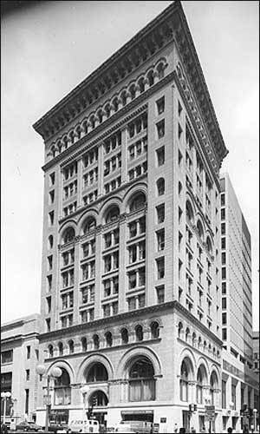
1 Court Street Project
The University purchased the Ames Building in September 2019
Ames Hotel: 114 key boutique-style hotel, ground floor retail space
Planned conversion to up to 300-bed student dormitory
Student space and publicly-accessible retail planned for ground floor

Slide 4
1 Court Street Project
Exterior signage scheme needed to communicate building’s role on campus
4 flags along Court Street façade
Replacement lettering on main entry canopy
Replacement of awning fabric on Washington Mall
Vinyl graphics on existing glass rail along Washington Mall

Slide 5
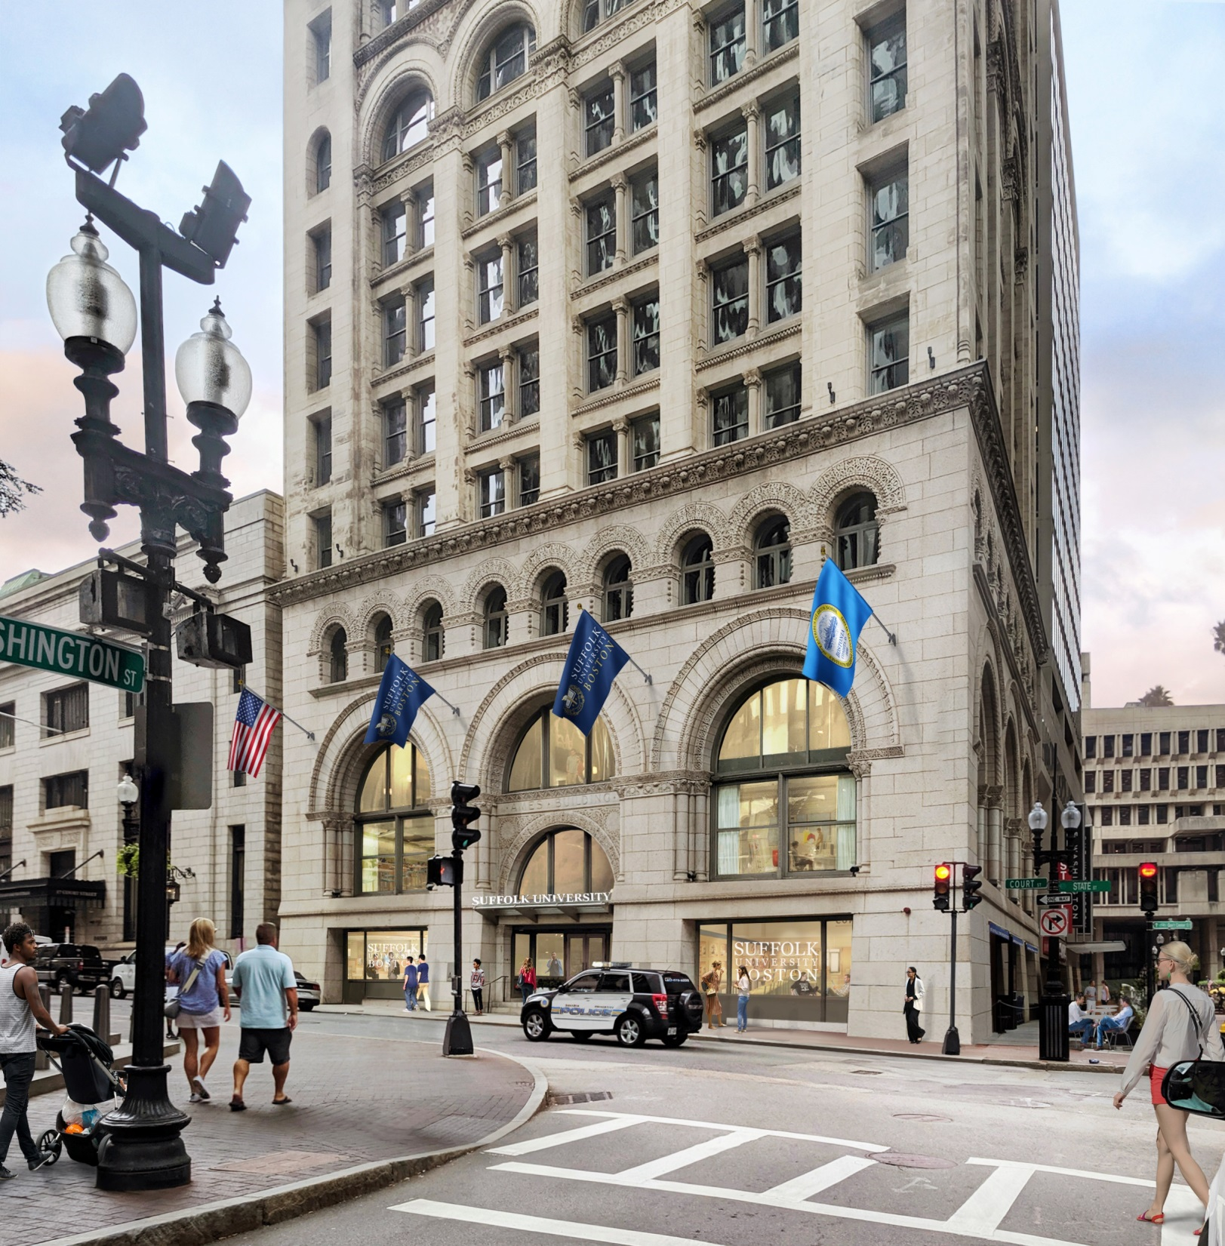
Proposed Design Scheme
Court Street Frontage
Looking north from Washington Street

Slide 6
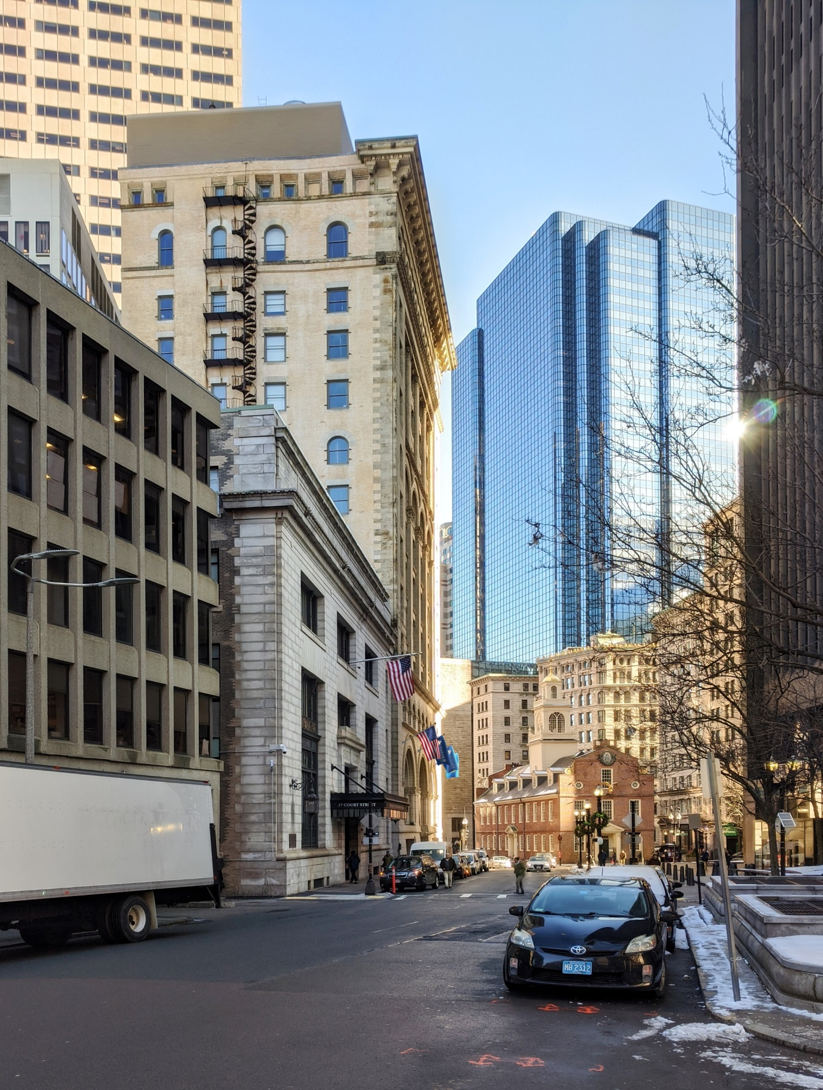
Proposed Design Scheme
Court Street Frontage
Looking southeast from Court Square

Slide 7
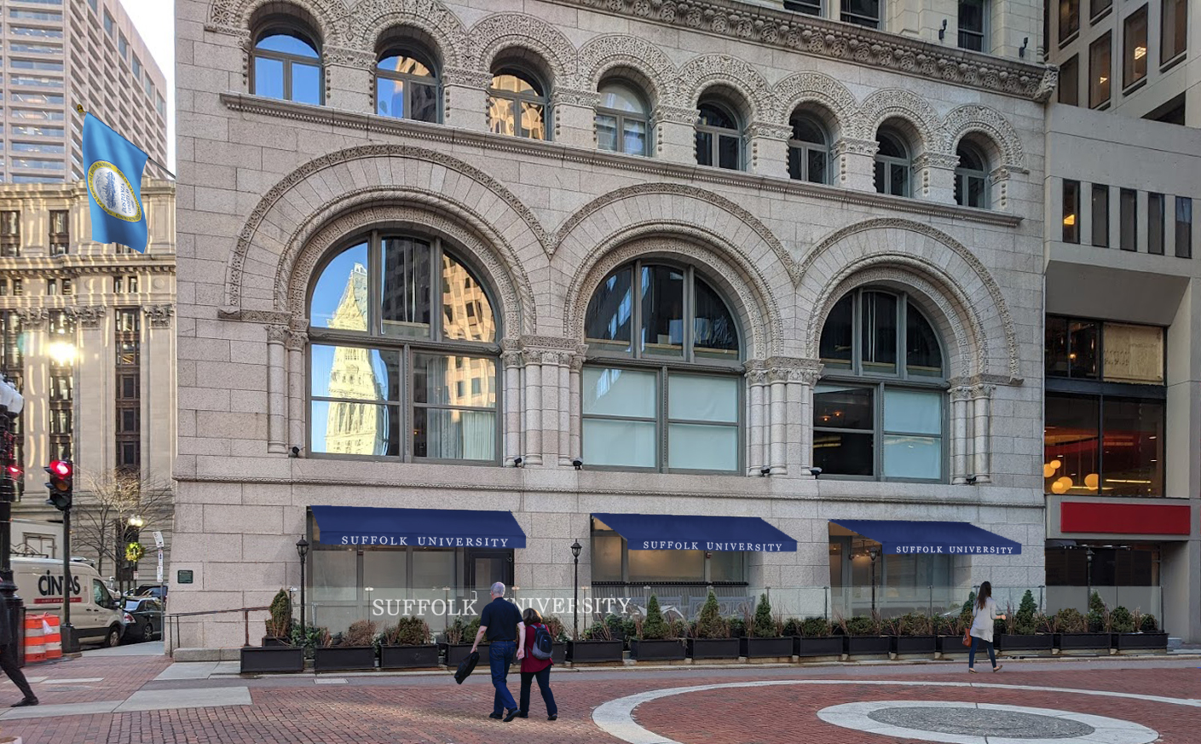
Proposed Design Scheme
Washington Mall Frontage

Slide 8
Proposed Design Scheme

Slide 9
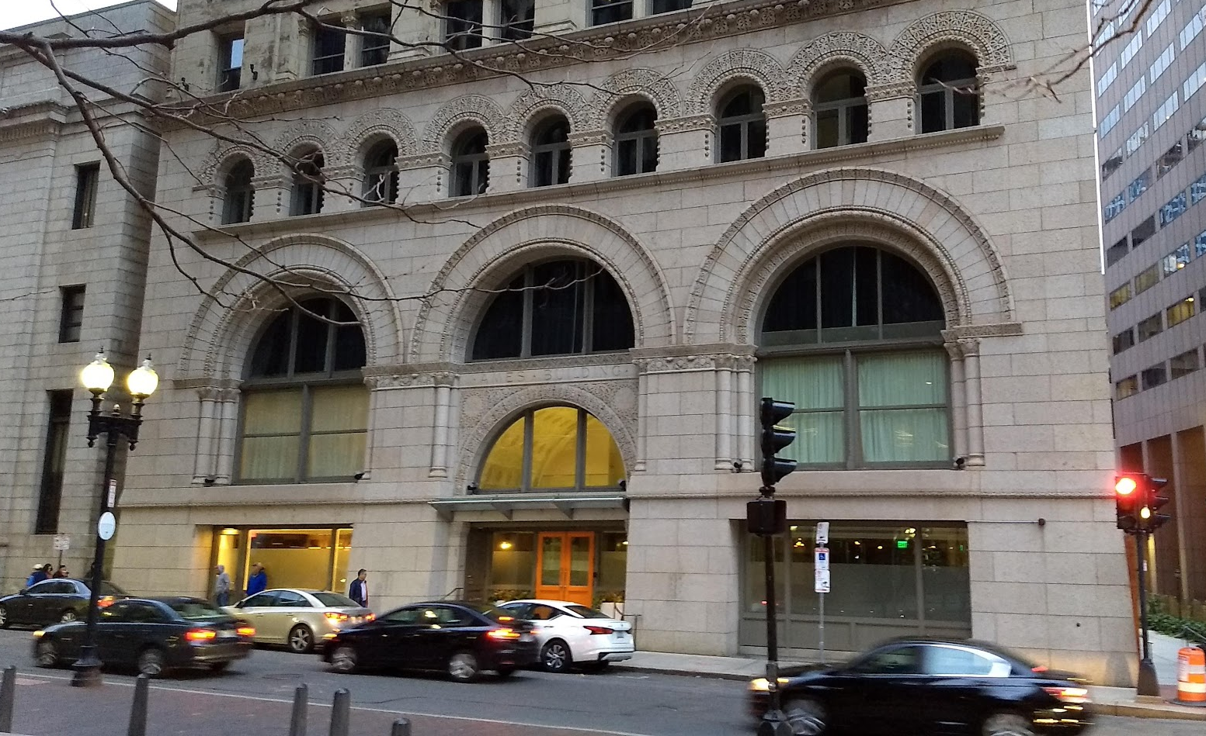
Existing Conditions as of November 2019

Slide 10
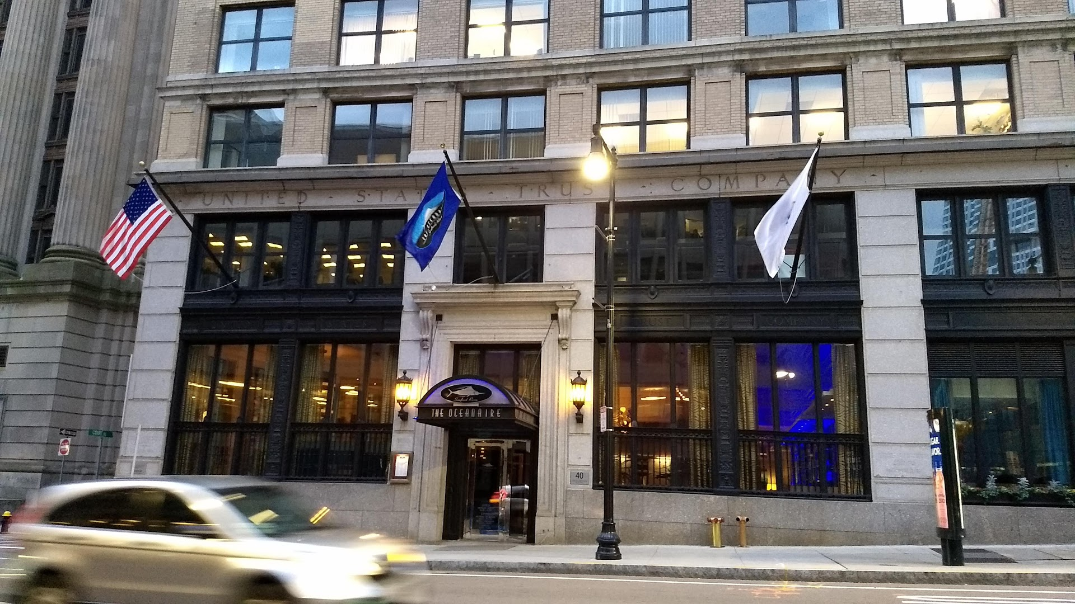
Suffolk University IMP – Public & Task Force Meeting
Local Precedents
US Trust Company Building, 40 Court St

Slide 11
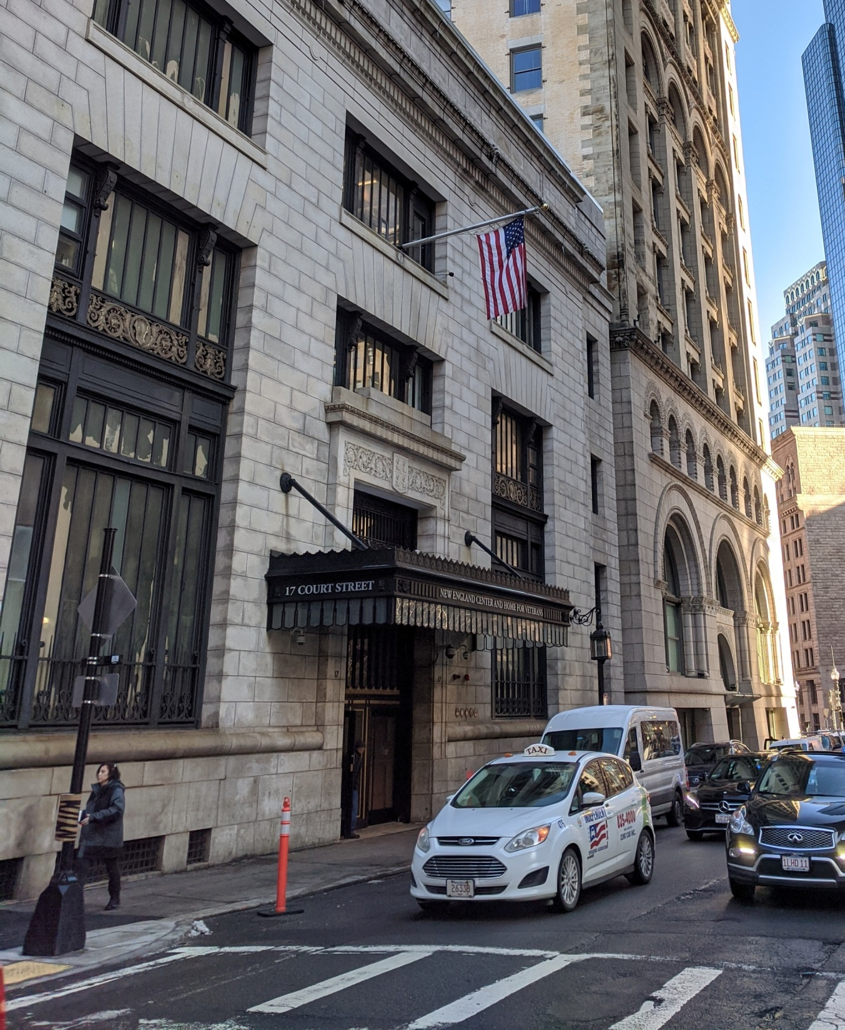
Local Precedents
New England Center and Home for Veterans, 17 Court St

Slide 12
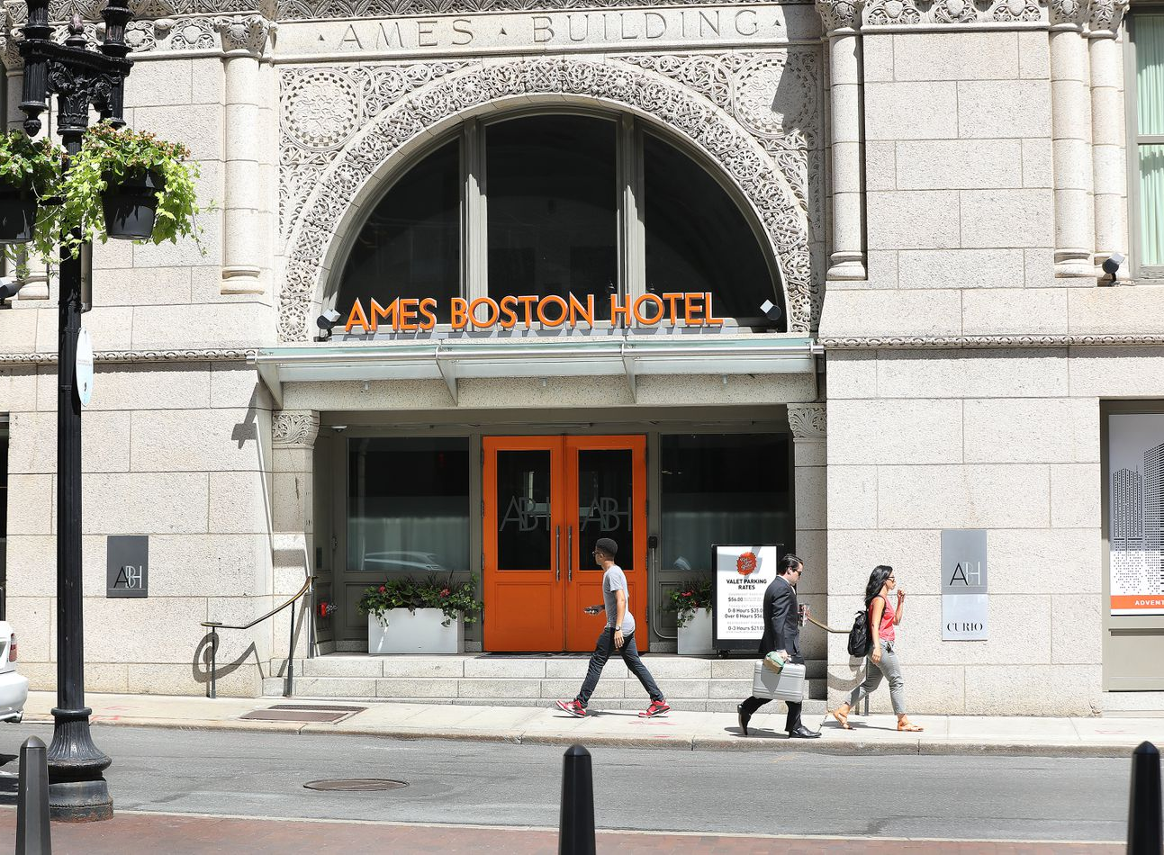
Local Precedents
Prior Ames Hotel,
1 Court St

Slide 13
Questions? Comments?

Slide 14
12 ft 0-32 Aluminum Out Rigger Flagpoles
4” Butt
2.5” Top
.156 Wall Thickness
*Suffolk and Flagraphics will make every effort to install poles in mortar joints, avoiding blocks wherever possible

Slide 15
3D Non-illuminated Aluminum Channel Letters
12” high
2.5” deep
16 ft long
Mounted on raceway atop existing glass canopy

Slide 16
Estimated Costs
Item | Estimated Total Cost
Aluminum Canopy Lettering | $9,600
Flagpoles | $19,400
Awnings | $4,200

Slide 17
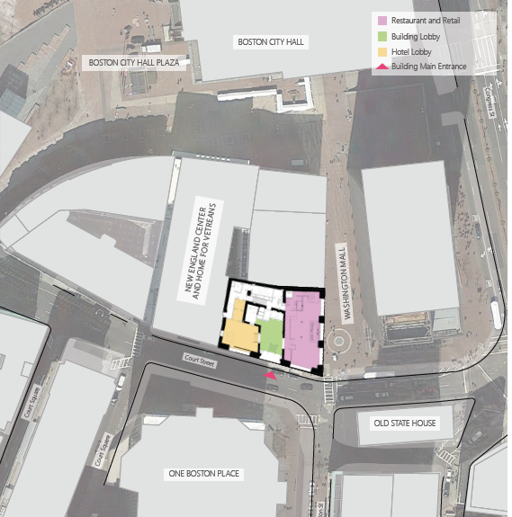
1 Court Street Residence Hall – Site Contexts and Existing Conditions

Slide 18
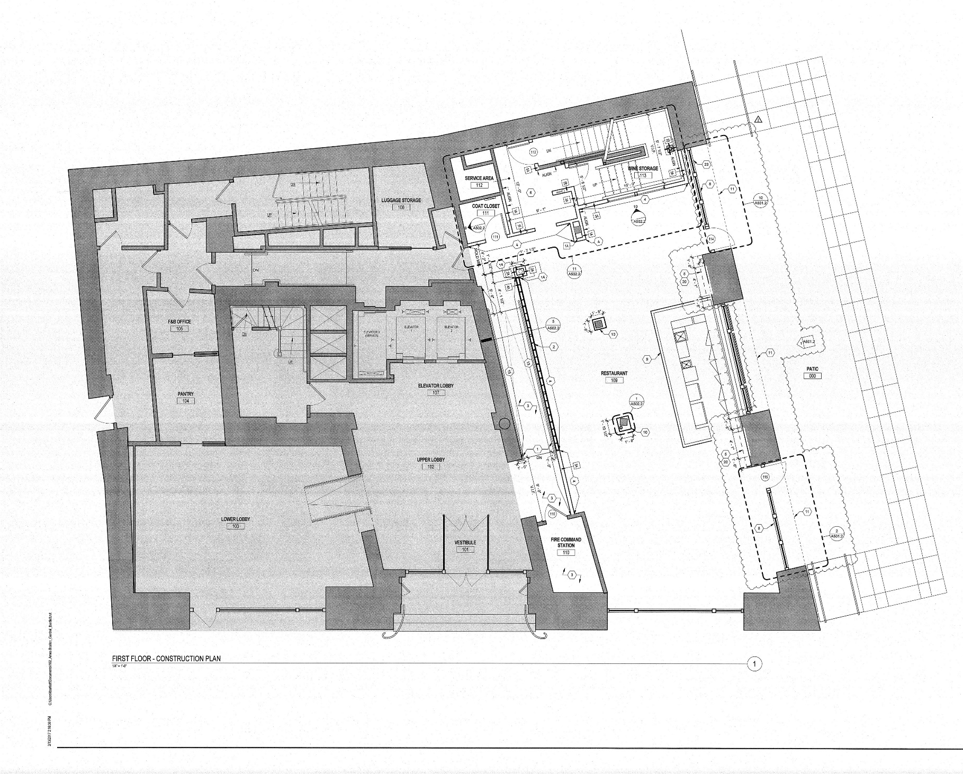
1 Court Street Residence Hall – Existing Ground Floor Plan

Slide 19
1 Court Street Residence Hall – Proposed Ground Floor Plan
Publicly-accessible Retail
Lobby
Student Space

