Slide 1
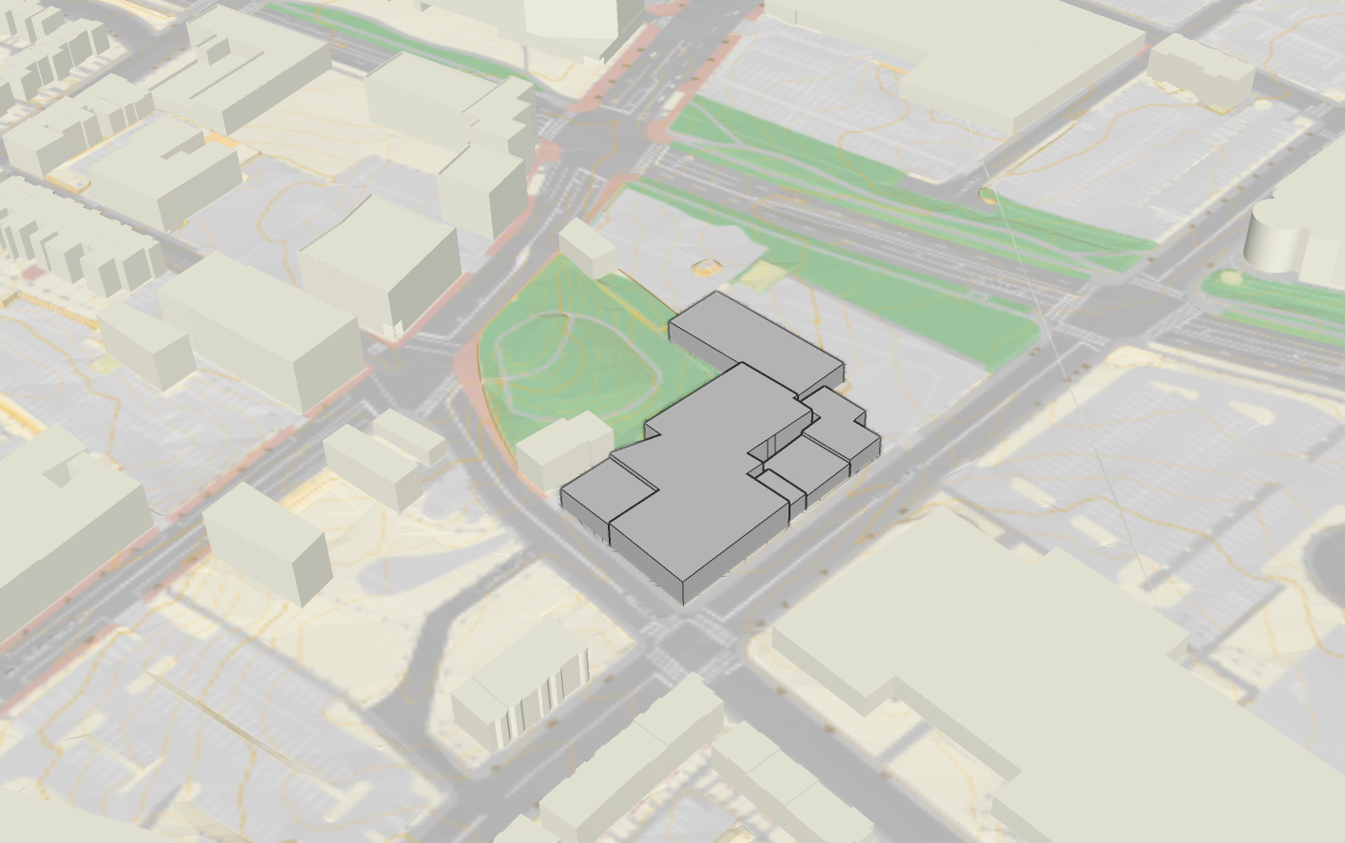
1003-1011 HARRISON AVENUE – EXISTING CONDITIONS
WASHINGTON STREET
NAWN FACTORY
MELNEA CASS BLVD
PARCEL 8
ELIOT BURYING GROUND
TORRENT SIX / HISTORIC BOSTON
BENJAMIN FRANKLIN INSTITUTE OF TECHNOLOGY
HARRISON AVENUE
EUSTIS STREET

Slide 2
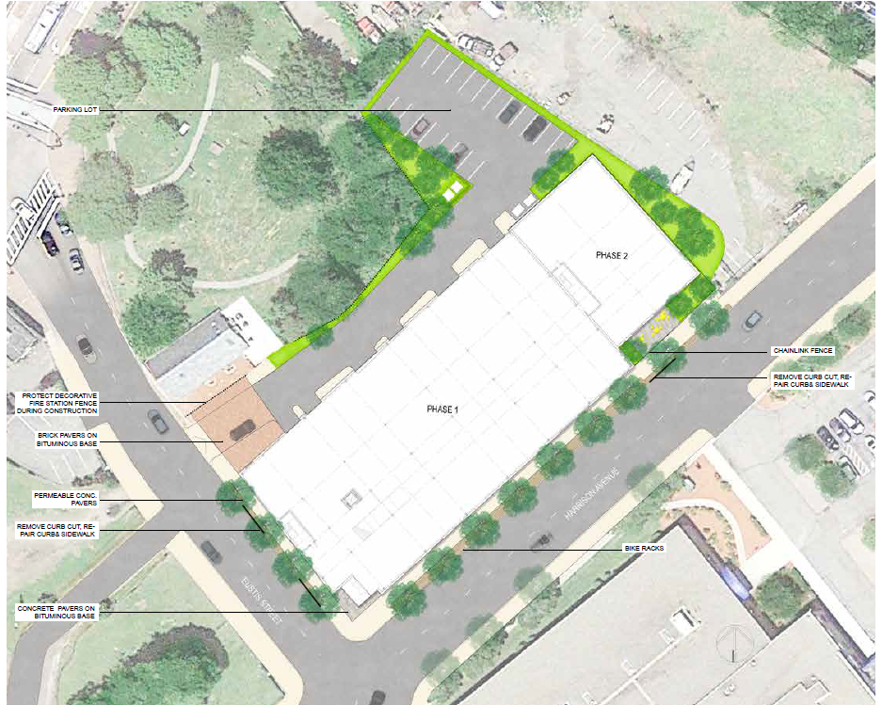
1003-1011 HARRISON AVENUE – PRELIMINARY FUTURE SITE PLAN

Slide 3
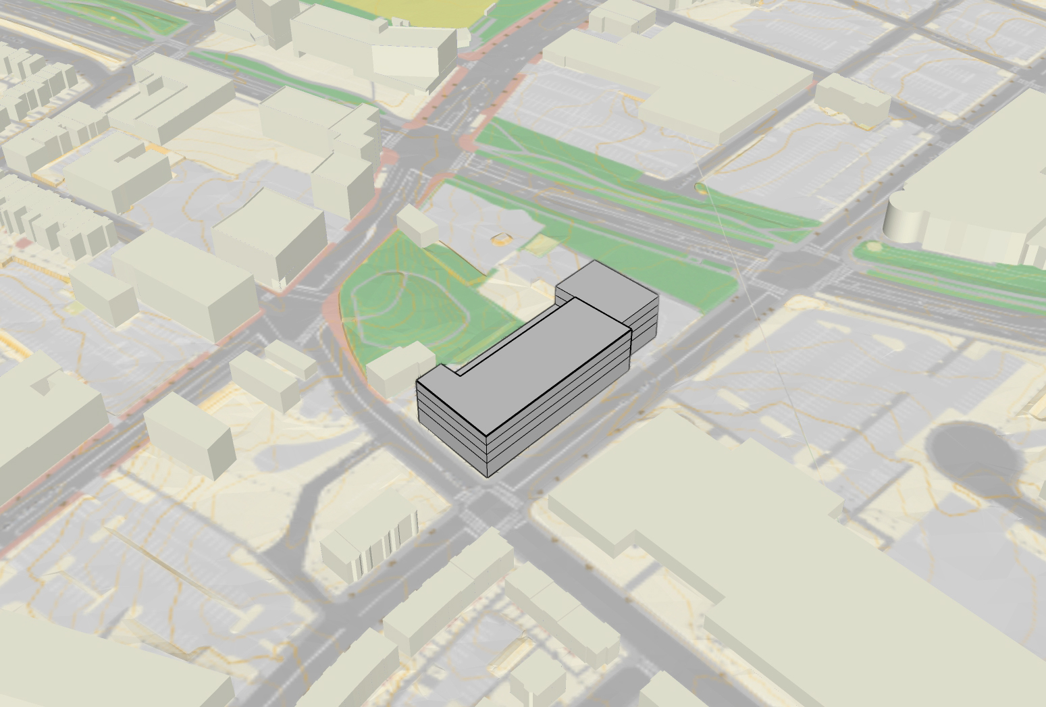
1003-1011 HARRISON AVENUE – POTENTIAL MASSING SCENARIOS

Slide 4
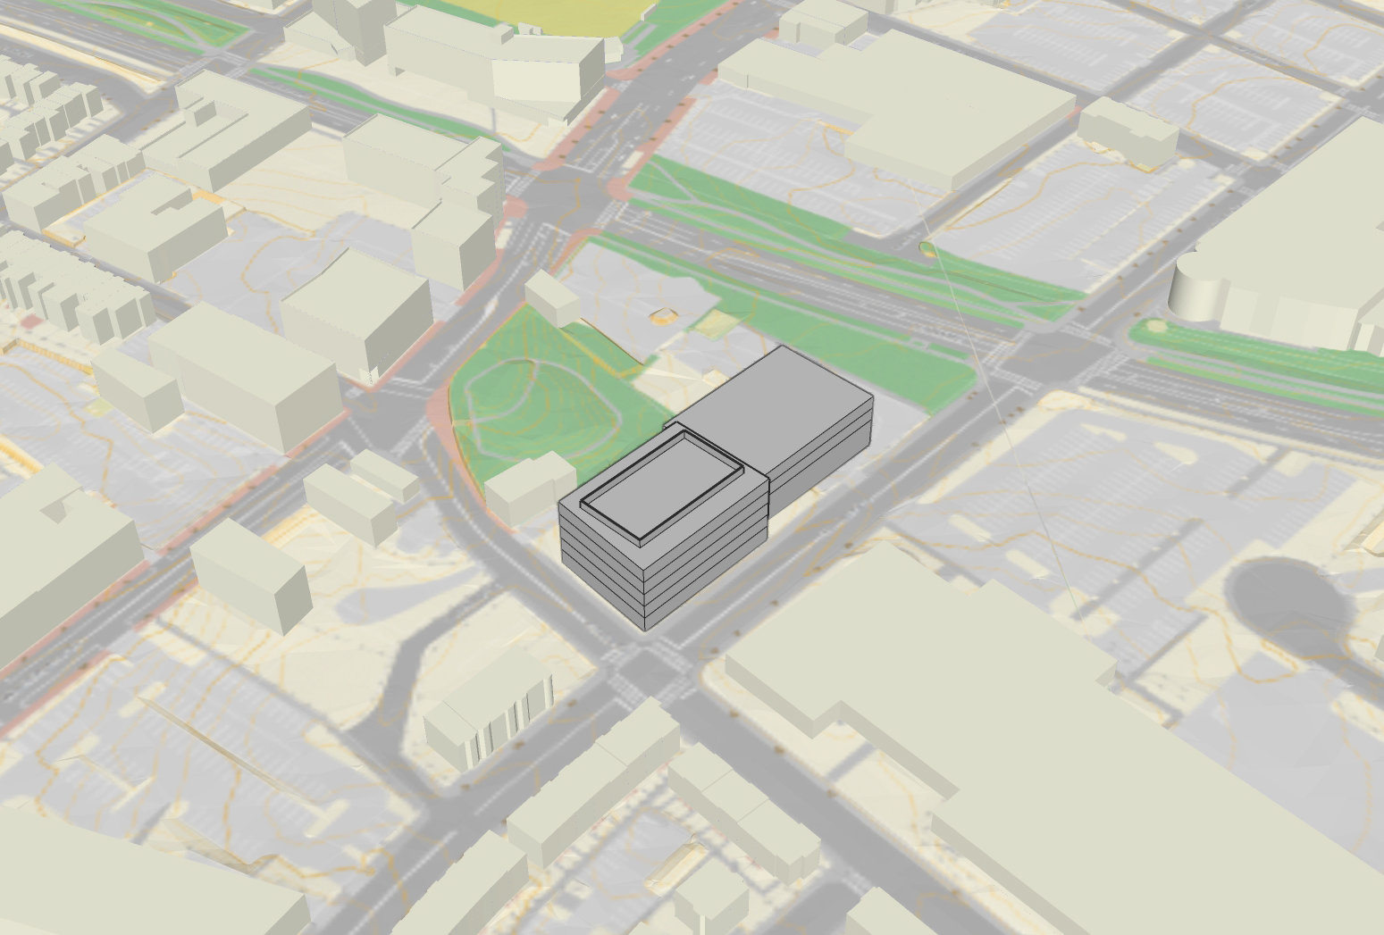
1003-1011 HARRISON AVENUE – POTENTIAL MASSING SCENARIOS

Slide 5
1. 1003-1013 Harrison Avenue, view northeast
2. 1003-1013 Harrison Avenue, view northwest

Slide 6
3.
4. View looking southwest along Harrison Avenue

Slide 7
5. 1003-1013 Harrison Avenue, view north
6. View northeast along Harrison Avenue

Slide 8
7. 1003-1013 Harrison Avenue, view northwest
8. View north to the east of 1003-1013 Harrison Avenue and to the west of Melnea Cass Boulevard

Slide 9
9. View southwest to rear of 1003-1013 Harrison Avenue
10. View south along Eustis Street

