Slide 1
217 Albany Street South End Landmark District Commission, Advisory Review
There are three cover slide options with variations of the logo used, depending upon your photo.
For example, if you have a photo with a dark background, use the white logo option (slide 3)
Proposal cover slides can be found in an InDesign template file and will need to be designed and added separately.
Presented by
Nicole Benjamin-Ma, VHB
Samantha Gajewski, National Development
August 7, 2018

Slide 2
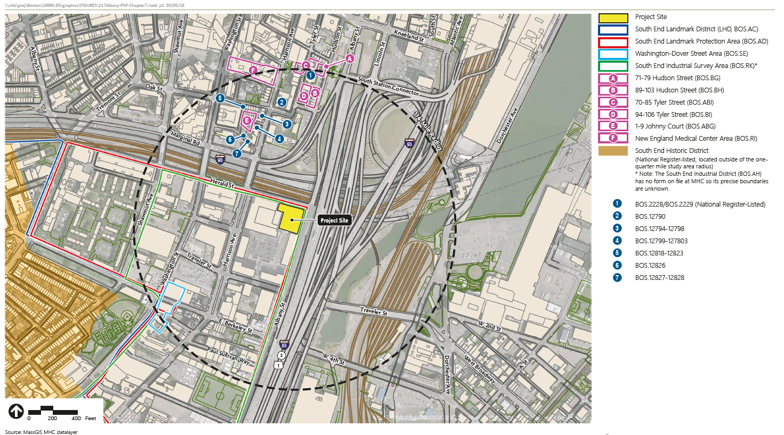

Slide 3
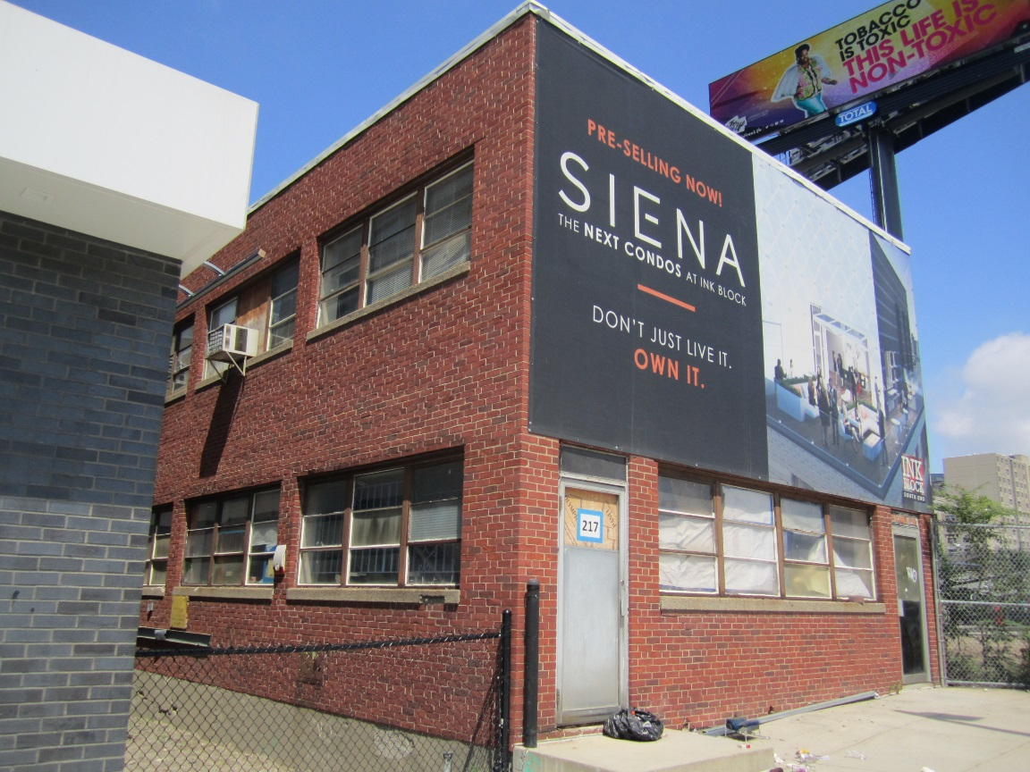
Transit Insurance Agency Building, 217 Albany: History
Constructed c. 1960, after urban renewal of “New York Streets”
Home of Transit Insurance Agency office 1961-2016

Slide 4
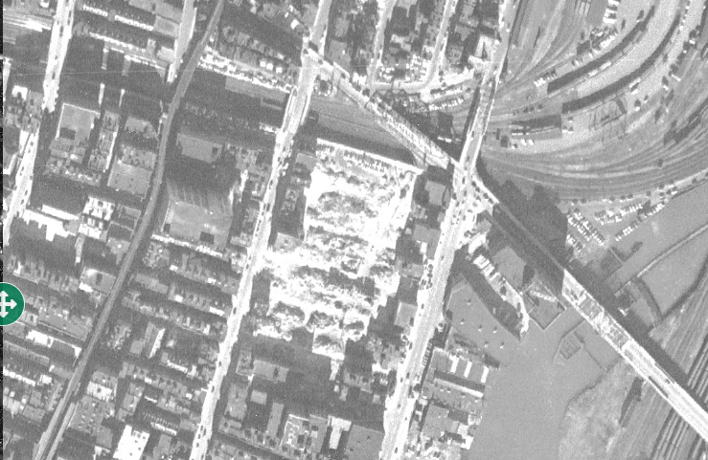
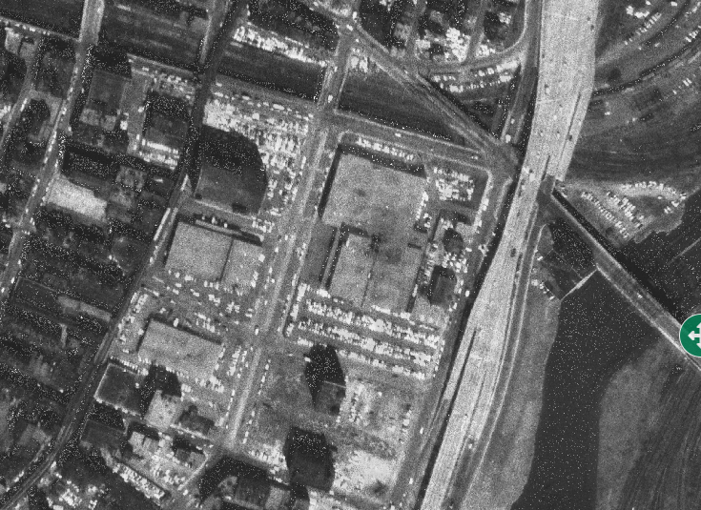
Transit Insurance Agency Building, 217 Albany: History
1955
1962

Slide 5
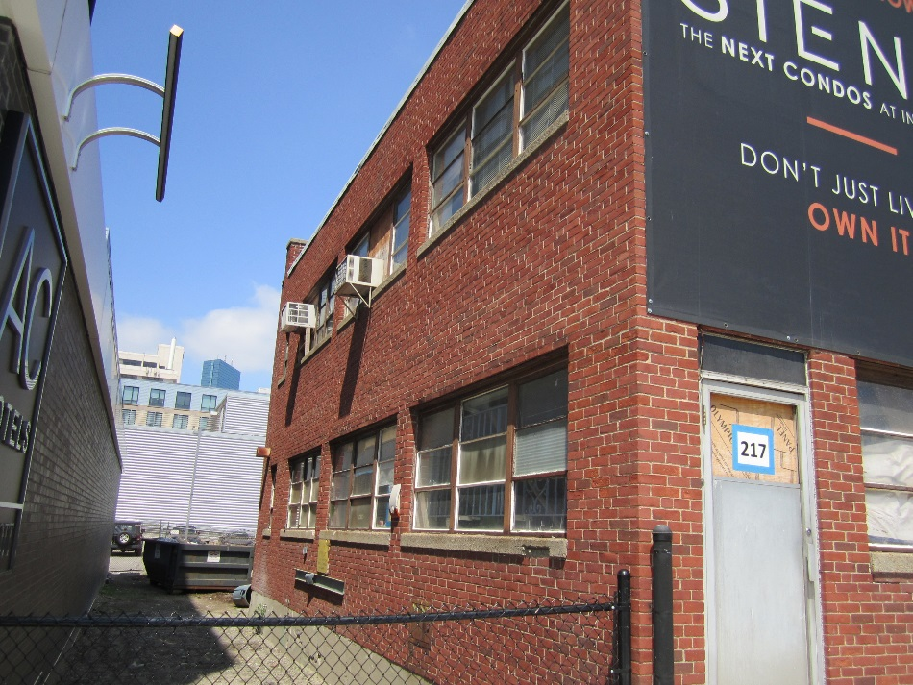
Transit Insurance Agency Building, 217 Albany
East façade and south elevation

Slide 6
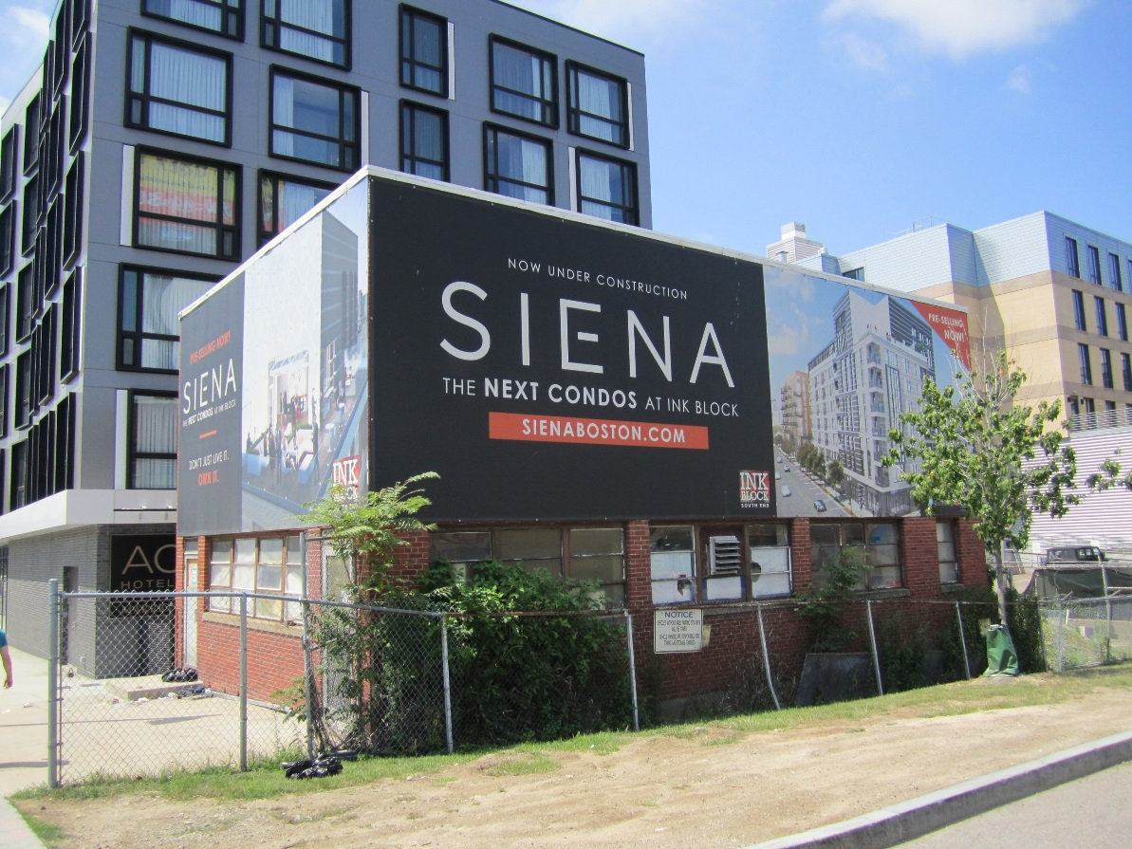
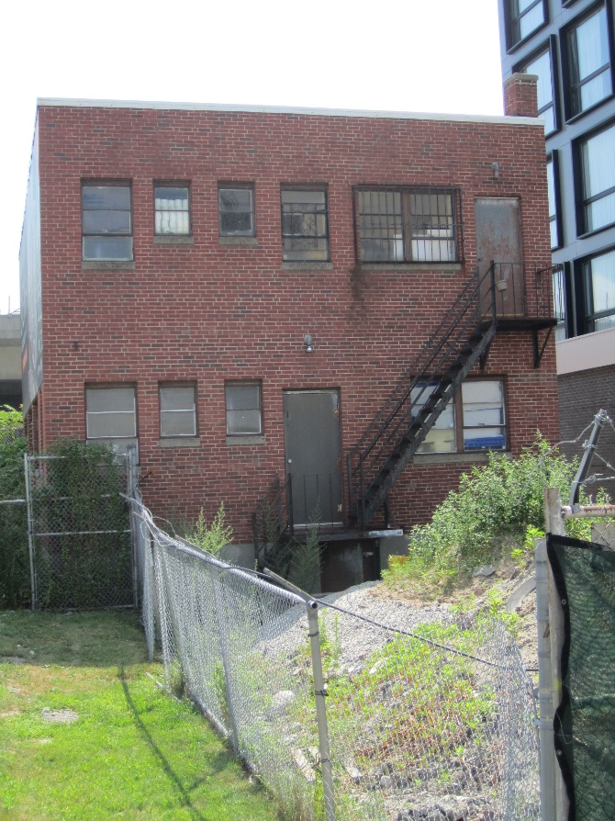
Transit Insurance Agency Building, 217 Albany
North and west elevations

Slide 11
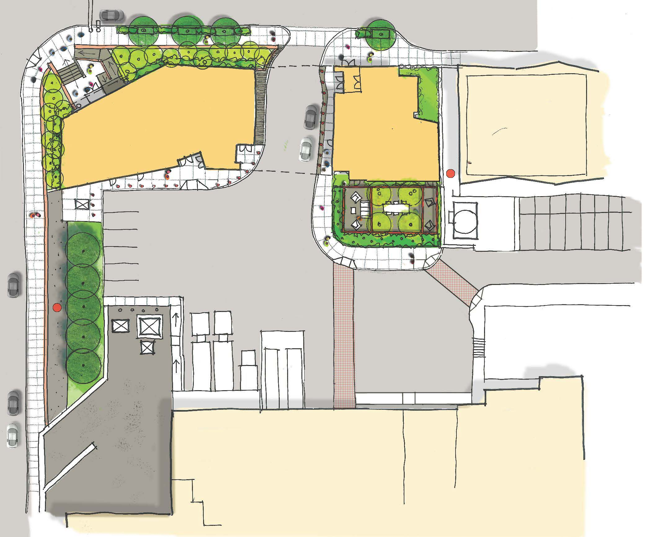
217 Albany Landscaping Plan

Slide 13
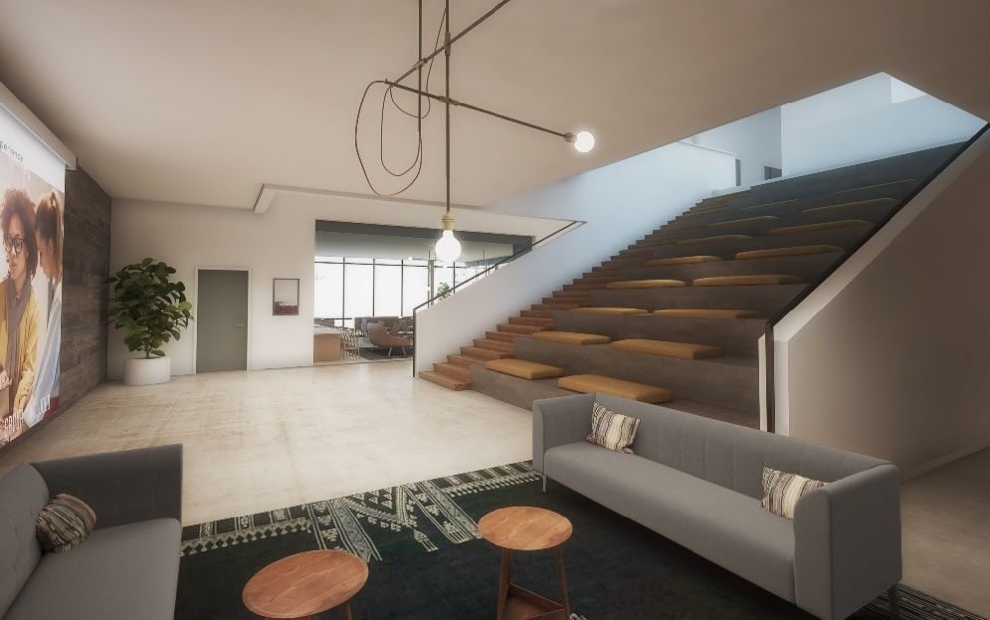
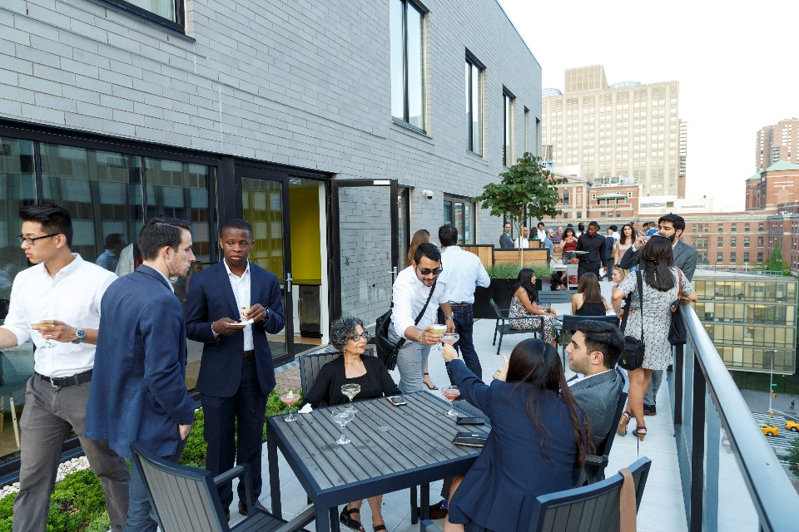
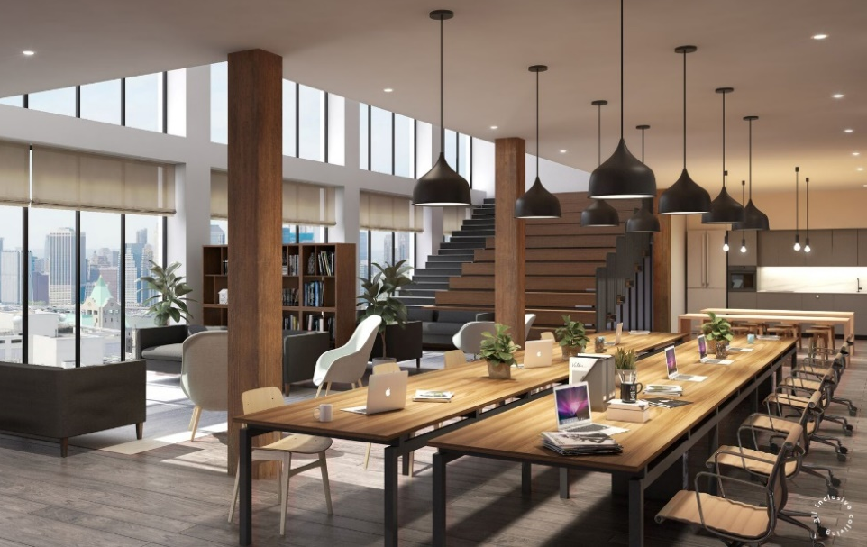
Communal Spaces

Slide 14
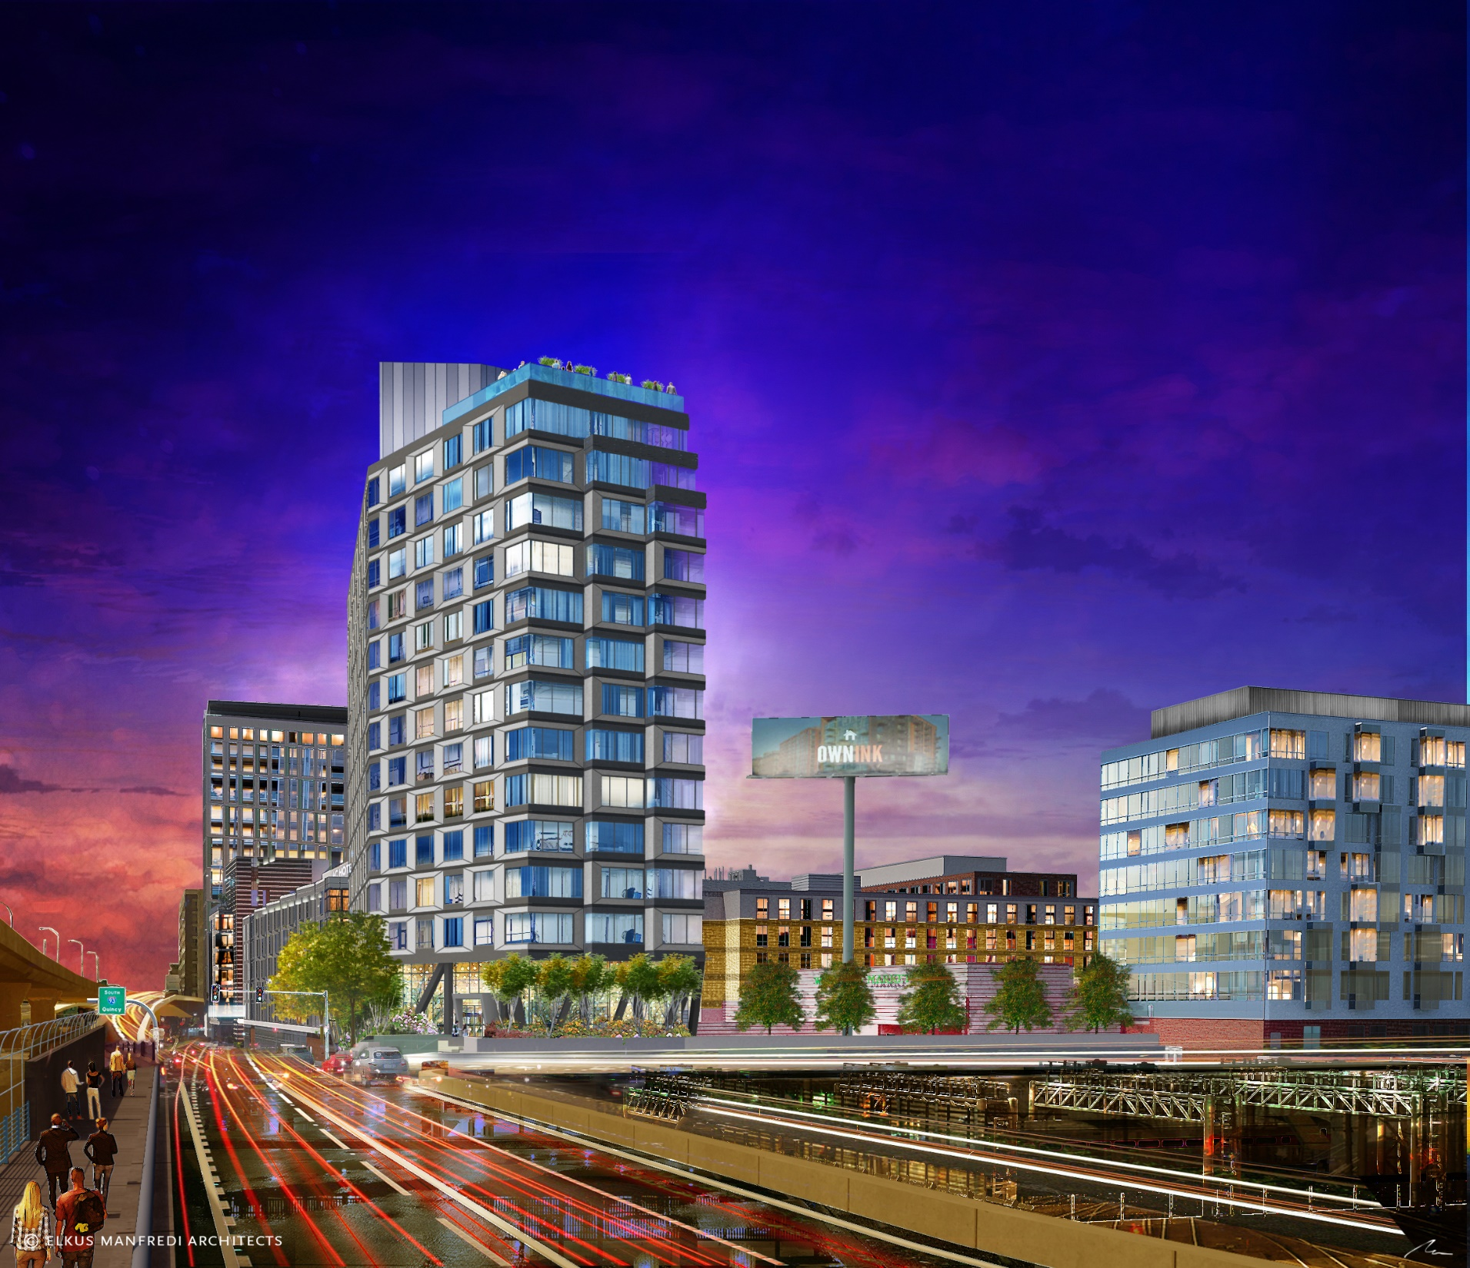
217 Albany Program

