Slide 1
Fort Point Channel Landmark District Commission
12/14/2017
Presentation of Proposed Node Location on Summer Street

Slide 2
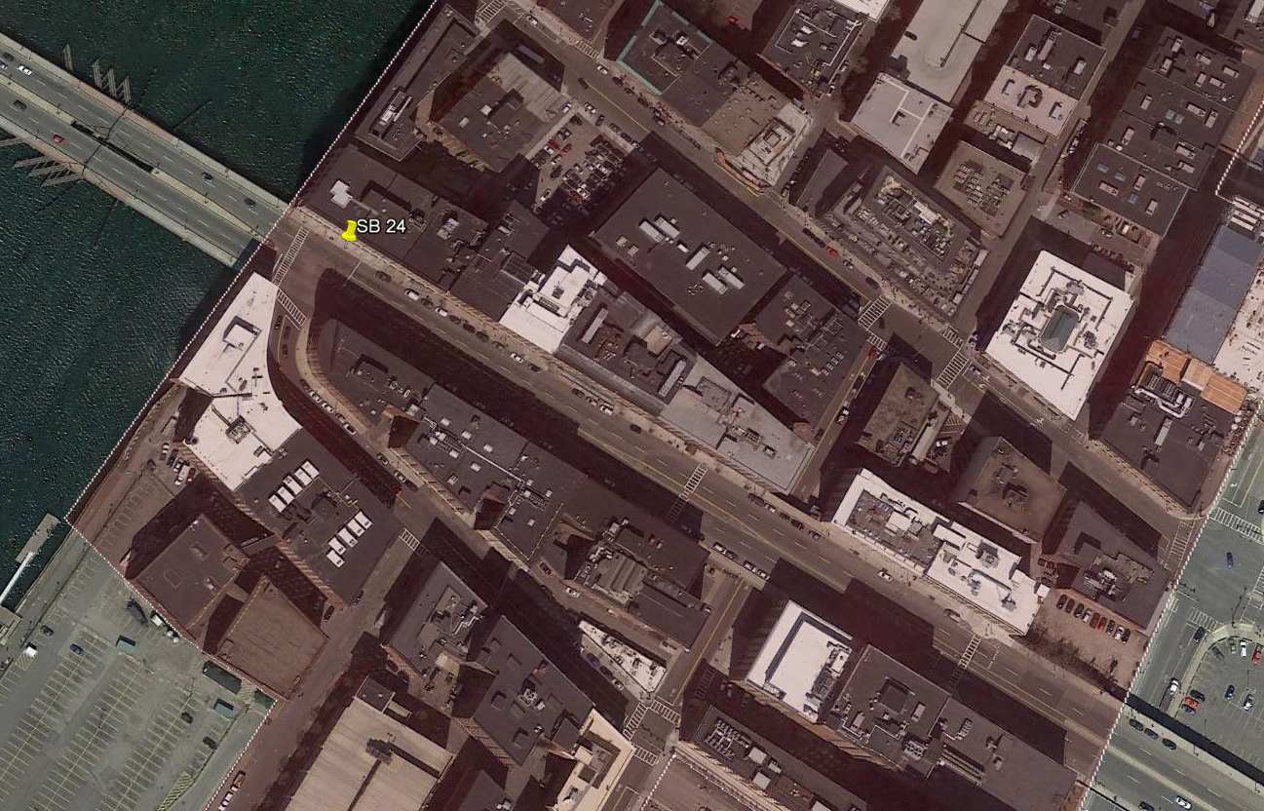
SB024
Location Overview

Slide 3
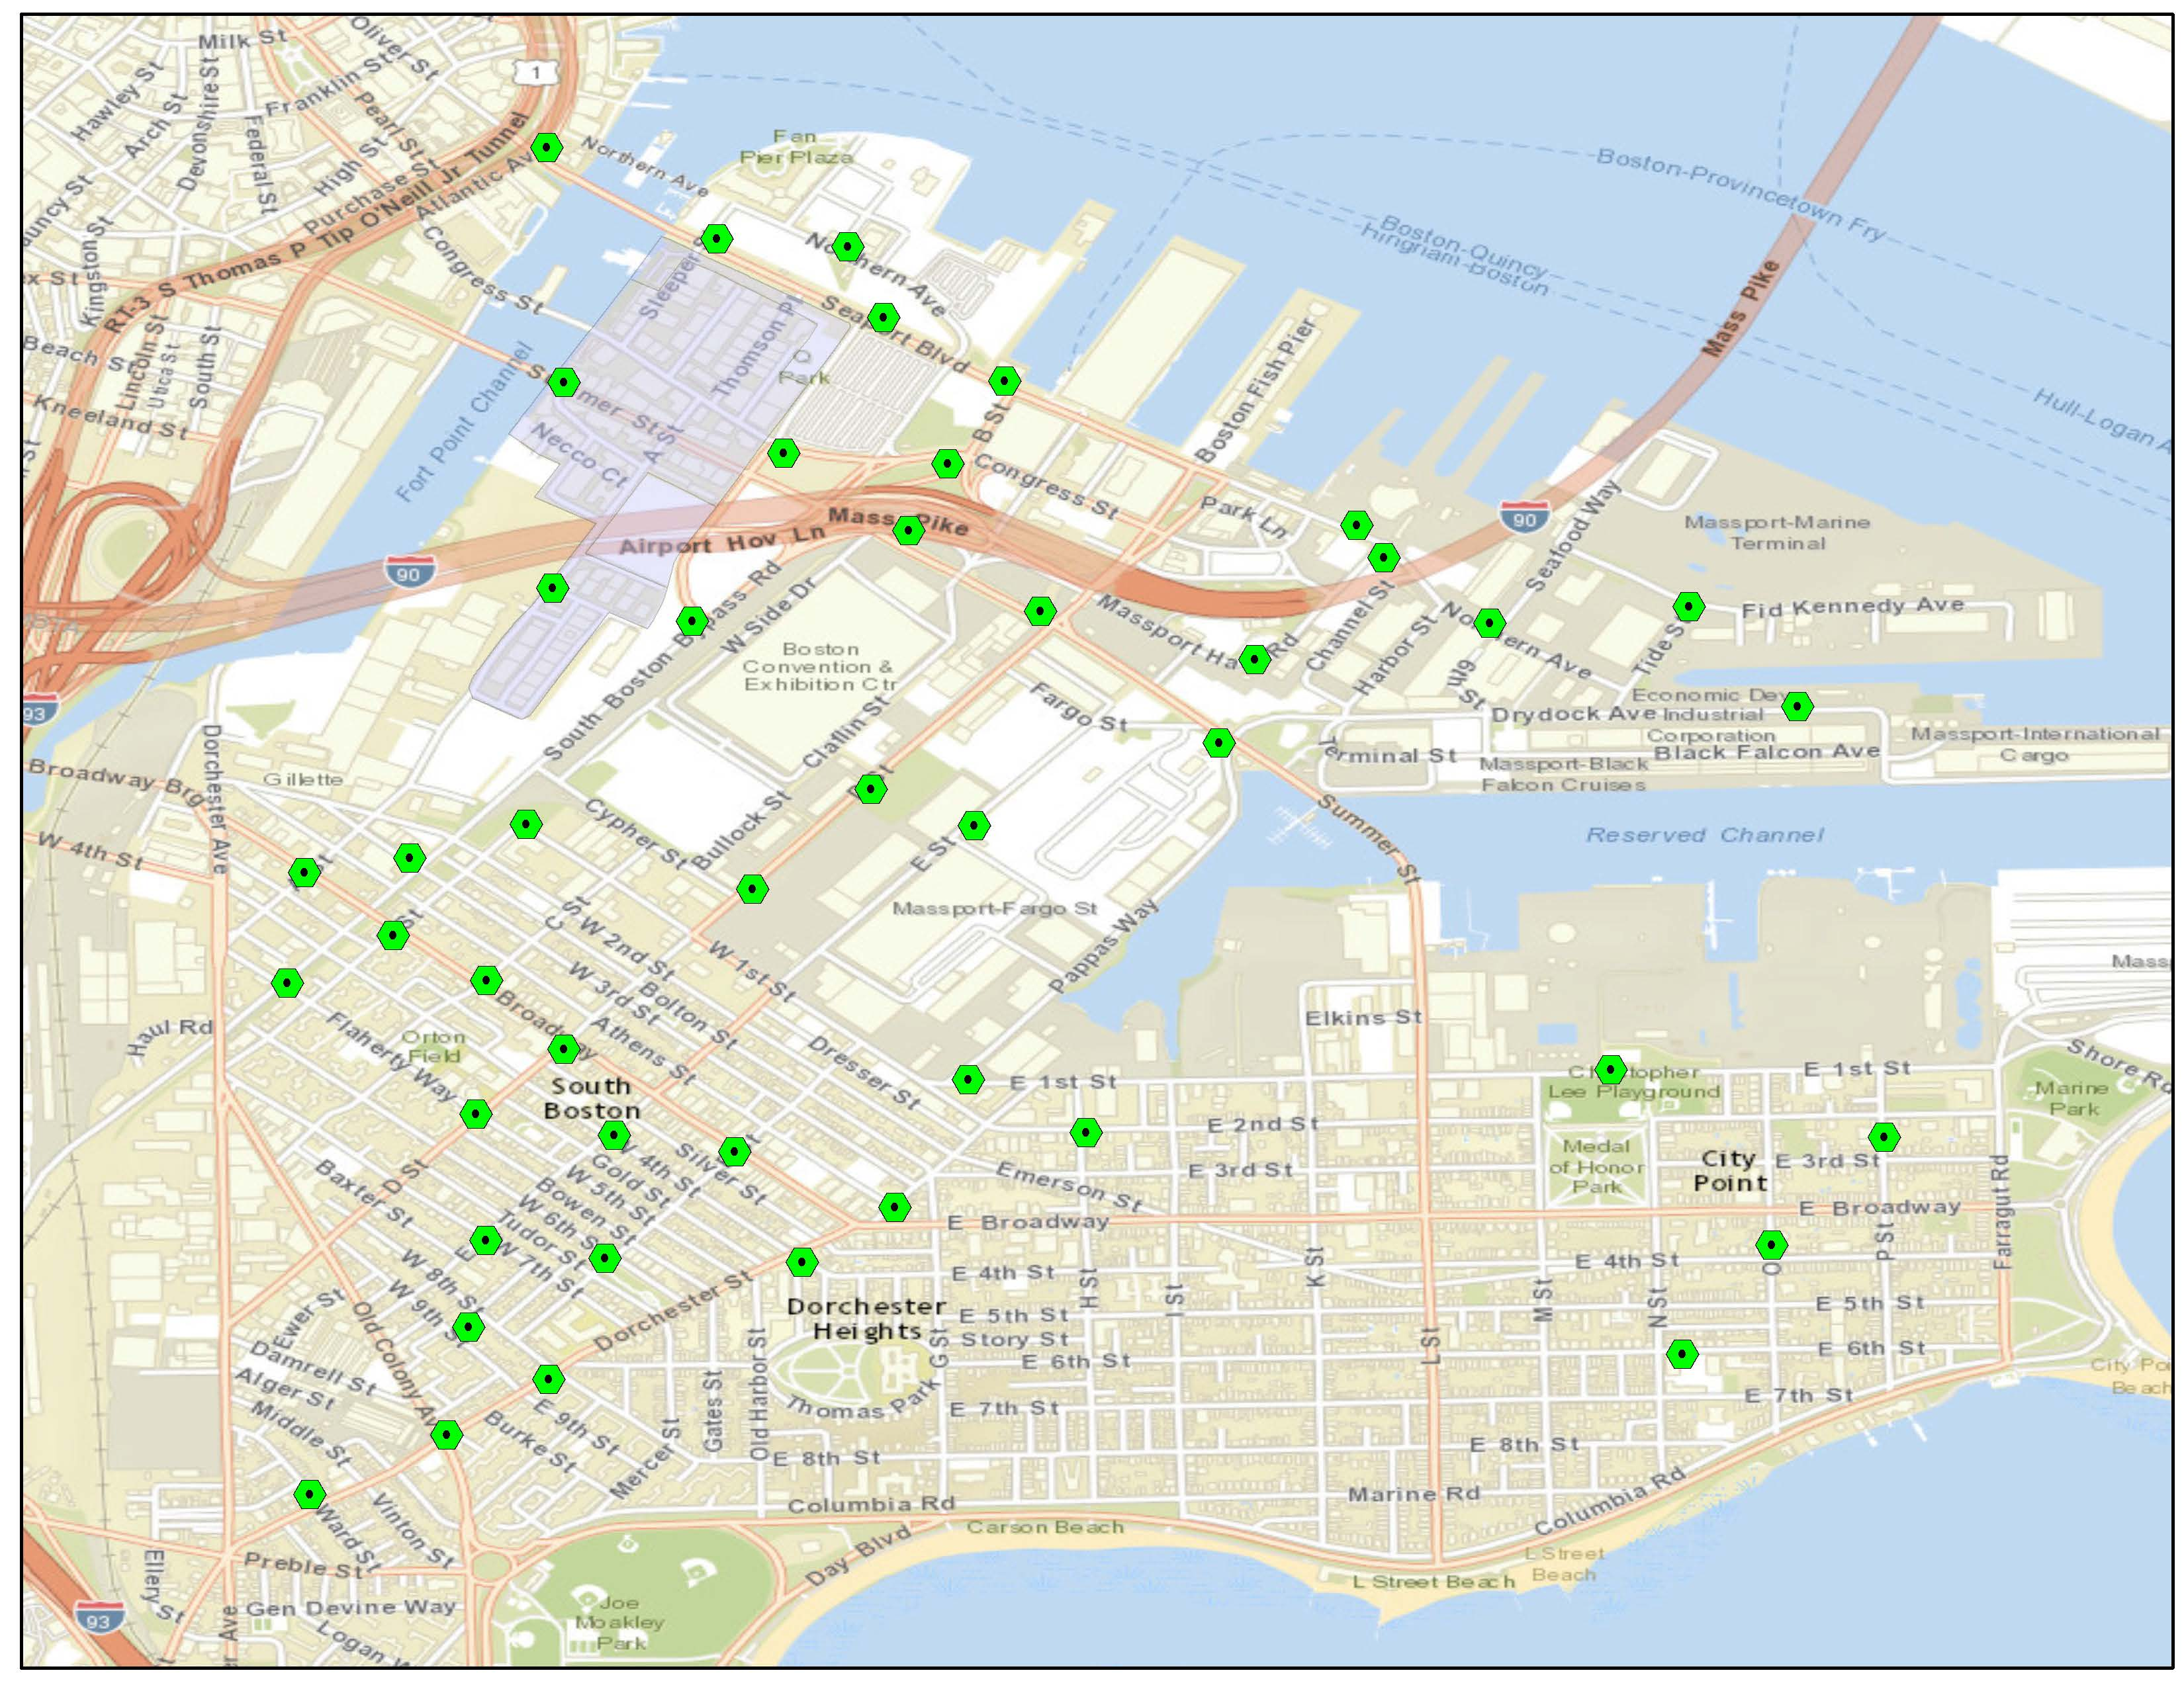
South Boston Overview
Crown Castle Node Locations

Slide 4
History of Crown’s effort on Summer Street
December 9, 2016 – Fort Point Channel Commission Approved Crown Castle’s proposal for a Double Fort Point Style Light with telecommunications equipment at this location
March 2017 – the PIC approved a Boston Public Works Department Improvement Plan along Summer Street that included a new streetlighting scheme in this area
  March 2017 – Boston Streetlighting Department rejected Crown’s proposal for a Fort Point style light in this location because it would frustrate the new scheme.
December 2017 – Crown is proposing an Arieta style LED light in this location that is consistent with Public Work’s scheme.

Slide 5
Public Works Department –
Summer Street Improvement Plan
Location of Crown’s proposed Arieta light
Yellow dots – Ft. Point lights
Purple dots - Arieta lights

Slide 6
Public Works Department Scheme
Leotek Arieta LED Light (purple dots on previous page)

Slide 7
Node Profile for SB24

Slide 8
Proposed Replacement Pole

Slide 9
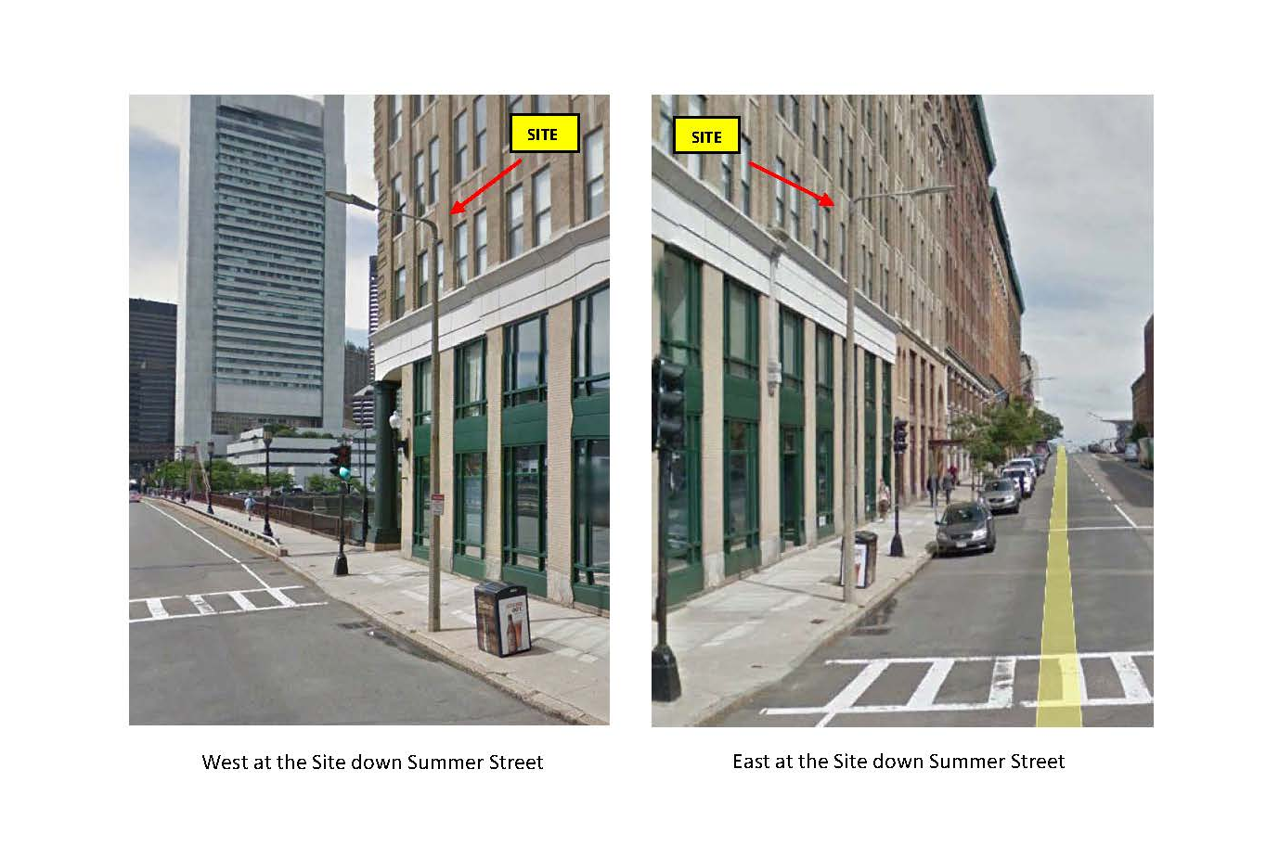
Existing Conditions
Located near 250 Summer Street

Slide 10
Joseph Shannon
Government Relations Manager
(339) 205-7008
Joseph.Shannon@crowncastle.com

