Slide 1
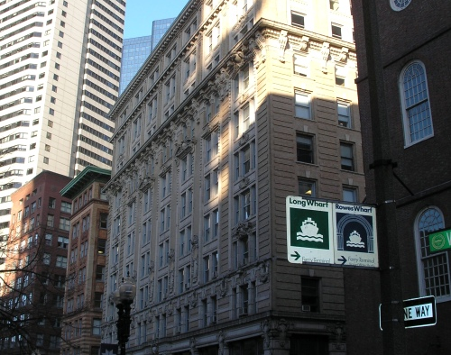
OLD SOUTH BUILDING
294 Washington Street/10 Milk Street
REPLACEMENT OF 9TH FLOOR TERRA-COTTA WASH/WATER TABLE
ABBOT BUILDING RESTORATION
CBI CONSULTING

Slide 2
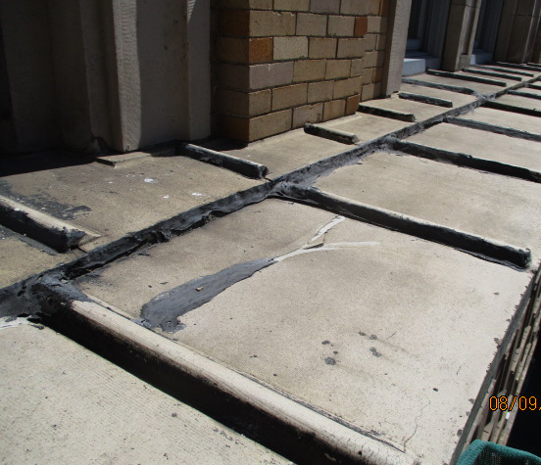
PROPOSED CHANGES TO
EXISTING CONDITIONS:
Section to be replaced with GFRP
Existing terra-cotta to remain
Existing terra-cotta to remain
GFRP replacement section
GFRP replacement section

Slide 3
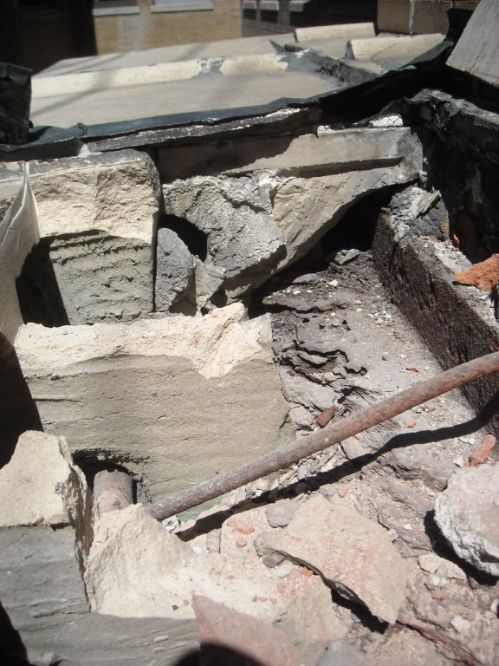
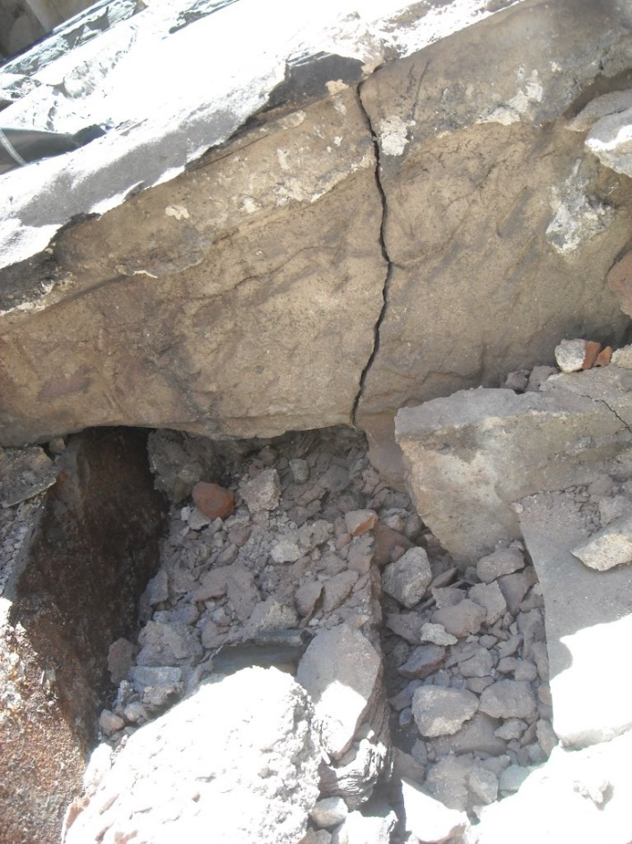
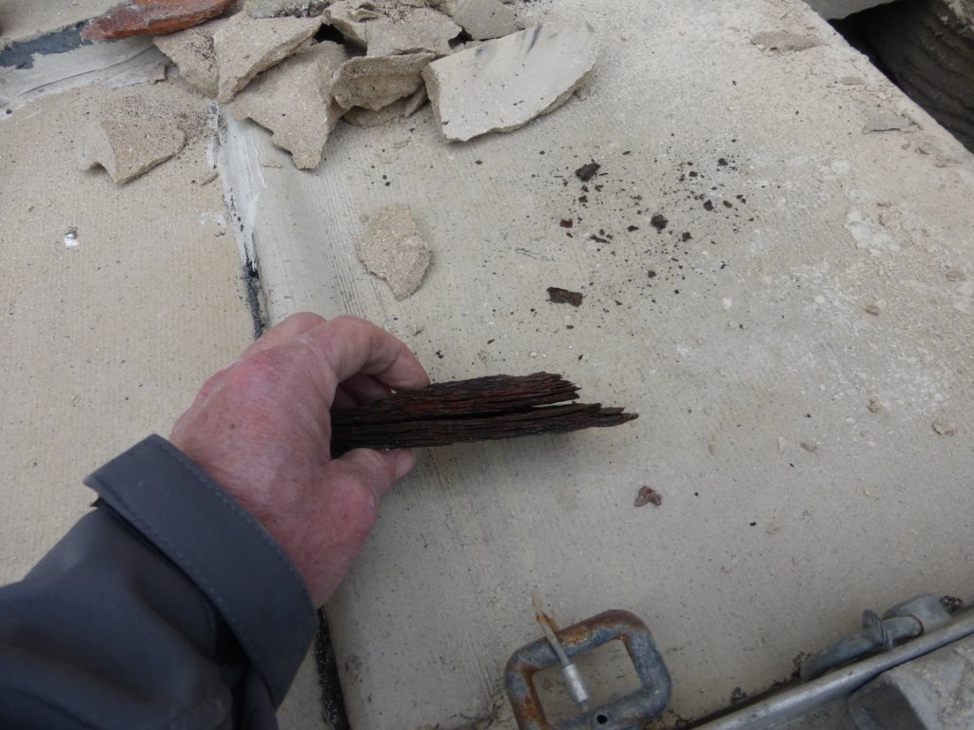
REASON FOR CHANGE:
2016 investigation uncovered heavily oxidized (corroded) steel elements.
Underlying steel support structure compromised
Due to extensive amount of corrosion conditions considered a danger to life safety
Removal and replacement advised
Corroded steel supports
Cracked terra-cotta
Extensive Corrosion

Slide 4
REPAIR OPTIONS:
Option #1 – Remove and not replace.
Option #2 – Retain the existing steel structure, to support a lighter GFRP and light gauge metal framing.

Slide 5
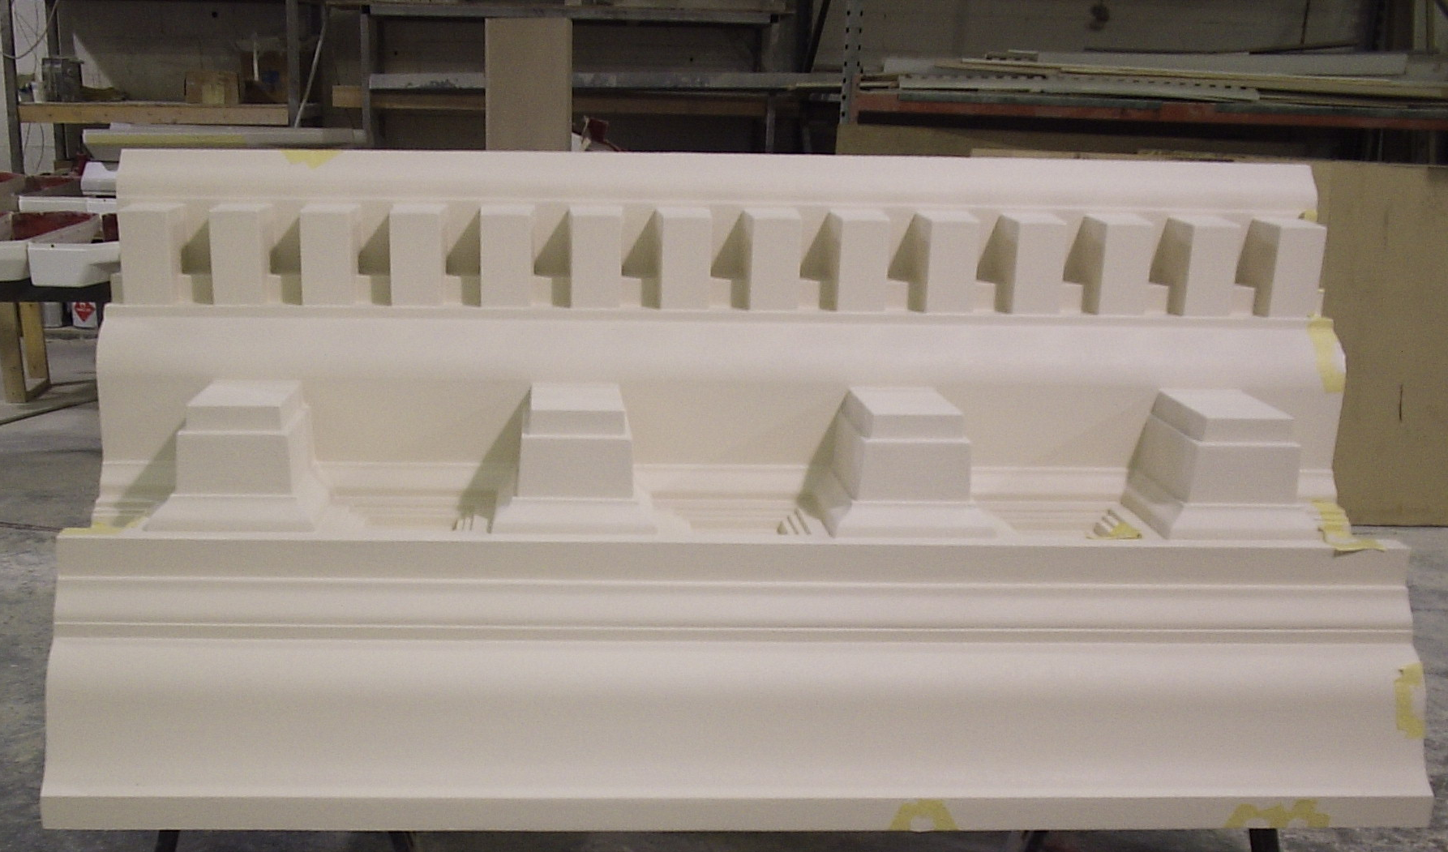
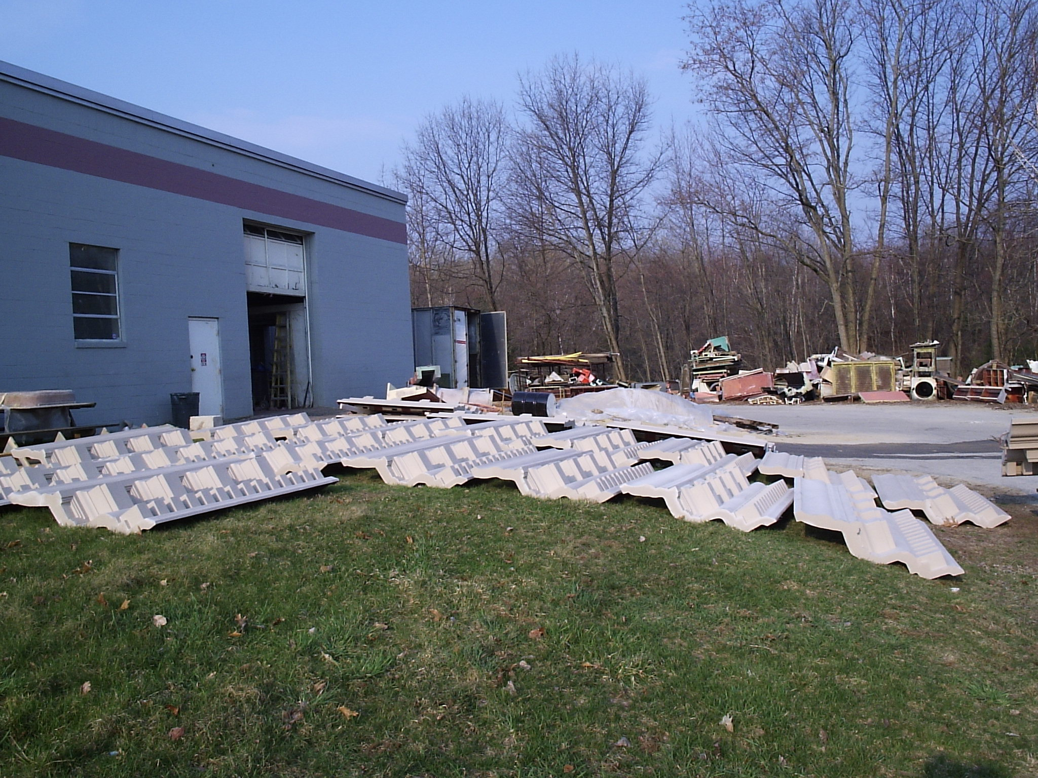
WHY
GFRP?
GFRP or Glass Fiber Reinforced Plastic
High strength to weight ratio
Corrosion resistant - Resists salt water, chemicals, and the environment – unaffected by acid rain, salts and most chemicals
Ability to mold complex shapes
Low maintenance
For the Old South Building – GFRP allows for replacement in kind while minimizing further unnecessary demolition

Slide 6
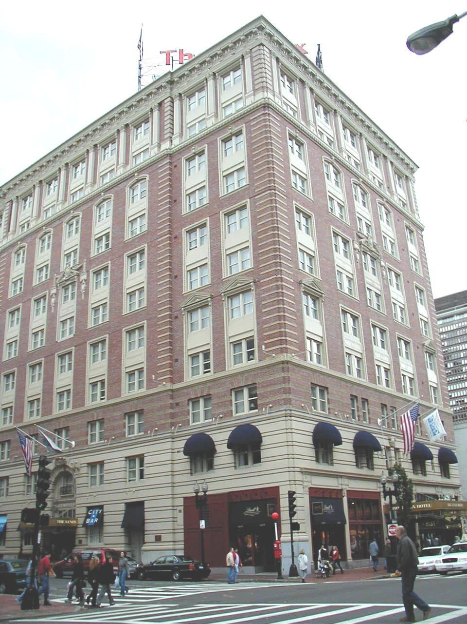
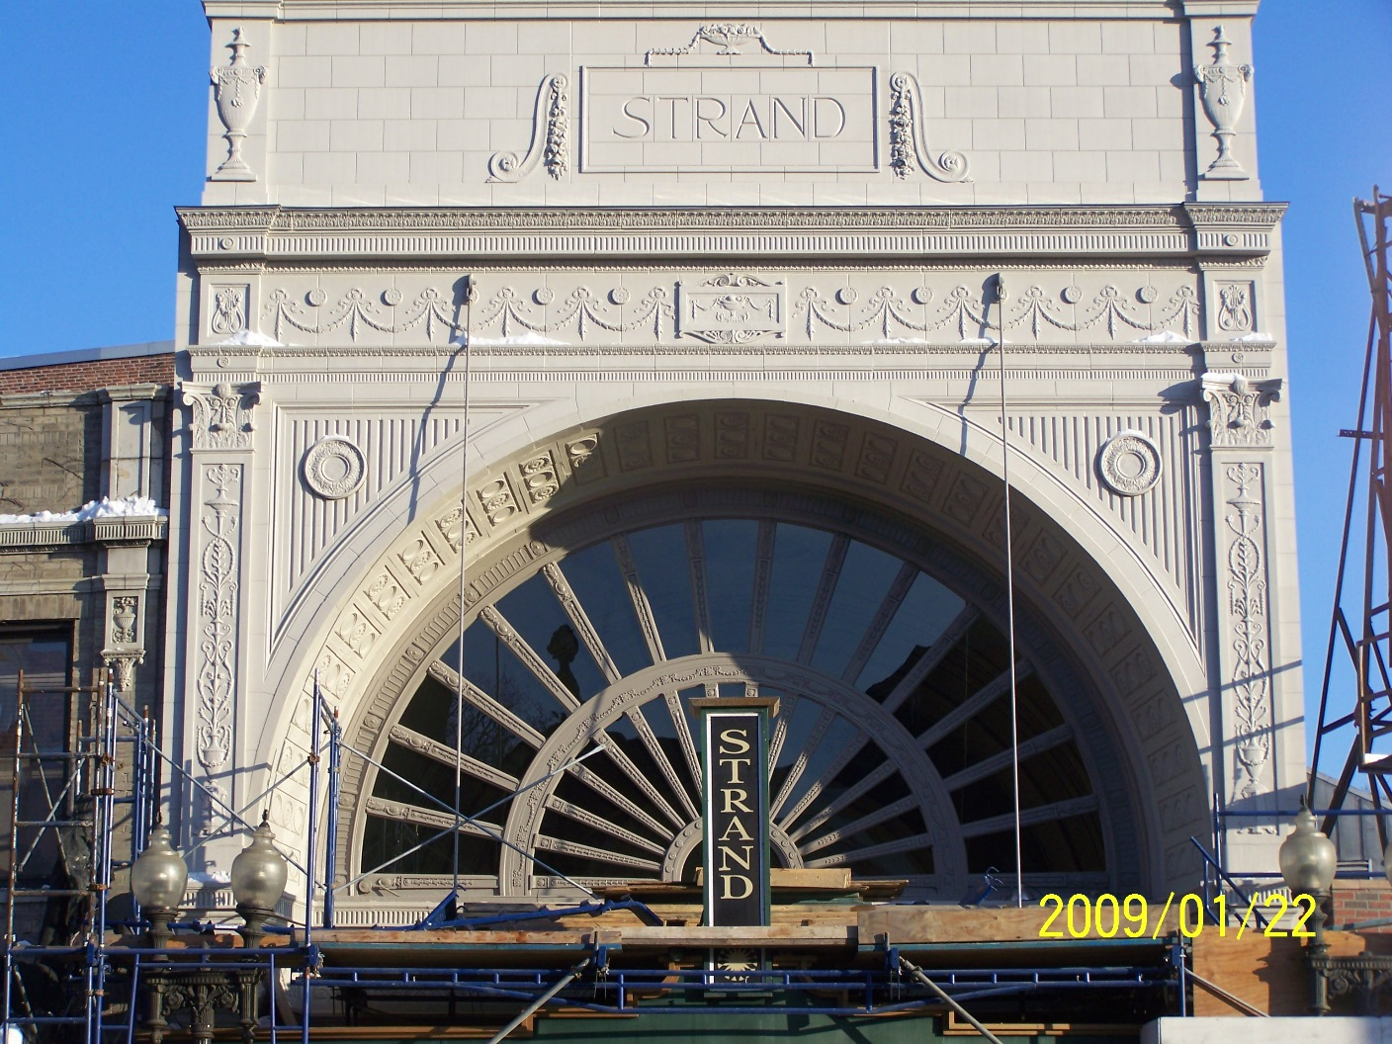
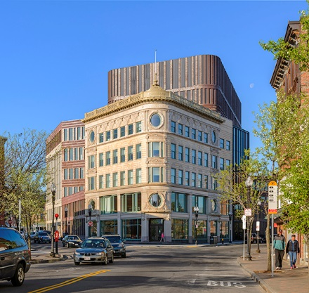
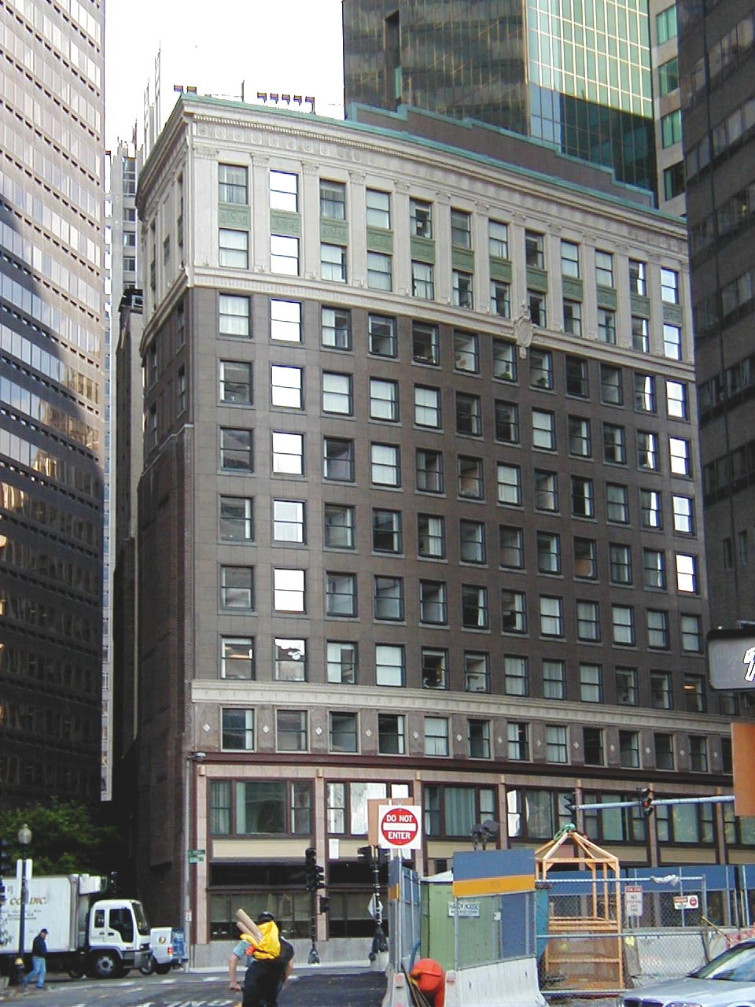
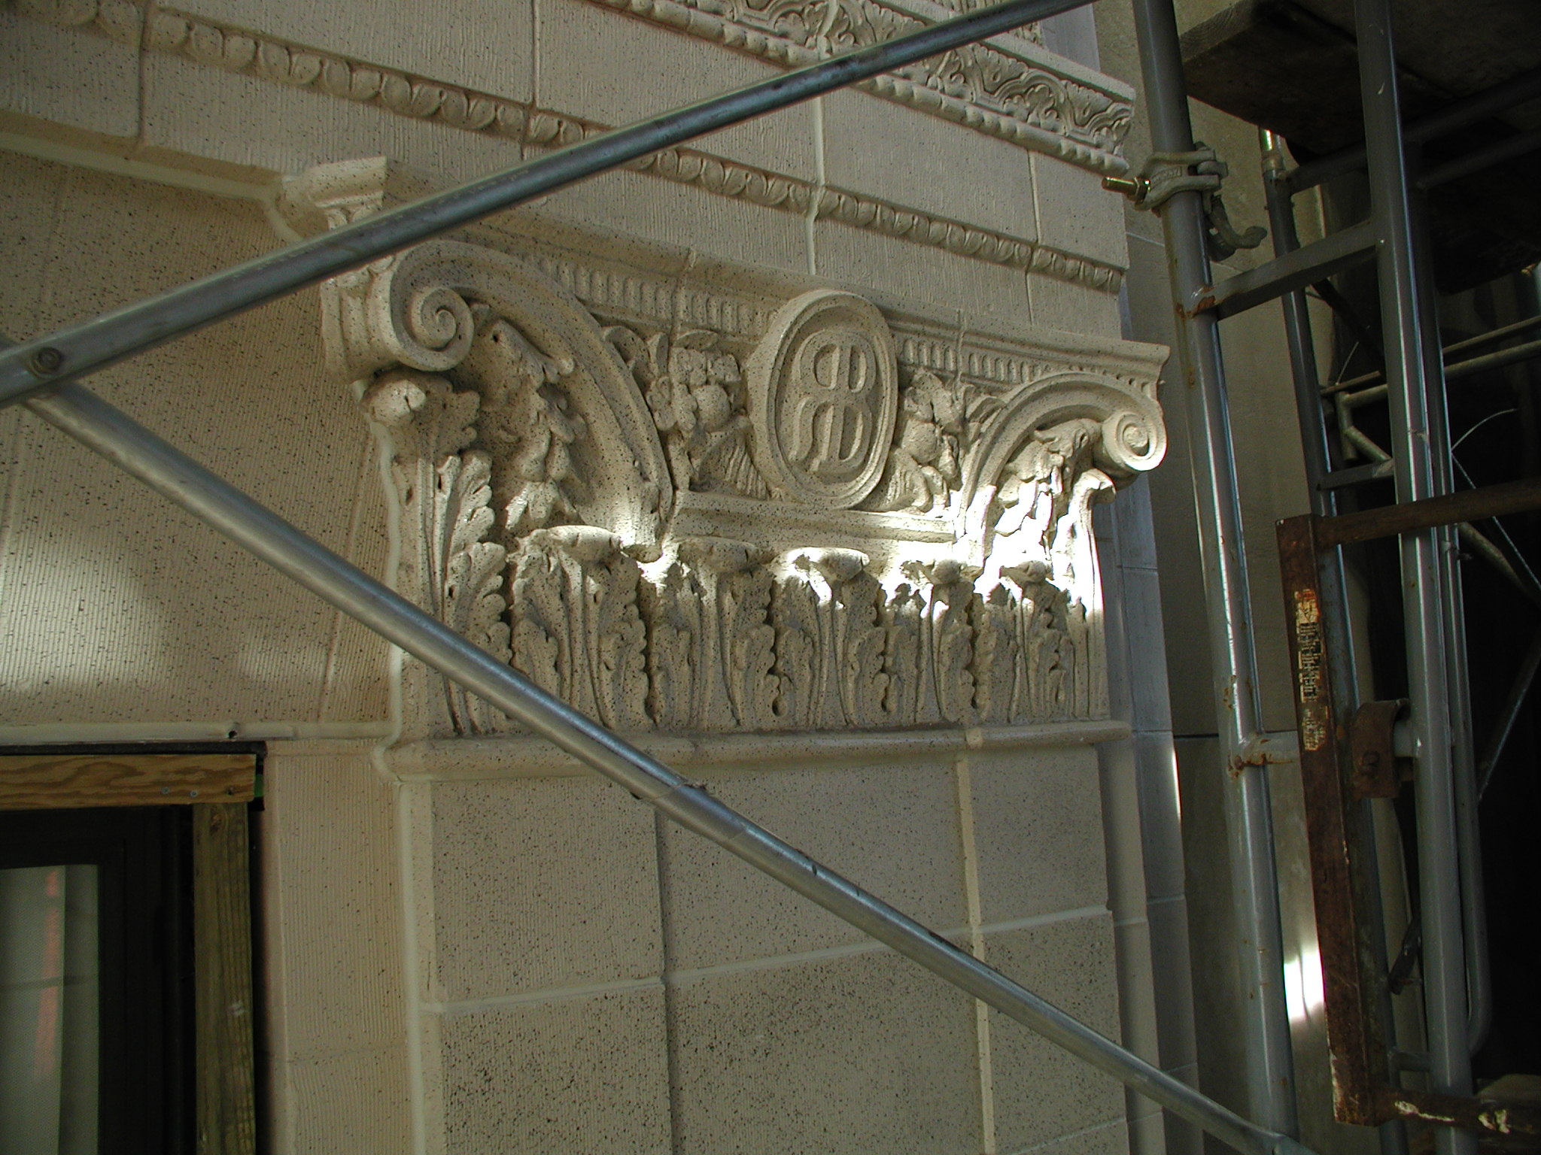
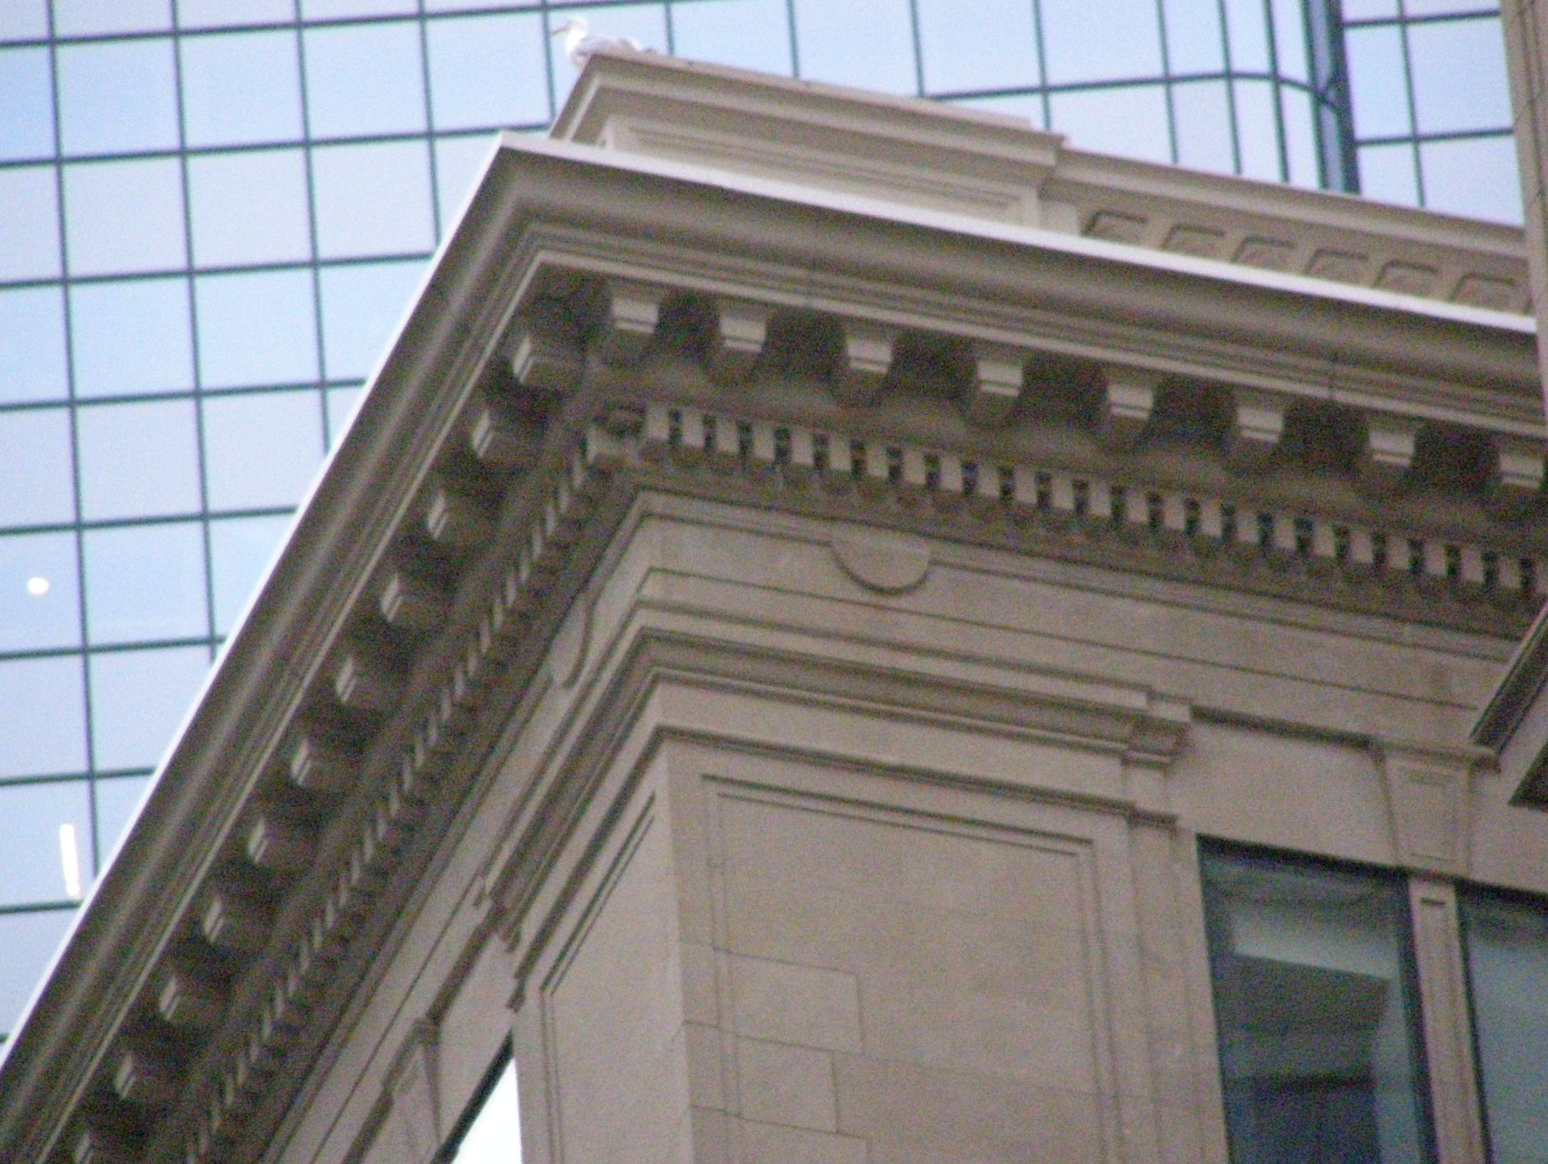
GFRP REFERENCES:
The Lennox Hotel
The Strand Theatre – Roxbury, MA
Ferdinand Building – Roxbury, MA
10 High Street, Downtown Boston, MA
10 Post Office Square – PENDING LANDMARK

Slide 7
CONCLUSION:
GFRP provides the least evasive repair option
This high strength, light weight, extremely durable material allows for less total work to be done now and going forward
Using this option, a seamless, in kind repair can be made maintaining the historic aesthetic of the building

