Slide 1
Fisher College Sprint Upgrade 114-118 BEACON st
By authorized Agent for Sprint Jon Ritter of TRM, Inc.
16 Chestnut street, Foxboro, MA 02035

Slide 2
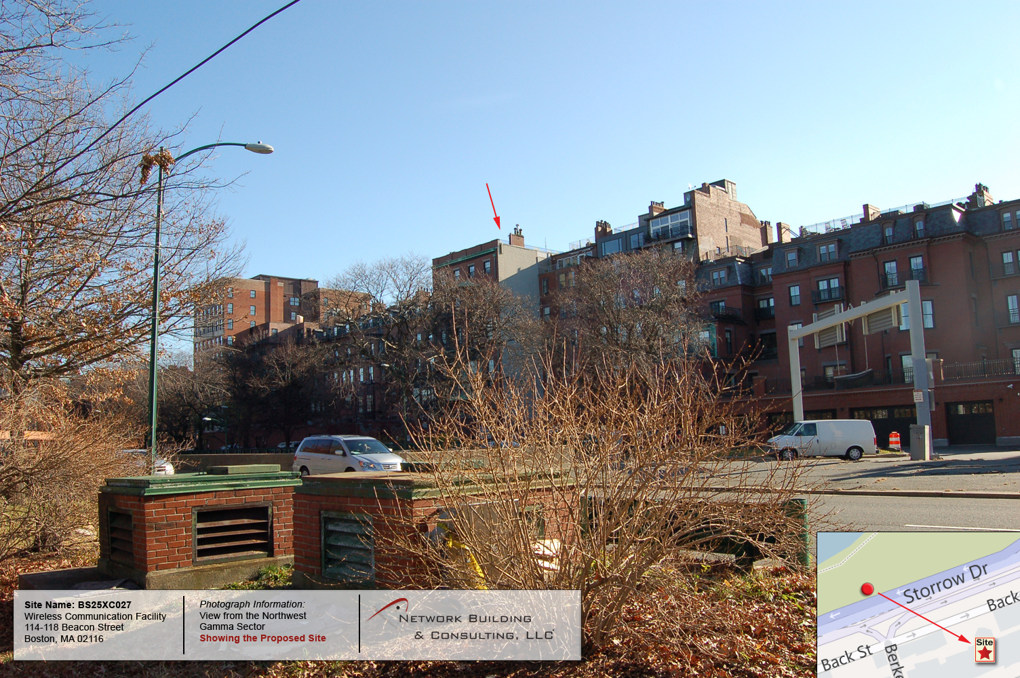

Slide 3
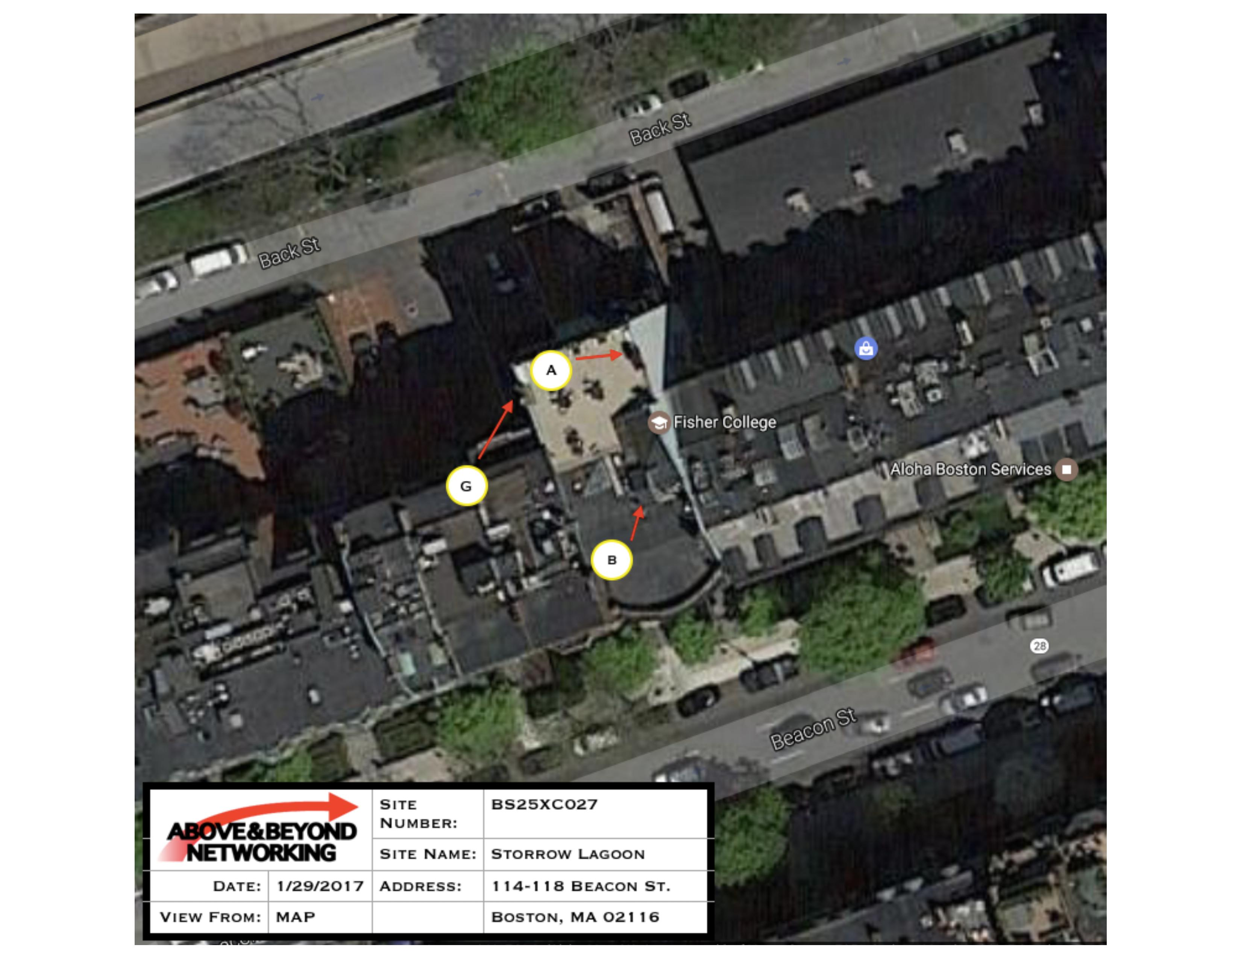

Slide 4
Sprint 2.5 Equipment Project Summary
Remove and Replace (3) Three Antennas (Paint to Match)
Attach (3) Three RRH’s (below parapet line)
Install (2) Two Conduits to run through existing cable trays with new lines to service Antennas and RRHs
Photo simulations to follow of (3) Sectors (Alpha, Beta & Gamma) with the proposed equipment

Slide 5
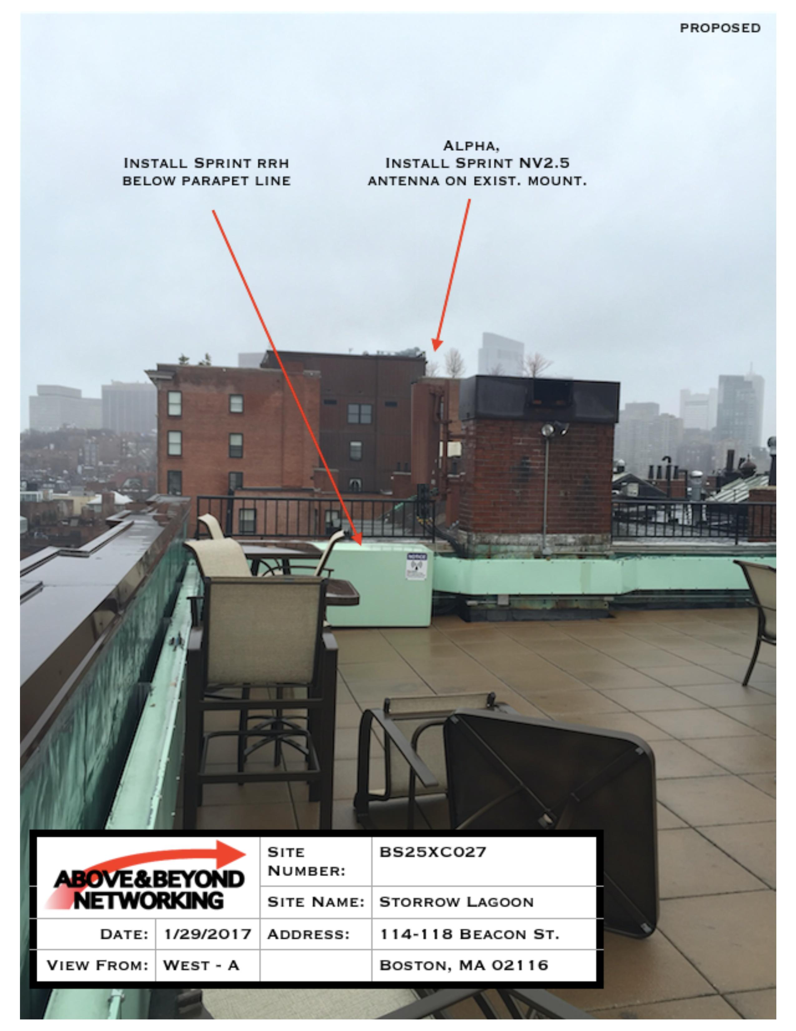

Slide 6
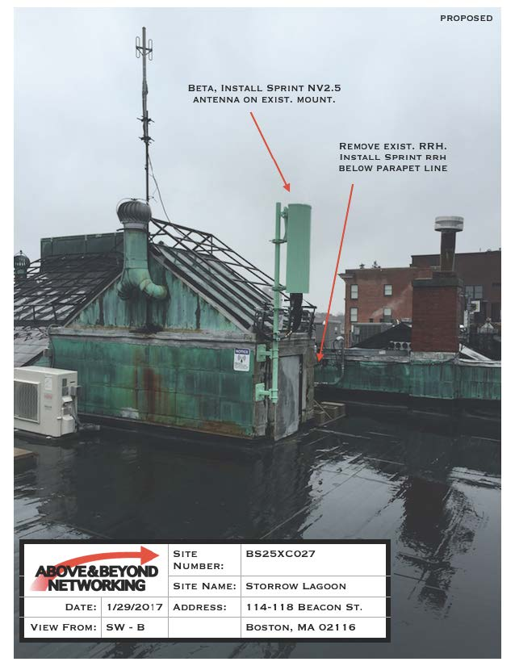

Slide 7
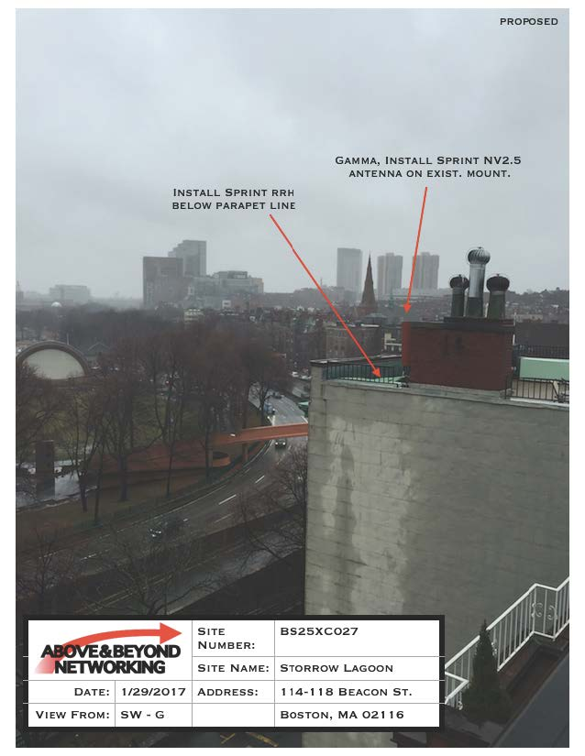

Slide 8
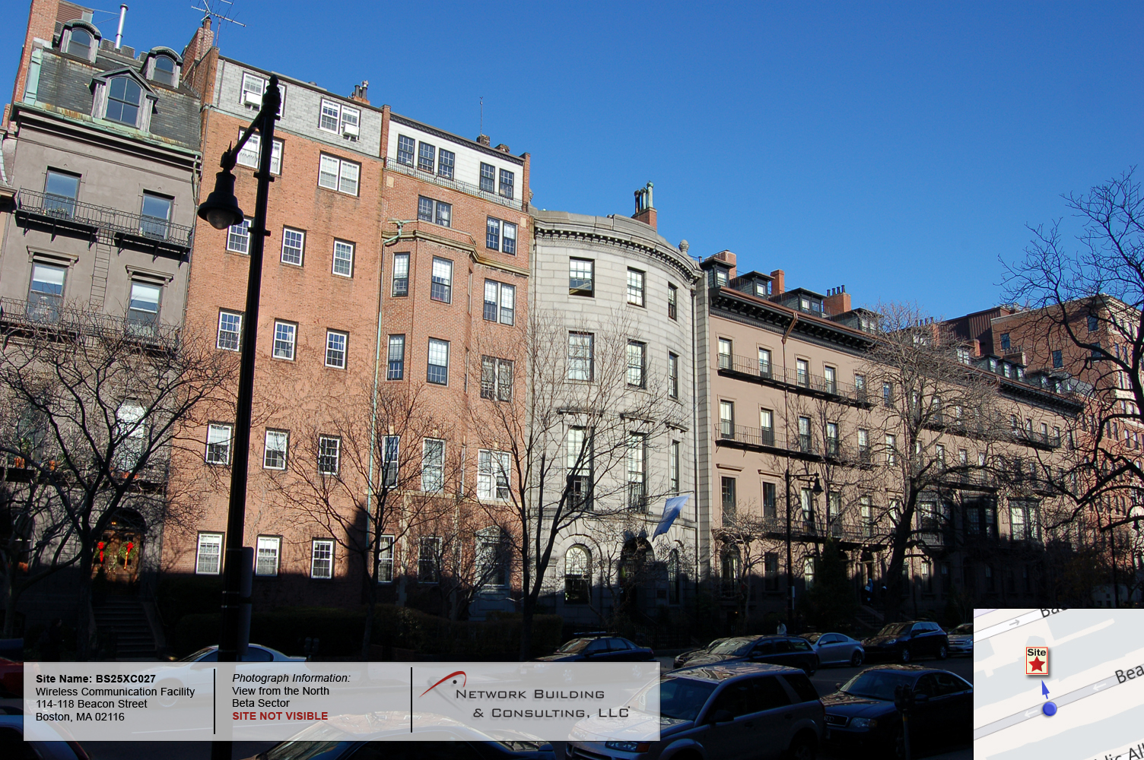

Slide 9
Goals / Approvals
Building Permit was been issued on 1/11/2017
Landlord (Fisher College) consent on 1/5/2017
BBAC Approval - - In process

Slide 10
2.5 Project Benefits to the Back Bay
Network Capacity / Peak Load
  Definition
    The amount of traffic (activity) that a network can handle at one time
    More Capacity means the network can handle more simultaneous users and/or faster speeds
Sprint 2.5 Capacity
  200 Additional customers per sector, (3) sectors, total of 600 customer increase during peak load.

Slide 11
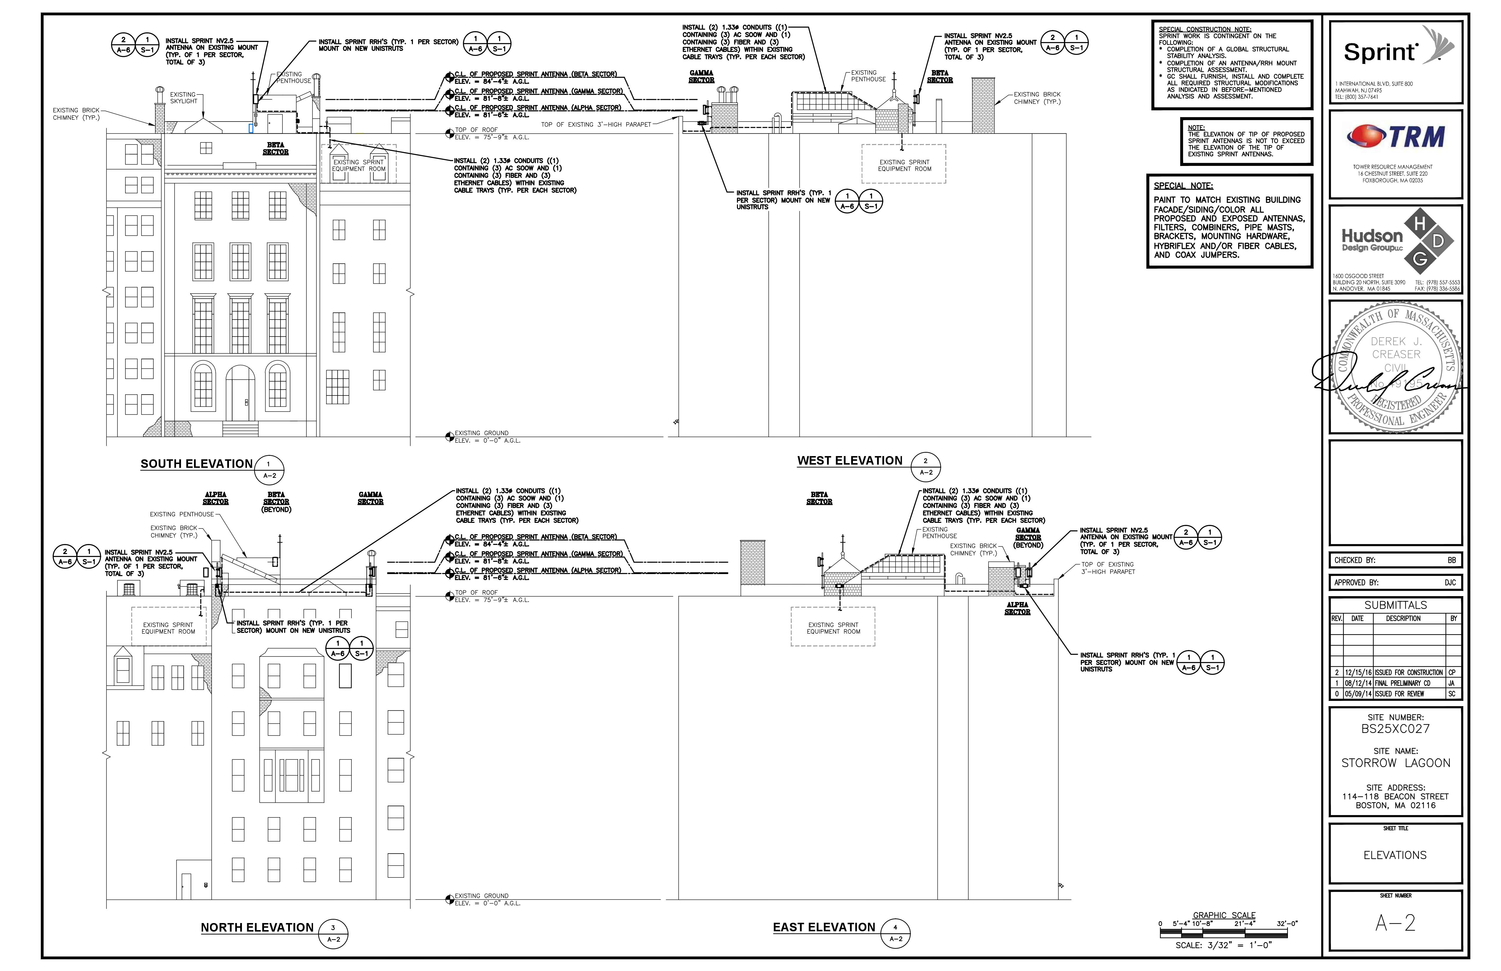

Slide 12
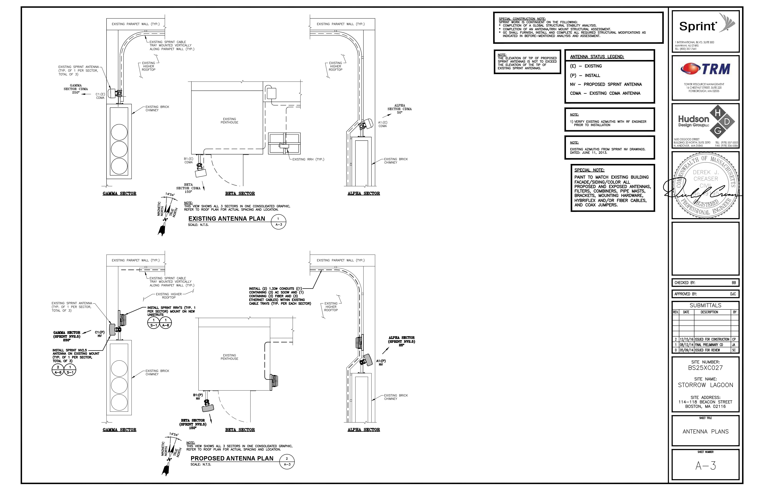

Slide 13
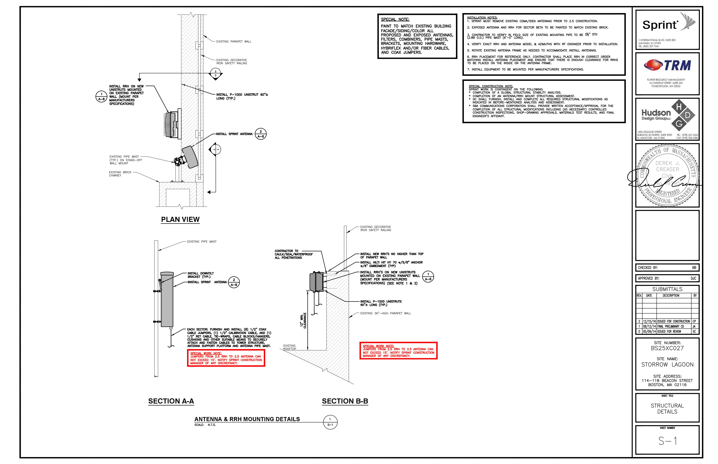

Slide 14
Conclusion
Sprint’s upgrade will substantially increase capacity in the back bay area, which is extremely critical during period of peak load/ maximum capacity
Sprint has and will continue to adhere to the design requirements of the BBAC
Sprint requests the 2.5 network upgrade be approved at Fisher College’s existing telecom facility

Slide 15
The End
Questions and comments welcome
Thank you!

